Slide 1


Stark Broadening Modeling with ML Algorithms
Tapalaga, I., Traparić, I., Trklja Boca, N. et al. Stark spectral line broadening modeling by machine learning algorithms. Neural Comput & Applic (2022).
Ivan Traparić
Institute of Physics Belgrade
Laboratory for Plasma Spectroscopy and Lasers

Slide 2
Resume
Database creation
Model selection
Results
Conculsion

Slide 3
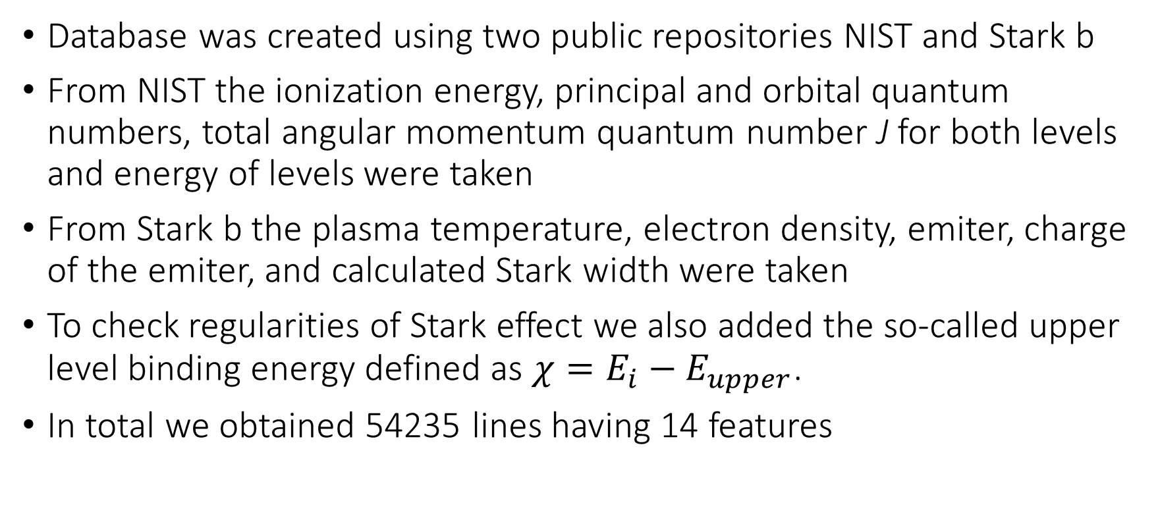
Database creation - Stark Broadening Regularities study
Database was created using two public repositories NIST and Stark b
From NIST the ionization energy, principal and orbital quantum numbers, total angular momentum quantum number J for both levels and energy of levels were taken
From Stark b the plasma temperature, electron density, emiter, charge of the emiter, and calculated Stark width were taken
To check regularities of Stark effect we also added the so-called upper level binding energy defined as $χ=E_{i}−E_{upper}$.
In total we obtained 54235 lines having 14 features

Slide 4
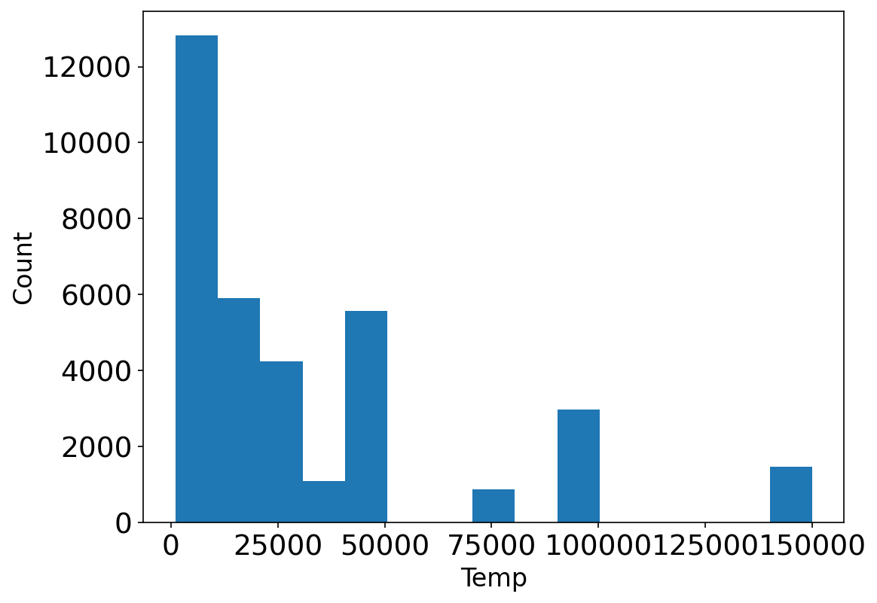
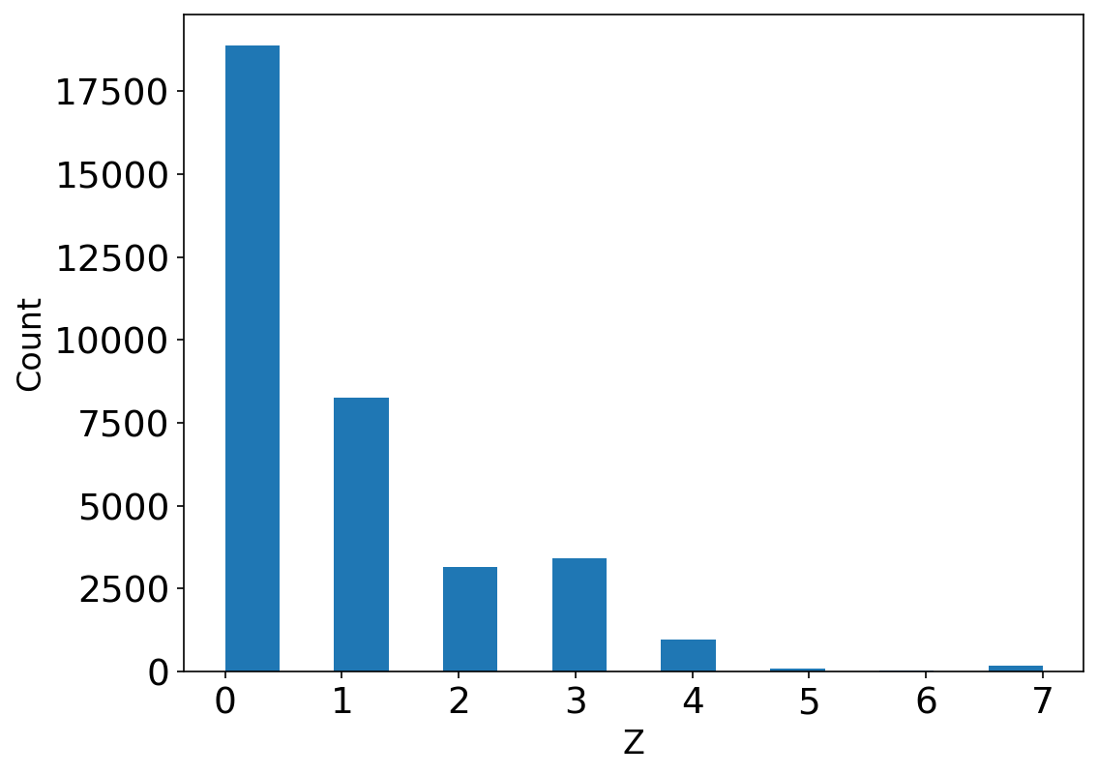
Data cleaning
Outliers: energy of lower level > energy of upper level
Dataset selected so that: Ne <= 1e17 cm⁻³; T<= 150 000 K; upper level energy < 500 eV.
Remaining dataset contained 36256 lines.

Slide 5
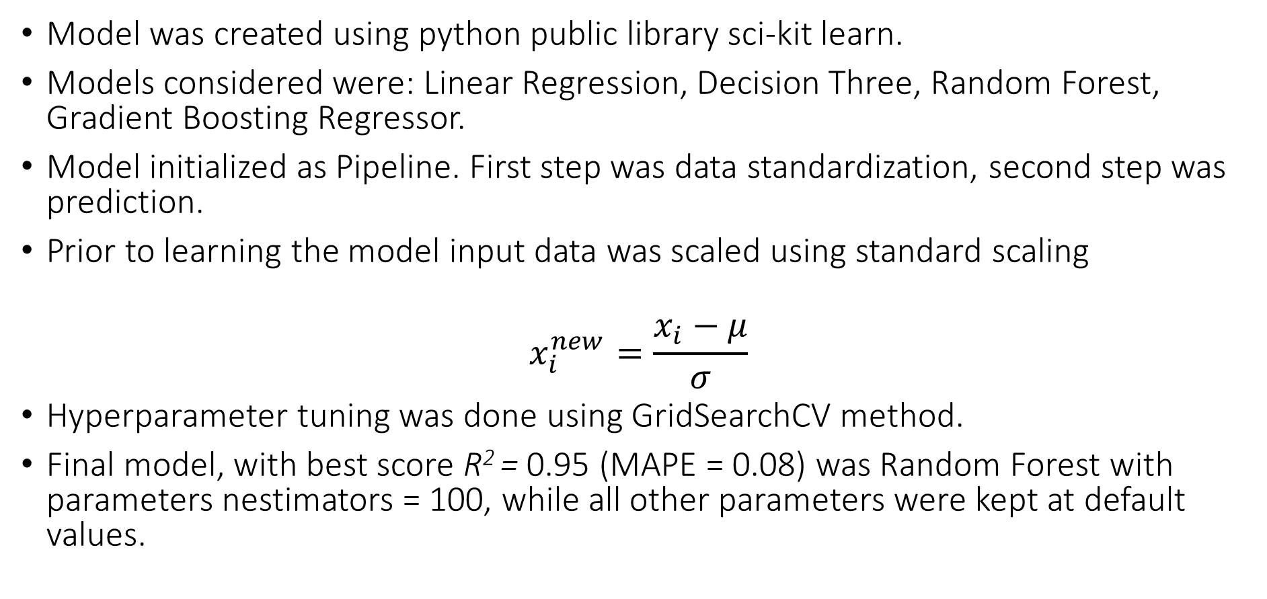
Choice of the model
Model was created using python public library sci-kit learn.
Models considered were: Linear Regression, Decision Three, Random Forest, Gradient Boosting Regressor.
Model initialized as Pipeline. First step was data standardization, second step was prediction.
Prior to learning the model input data was scaled using standard scaling
$$x_{i}^{new}=\frac{x_{i}−μ}{σ}$$
Hyperparameter tuning was done using GridSearchCV method.
Final model, with best score R² = 0.95 (MAPE = 0.08) was Random Forest with parameters nestimators = 100, while all other parameters were kept at default values.

Slide 6
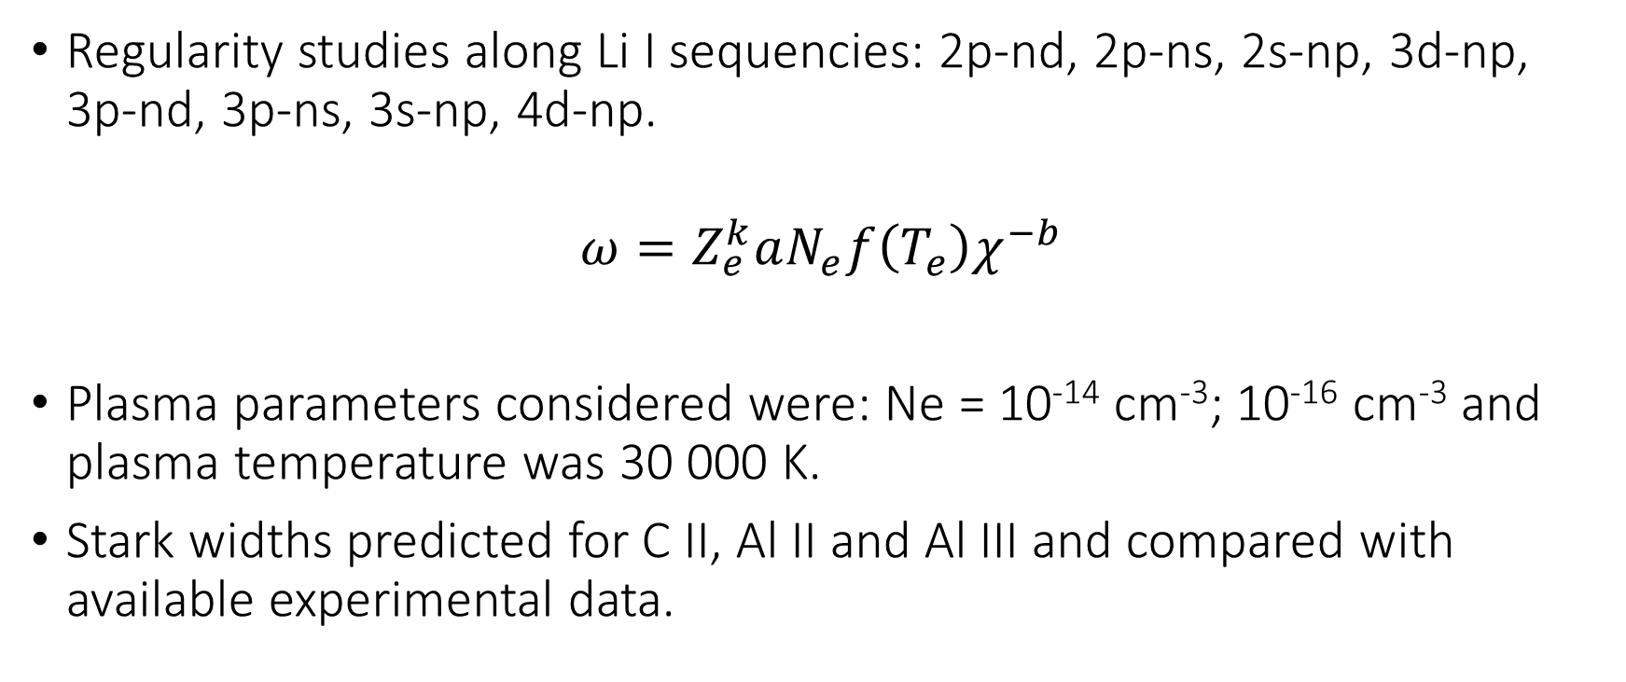
Results
Regularity studies along Li I sequencies: 2p-nd, 2p-ns, 2s-np, 3d-np, 3p-nd, 3p-ns, 3s-np, 4d-np.
$$ω=Z_{e}^{k}aN_{e}f\left(T_{e}\right)χ^{−b}$$
Plasma parameters considered were: Ne = 10⁻¹⁴ cm⁻³; 10⁻¹⁶ cm⁻³ and plasma temperature was 30 000 K.
Stark widths predicted for C II, Al II and Al III and compared with available experimental data.

Slide 7
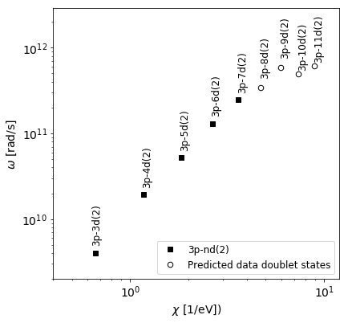
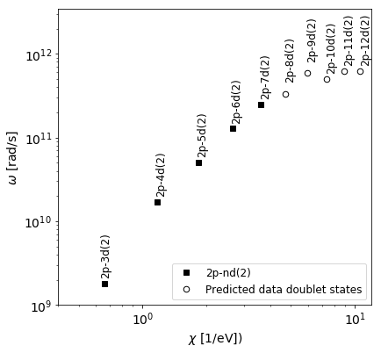
Regularities for Ne = 10¹⁴ cm⁻³

Slide 8
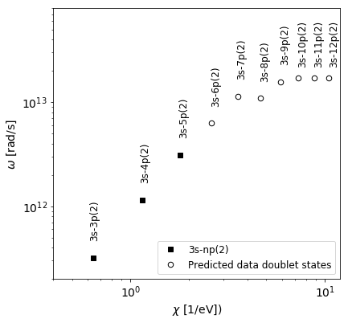
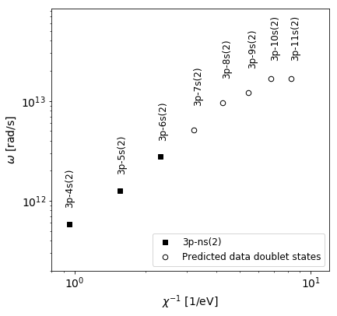
Regularities for Ne = 10¹⁶ cm⁻³

Slide 9
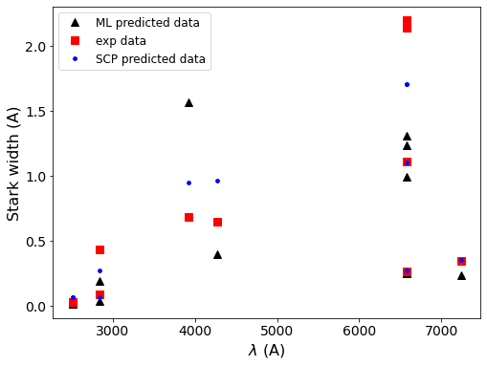
Comparison with experimental data (C II)
N. Larbi – Terzi et al., Mon. Not. R. Astron. Soc. 423, 766–773 (2012)

Slide 10
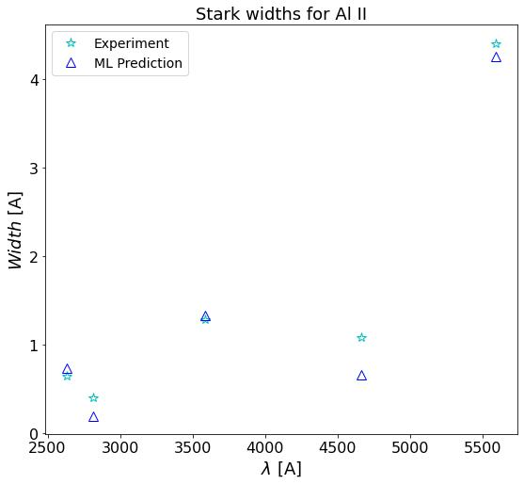
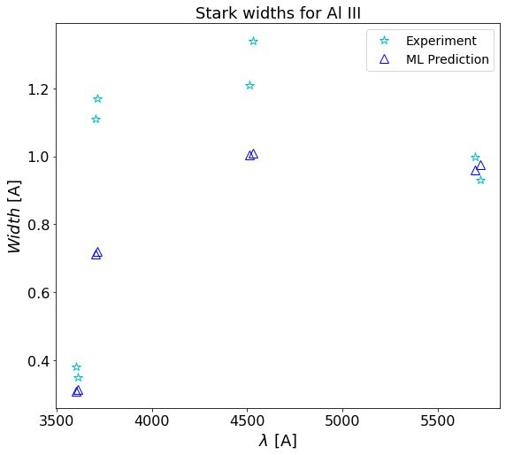
Comparison with experiment (Al II and Al III)
D. Dojić et al., Spectrochimica Acta Part B 166 (2020) 105816

Slide 11
Permutation importance check
Feature | Importance
Ne | 5.9 ± 0.2
ni | 3.50 ± 0.12
Z | 1.04 ± 0.04
χ | 0.37 ± 0.04
Emitter | 0.31 ± 0.03
li | 0.19 ± 0.02
Eupper | 0.11 ± 0.02
nf | 0.11 ± 0.01
Elower | 0.048 ± 0.005
lf | 0.029 ± 0.004
J lower | 0.029 ± 0.007
J upper | 0.021 ± 0.005
Te | 0.017 ± 0.003
Ei | 0.002 ± 0.001
Permute each feature 10 times
Calculate decrease in performance
Higher the decrease, more important is the feature.

Slide 12
New model
New model established
Model initialized as Pipeline model, same as before. First step data standardization, second prediction.
Regressor changed to Transformed Regressor, meaning that the target variable is also scaled.
According to the permutation importance, the upper level energy and ionization energy were dropped.
R² improved to 0.98, while MAPE on test data was 10 %.

Slide 13
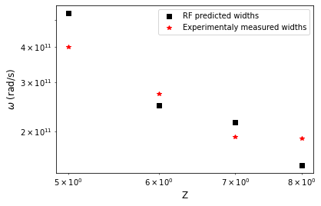
Regularities within isoelectric sequence of Be
B. Blagojevic et al., JQSRT 61, 1999

Slide 14
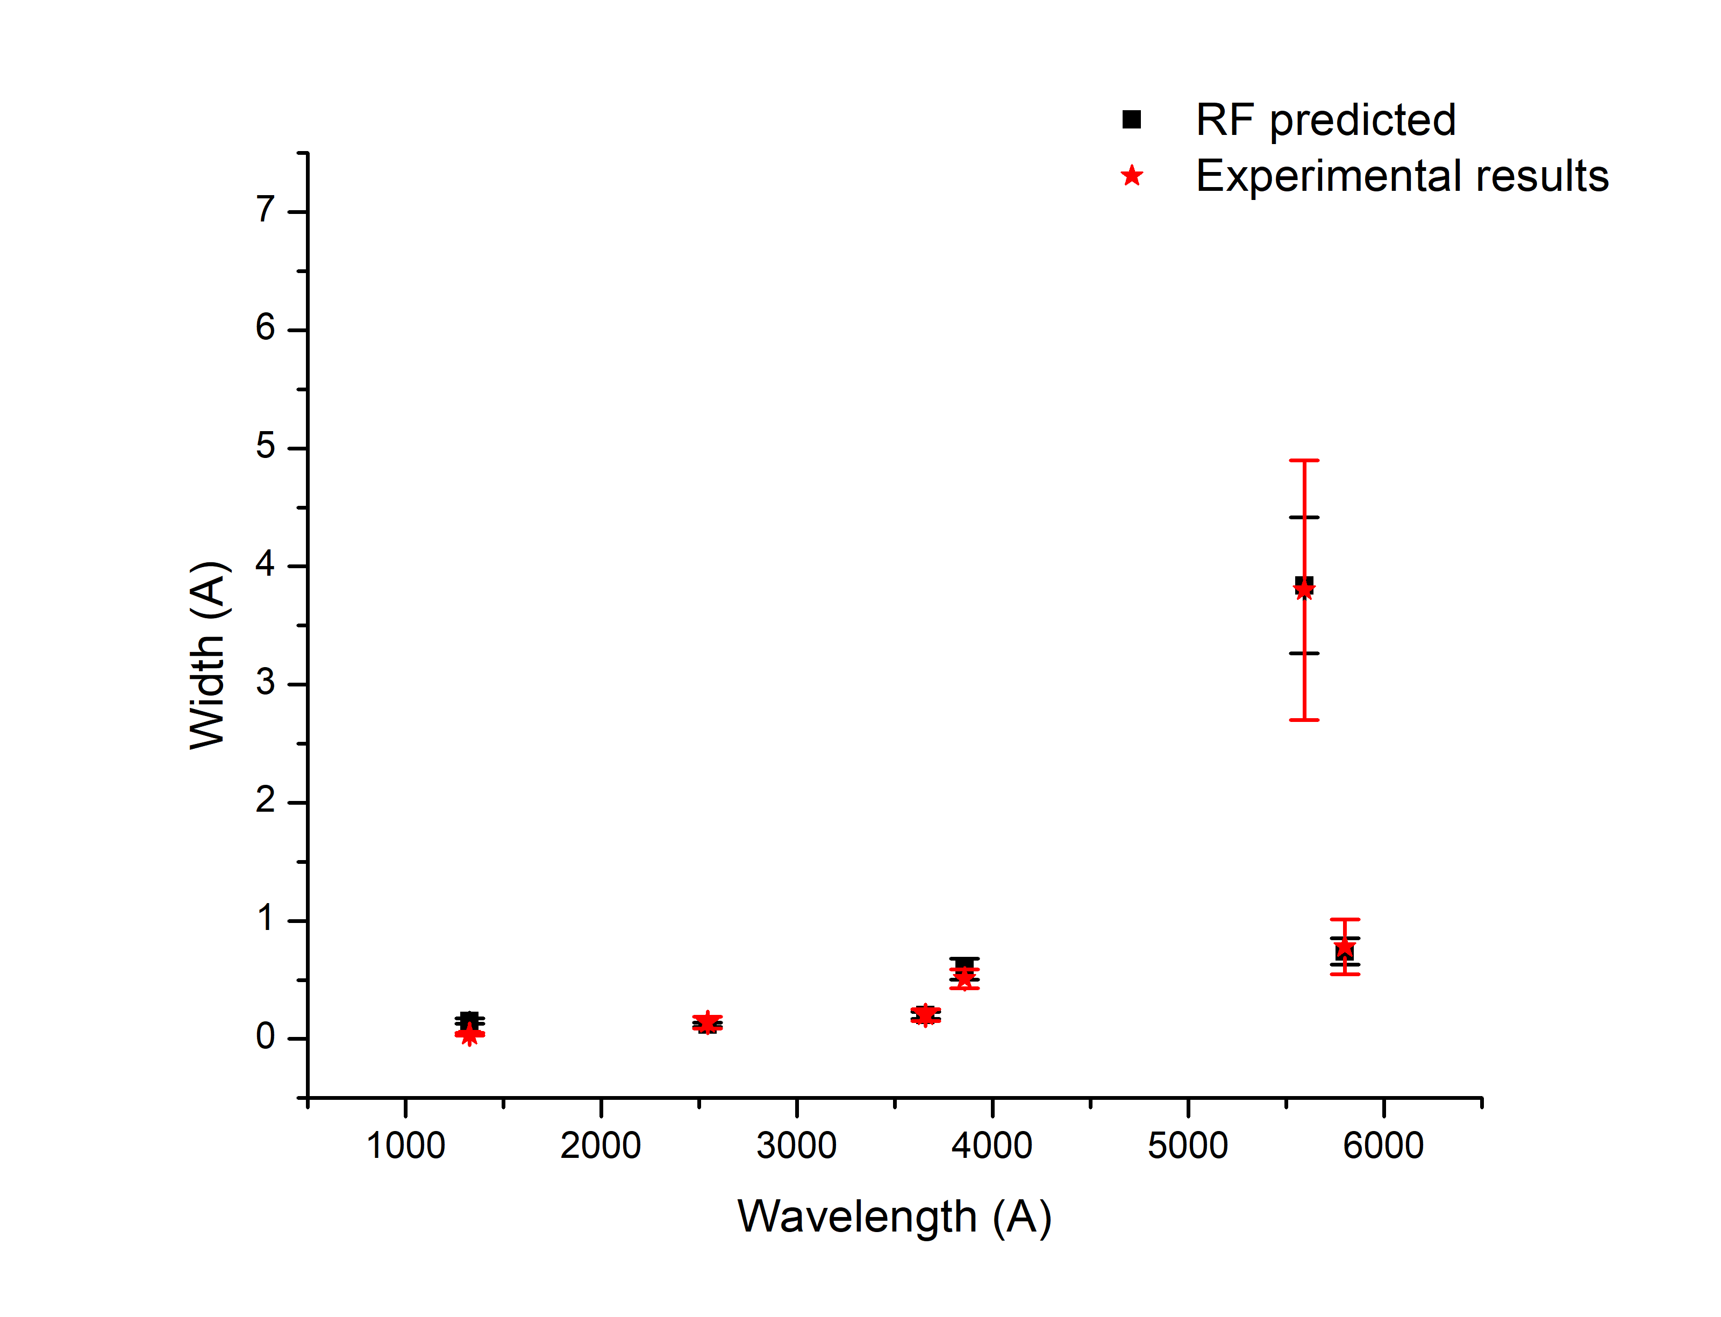
Comparison with experimental data
Ne = 10¹⁷ cm⁻³
Si II 385.602 nm 3p – 4p
Al II 559.323 nm 4p – 4d
C I 132.912 nm 2s²2p² – 2s2p³
C IV 580.131 nm 3s – 3p
Cl III 365.695 nm 4s – 4p
Cu II 254.480 nm 4p – 5s
Konjevic et al., J. Phys. Chem. Data 31, 2002

Slide 15
Conclusions and future work
Potential application of ML algorithms in predicting the Stark width is shown.
Solid agreement with experimental data is obtained
Regularities within isoelectric sequence also checked, agreement with experiments solid
Expand the method to be able to predict Stark widths for highly ionised states
Make web application for potential users

