Slide 1




COLLISIONAL DATABASES WITHIN VAMDC:
SYNERGY WITH RADAM and Nano-IBCT COST ACTIONS
Belgrade Electron-Atom/Molecule DataBase –BEAMDB
Virtual Atomic and Molecular
Data Centre - VAMDC
Bratislav Marinković, Stefan Ivanović, Nebojša Uskoković and Dragutin Šević
Institute of Physics Belgrade
14th SCSLSA, Bajna Bašta, 19.06.2023

Slide 2
Outline:
Short introduction of the abbreviations:
VAMDC, COST, RADAM, Nano-IBCT
Subject of the study: Electron/atom(molecule) interactions
Observables and experimental method
Data providers
Databases and data curation - BEAMDB
Perspectives and challenges (SWOT analysis)
Acknowledgements

Slide 3


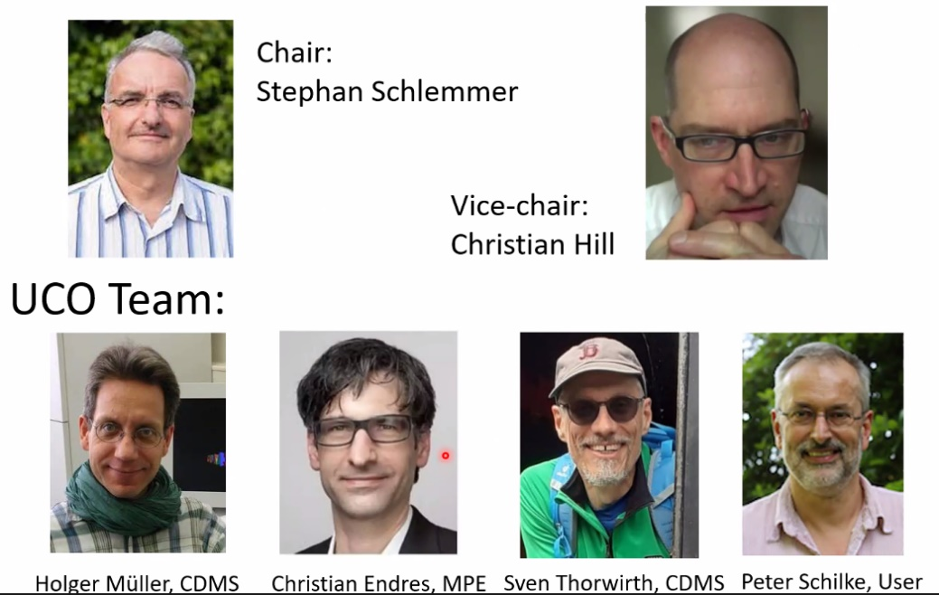
VAMDC - Virtual Atomic Molecular Data Centre
FP7 project great idea: a common portal ‘single point entry’
Contribution to e-infrastructure
Dubernet ML, Boudon V, Culhane JL, et al. JQSRT 111 (2010) 2151
M S Dimitrijević, S Sahal-Bréchot, A Kovačević, D Jevremović,
L Č Popović, Proc. 25th SPIG 2010, JP Conf.Ser. 257 (2010) 012032
“…aiming to build a secure, documented, flexible and interoperable e-science environment-based interface to existing atomic and molecular databases.”
In 2014 MoU – VAMDC Consortium (communities of VAMDC and SUP@VAMDC projects): M L Dubernet et al. J. Phys. B 49 (2016) 074003 [18pp]; "A Decade with VAMDC: Results and Ambitions" Atoms 8 (2020) 76 [45pp].
In 2022 new leadership by S Schlemmer and C Hill

Slide 4
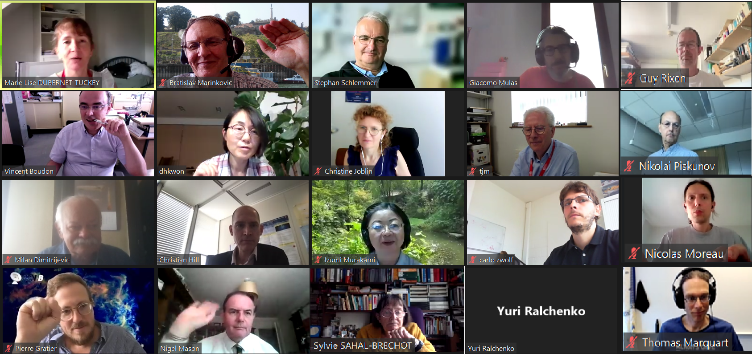

Slide 5

COST – Co-Operation in Science and Technology
Establish in 1971
Nowadays: 41 Full Members, 1 Cooperating Member and 1 Partner Member
COST Actions – networking consortia funded for 4 years

Slide 6

COST – Co-Operation in Science and Technology
Establish in 1971
Nowadays: 41 Full Members, 1 Cooperating Member and 1 Partner Member
COST Actions – networking consortia funded for 4 years
P9 Action RADAM – Radiation Damage in Biomolecular Systems (2003-2007) Chair Nigel J Mason
  “The main objective is to obtain a detailed understanding of the fundamental interaction processes for different types of incident radiation that occur from the initial deposition of radiative energy to the formation of radiation damage in biological material.”

Slide 7
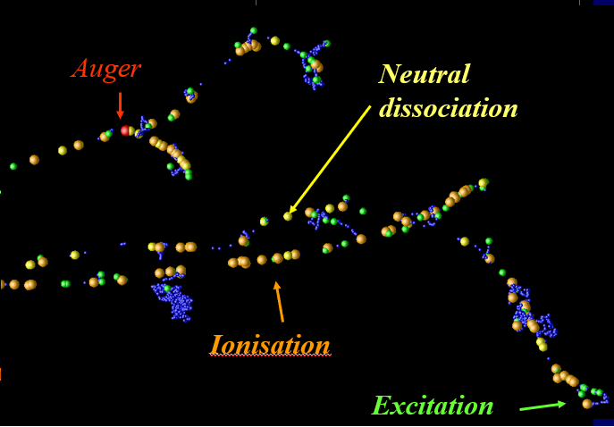
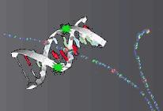

COST – Co-Operation in Science and Technology
Establish in 1971
Nowadays: 41 Full Members, 1 Cooperating Member and 1 Partner Member
COST Actions – networking consortia funded for 4 years
P9 Action RADAM – Radiation Damage in Biomolecular Systems (2003-2007) Chair Nigel J Mason
  “The main objective is to obtain a detailed understanding of the fundamental interaction processes for different types of incident radiation that occur from the initial deposition of radiative energy to the formation of radiation damage in biological material.”
MP1002 - Nano-IBCT: Nano-scale insights in ion beam cancer therapy (2010-2014) Chair Andrey Solov’yov
  “...aims to combine, using a multiscale approach, the unique experimental and theoretical expertise to acquire greater insight at the nanoscopic and molecular level into radiation damage induced by ion impact.”

Slide 8
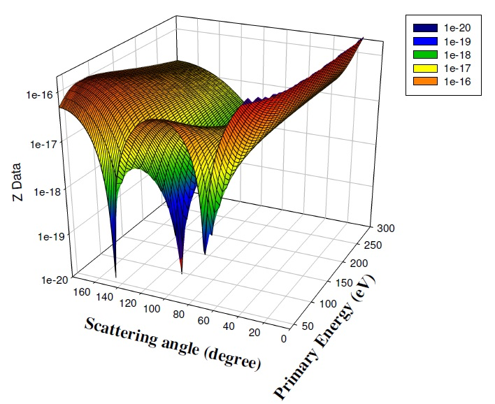
LCAP@IPB e/Mol database - BEAMDB
Elastic e/Ar scattering
DCS(E_{o},θ) surface

Slide 9
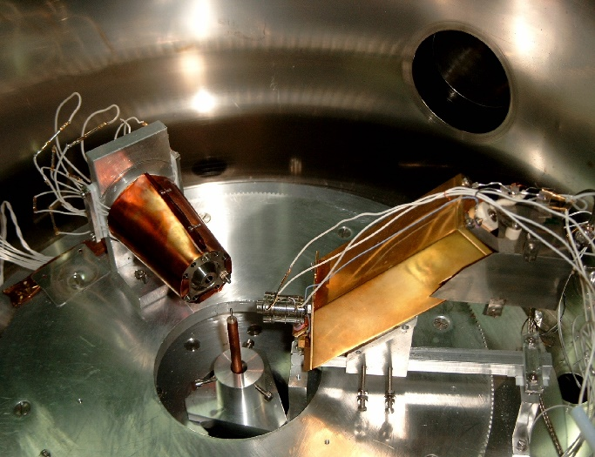
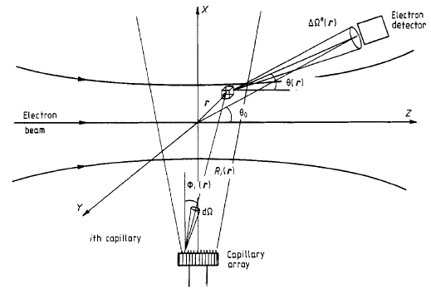
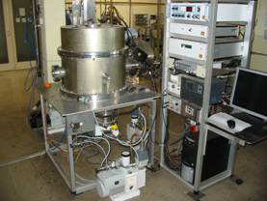
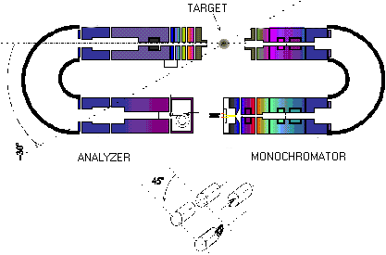
Effective interaction volume
Electron spectrometers at IP Belgrade

Slide 10


The parameters which characterize collision processes are the cross sections. Electron collision cross sections depend on impact energy Eo and scattering polar angles θ and φ. The differential cross section, for a specific well-defined excitation process indicated by the index n is defined as:
$$\frac{dσ_{n}\left(E_{o}Ω\right)}{dΩ}=\frac{k_{f}}{k_{i}}{\left|f_{n}\left(E_{o}Ω\right)\right|}^{2}$$
where Ω is the polar angle of detection, ki and kf are the initial and final electron momenta, and fn is the complex scattering amplitude (n = 0 refers to elastic scattering).
Integration over all scattering angles yields the integral and momentum transfer cross sections:

Slide 11
Intensity measurements and DCS
I(E_{o},θ)=DCS(E_{o},θ)η(E_{o})V_{eff}(θ)
Where are: DCS – differential cross section at the nominal angle and scattering angle averaged over the incident electron energy distribution and the detector energy and angle distributions, η – response function of the detector detecting electrons of the energy E_{o}, V_{eff} – effective scattering volume:
V_{eff}(θ)=∫_{r}ρ(r)f(r)ΔΩ(r)G[θ(r)]dr
Where are: ρ(r) – the spatial distribution of the target beam, f(r) – the spatial distribution function of the incident electron flux, ΔΩ(r) – the solid angle subtended by the electron detector at the scattering point r, G[θ(r)] – the assumed angular dependence in the region of interest.
11

Slide 12
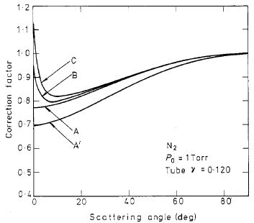
Effective Path Length Correction
User-friendly software for resolving some of the parameters in electron spectrometry experiments: scattering volume correction factor
R. Brinkmann and S. Trajmar 1981 J.Phys.E: Sci. Instrum. 14 245
12

Slide 13
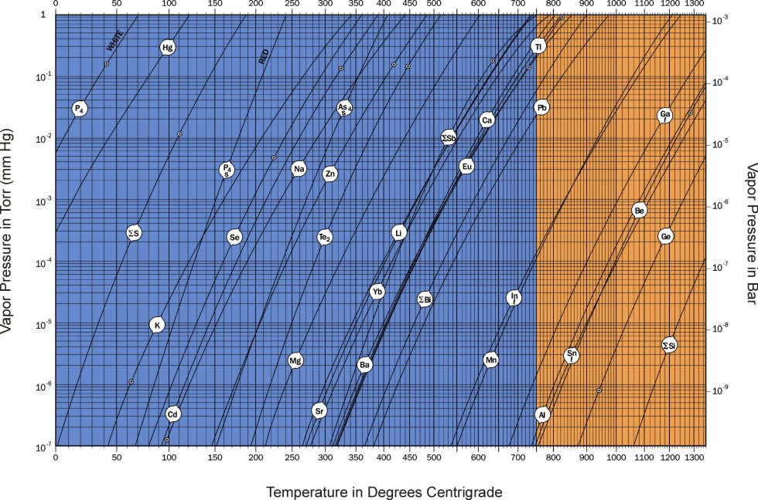
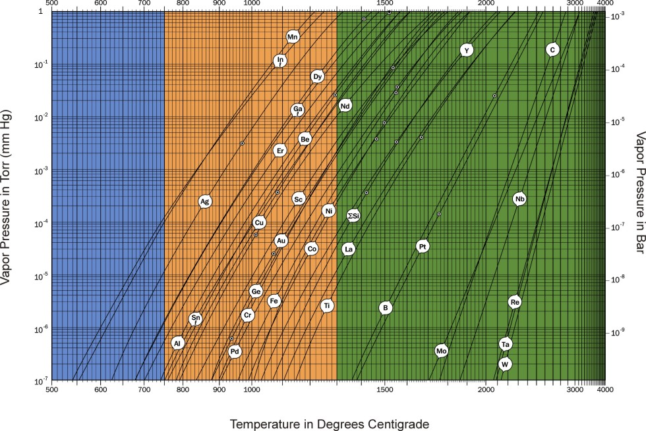
User-friendly software for resolving some of the parameters in electron spectrometry experiments: scattering volume correction factor and metal vapour pressure curves
13

Slide 14
Normalization of DCS
f(K,E_{o})=ω/2∙k_{i} /k_{f} ∙K²∙DCS(E_{o},θ)
Where are: f(K,E_{o}) – generalized oscillator strength k_{i} and k_{f} - incident and final electron momenta, K² – momentum transfer, ω – excitation energy
K²=2 E [2-ω/E_{o} – 2(1- ω/E_{o})^{1/2}cos(θ)]
E. Lassettre – (1959) extrapolation procedure
lim f = OOS as K² →0
FSF= OOS(1-x/x_{max})exp[-(x/x_{max})²]
Where are: x = K²/2ω and x_{max}=0.25 as defined in
Avdonoina et al. 1997 JPB 30 2591.
R. Panajotovic, D. Ševic, V. Pejcev, D.M. Filipovic, B.P. Marinkovic
The ¹S–¹P electron excitations of Zn at small scattering angles
Int. J. of Mass Spectrom. 233 (2004) 253–257
14

Slide 15
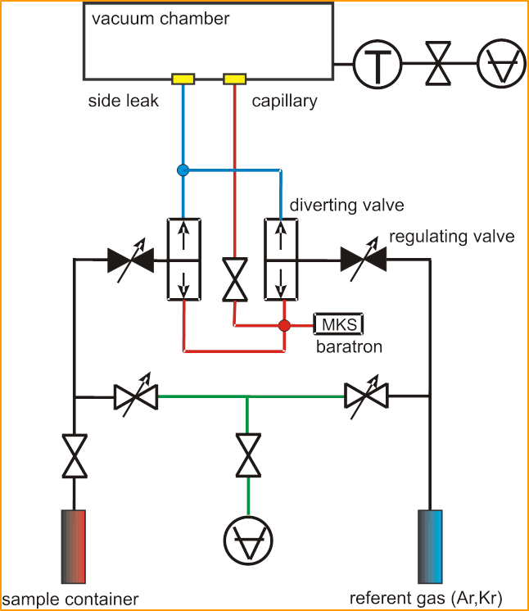

Relative flow technique - measuring absolute DCSs
In the relative flow method, the DCSs for scattering of unknown gas is determined by comparing scattering signals from the standard target with its known differential cross sections, at a given incident electron energy and scattering angle under identical collision geometry conditions
To obtain the same profiles for both gas beams, the gases must be operated at pressures behind the needle so that their mean free paths are the same.
S. K. Srivastava, Chutjian A and Trajmar S J. Chem. Phys. 63 2659 (1975)
J. C. Nickel, J.Phys.B: at. Mol. Opt. Phys. 21,1867 (1988)
M. Rankovic et al. EPJD 72, 30 (2018)

Slide 16
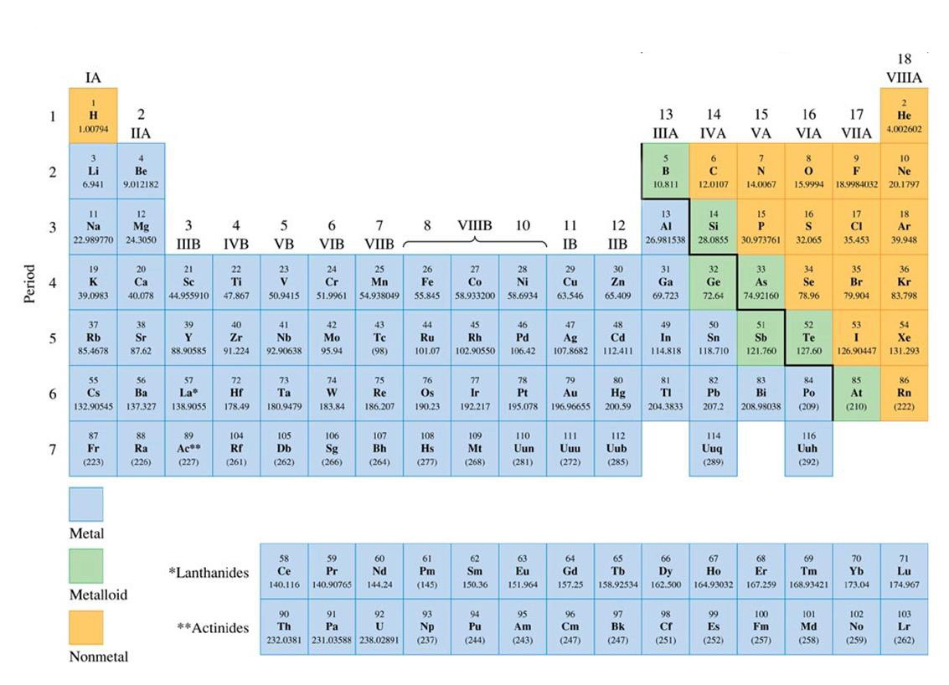
















Periodic Table of Elements

Slide 17
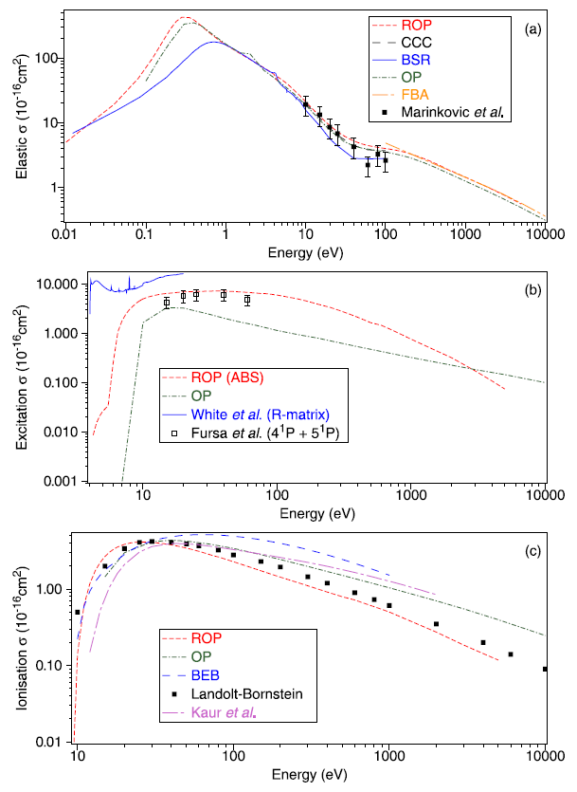
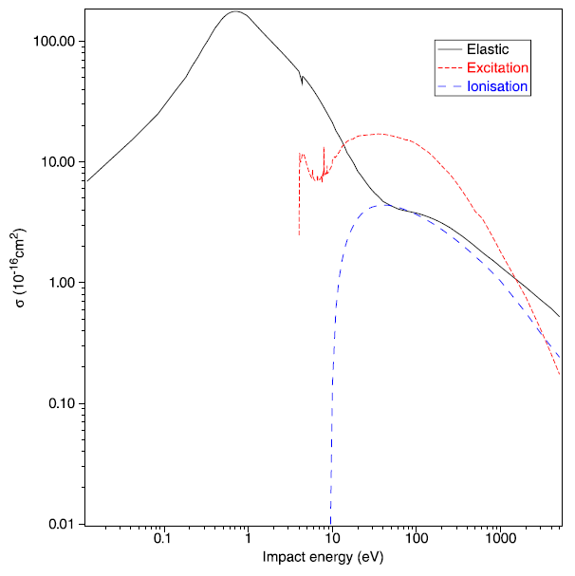
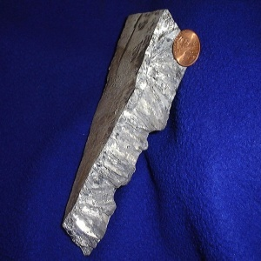
Zinc (Zn)
[Ar]3d¹⁰4s²
R. P. McEachran, B. P. Marinkovic, G. Garcia, R. D. White, P. W. Stokes, D. B. Jones, and M. J. Brunger, “Integral Cross Sections for Electron–Zinc Scattering over a Broad Energy Range (0.01–5000 eV)”, J. Phys. Chem. Ref. Data 49, 013102 (2020); doi: 10.1063/1.5135573

Slide 18
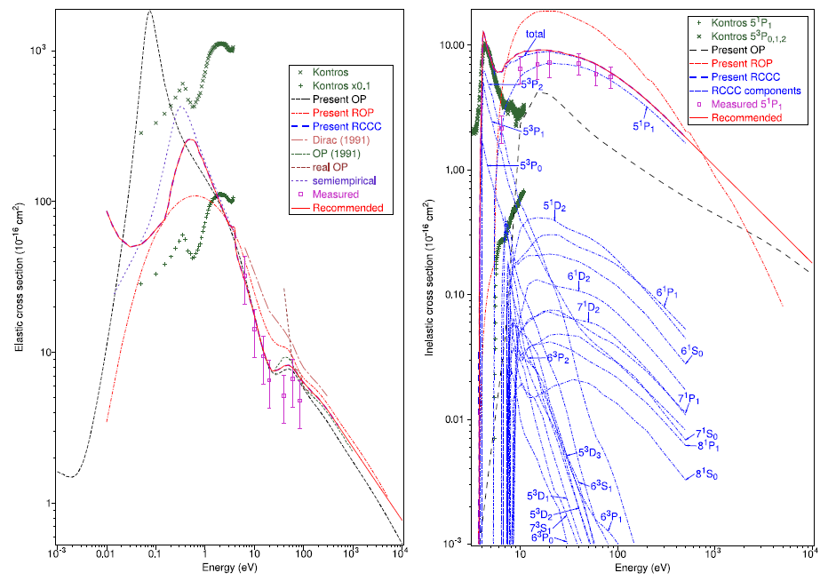
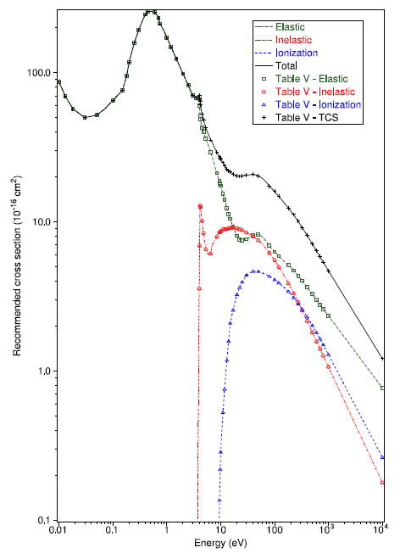
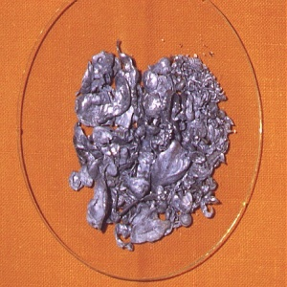
Cadmium (⁴⁸Cd)
[Kr] 3d¹⁰4s²
B. P. Marinković, R. P. McEachran, D. V. Fursa, I. Bray, H. Umer, F. Blanco, G. García, M. J. Brunger, L. Campbell, and D. B. Jones, “Cross Sections for Electron Scattering from Cadmium: Theory and Experiment”, J. Phys. Chem. Ref. Data 52(2), 023102 (2023) [12pp] doi: 10.1063/5.0145933

Slide 19
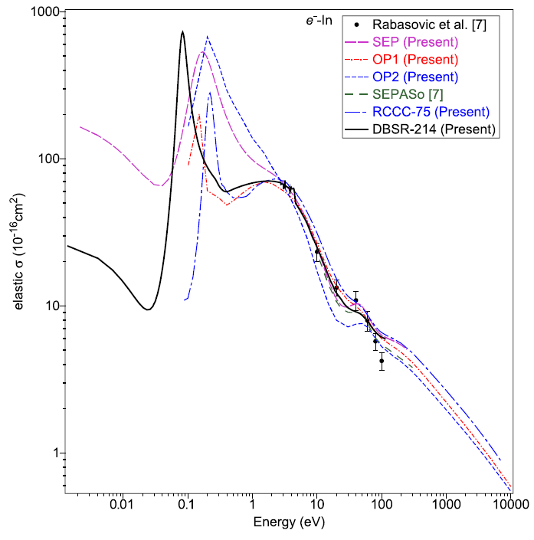
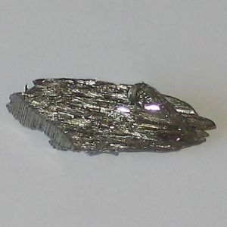
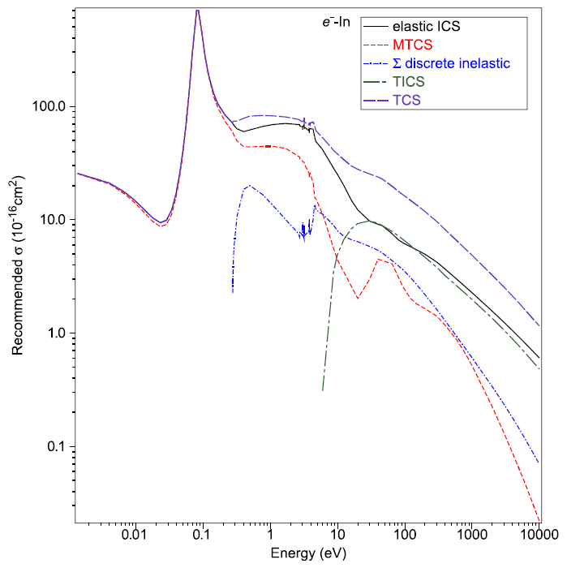
Indium (⁴⁹In)
[Kr]4d¹⁰5s²5p
K. R. Hamilton, O. Zatsarinny, K. Bartschat, M. S. Rabasović, D. Šević, B. P. Marinković S. Dujko, J. Atić, D. V. Fursa, I. Bray, R. P. McEachran, F. Blanco, G. García, P. W. Stokes, R. D. White, D. B. Jones, L. Campbell, and M. J. Brunger, “Recommended cross sections for electron–indium scattering”,
J. Phys. Chem. Ref. Data 50, 013101 (2021) [pp.20 accepted 3 Dec. 2020]. doi: 10.1063/5.0035218

Slide 20
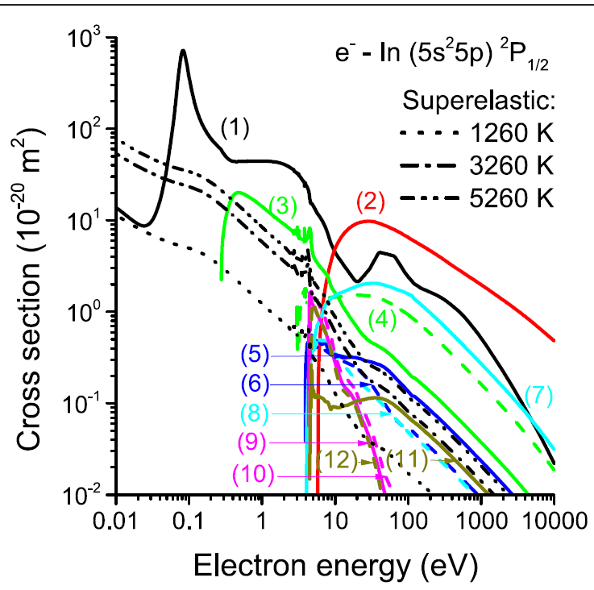
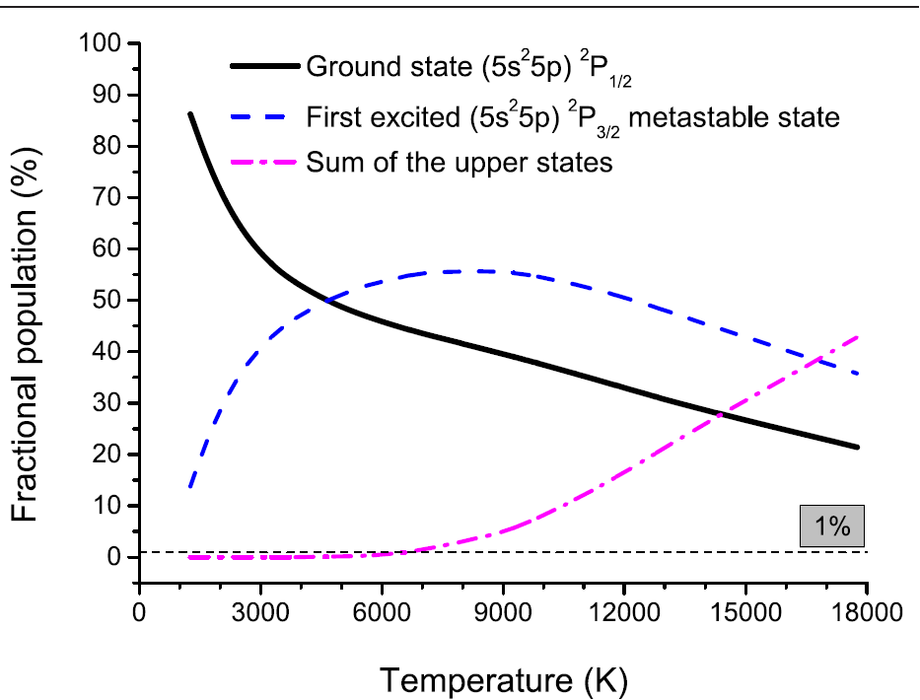
Indium (⁴⁹In)
[Kr]4d¹⁰5s²5p
Fractional populations of indium atoms in the (5s²5p)²P_{1/2} ground state, the first excited (5s²5p)²P_{3/2} metastable state, and the sum of all higher excited states, as a function of the indium vapour temperature.
Integral cross sections for e/In in the ground state (5s²5p)²P_{1/2}. Elastic momentum transfer (1), total ionization (2), and quantities that are obtained by multiplying the total cross section for superelastic collisions with the corresponding fractional populations of the first excited metastable state at indium vapour temperatures of 1260 K, 3260 K, and 5260 K. includes the discrete inelastic transitions: (5s²5p)²P_{3/2} (3), (5s²6s)²S_{1/2} (4), (5s²6p)²P_{1/2} (5), (5s²6p)²P_{3/2} (6), (5s²5d)²D_{3/2} (7), (5s²5d)²D_{5/2} (8), (5s²4p)²P_{1/2} (9), (5s²4p)²P_{3/2} (10), (5s²7s)²S_{1/2} (11) and (5s²4p)²P_{5/2} (12).
Saša Dujko, Jasmina Atić, Danko Bošnjaković, Ron D White, Peter Stokes, Kathryn R Hamilton, Oleg Zatsarinny, Klaus Bartschat, Maja S Rabasović, Dragutin Šević, Bratislav P Marinković, Dmitry V Fursa, Igor Bray, Robert P McEachran, Francisco Blanco, Gustavo Garcia, Darryl Jones, Laurence Campbell and Michael J Brunger, “Transport of electrons and propagation of the negative ionisation fronts in indium vapour”,
Plasma Sources Sci. Technol. 30, 115019 (2021) [22pp]. doi: 10.1088/1361-6595/ac3343

Slide 21
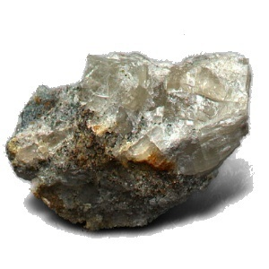
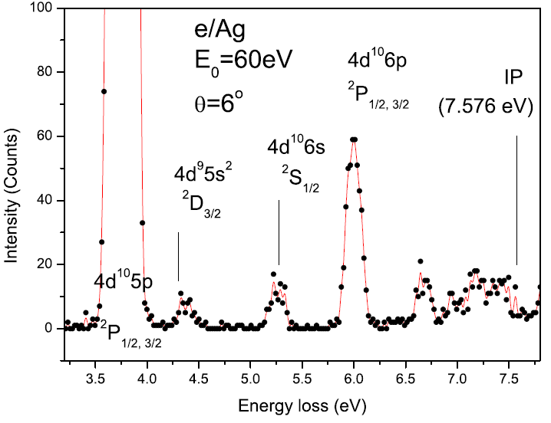
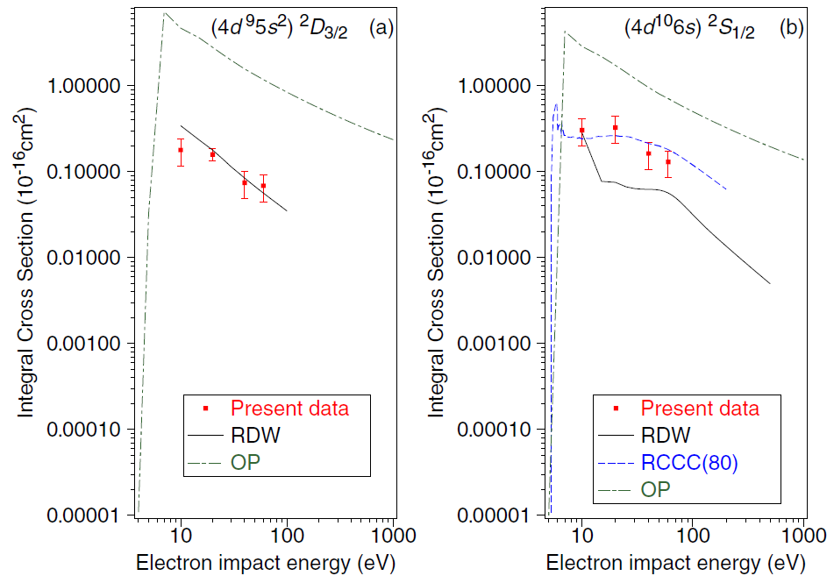
Silver (⁴⁷Ag)
[Kr]4d¹⁰5s
B. P. Marinković, S. D. Tošić, D. Šević, R. P. McEachran, F. Blanco, G. García, and M. J. Brunger,
“Electron-impact excitation of the (4d¹⁰5s) ²S_{1/2} → (4d⁹5s²) ²D_{3/2} and (4d¹⁰5s) ²S_{1/2} → (4d¹⁰6s) ²S_{1/2} transitions in silver:
Experiment and theory”, Phys. Rev. A 104, 022808 (2021) [8pp]. doi: 10.1103/PhysRevA.104.022808

Slide 22
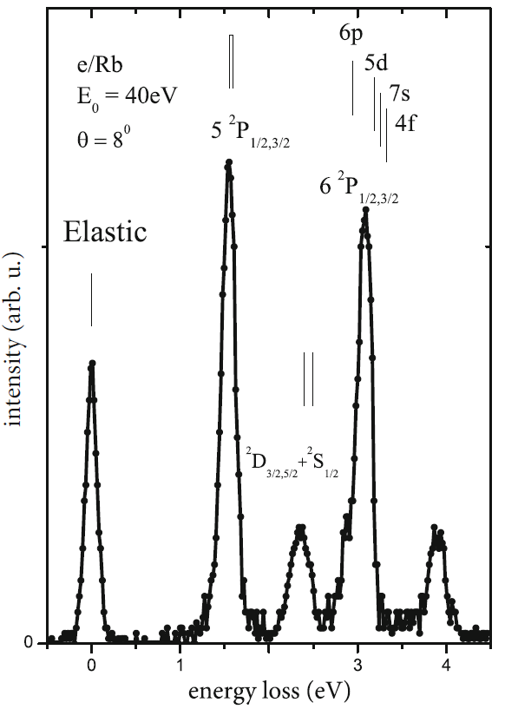
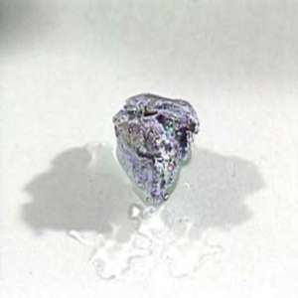
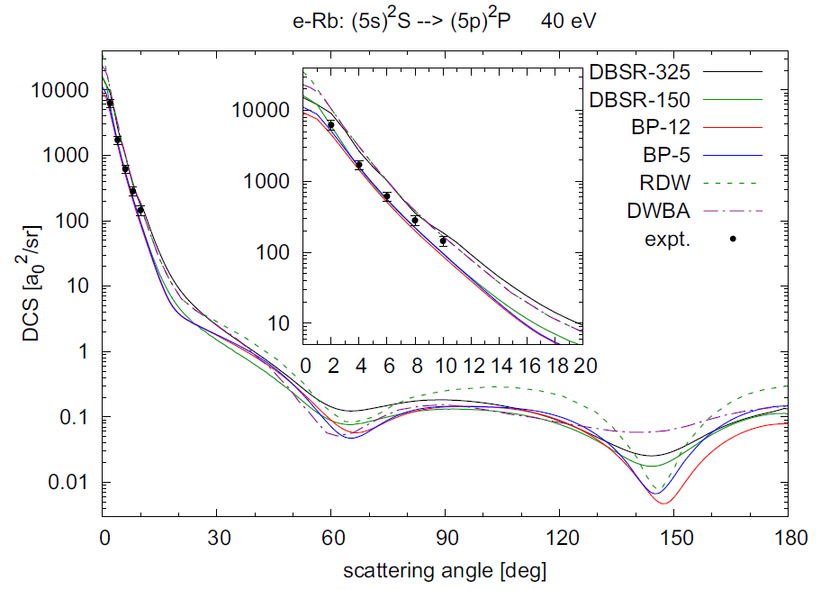
Rubidium (³⁷Rb)
[Kr]5s
K. R. Hamilton, O. Zatsarinny, K. Bartschat, B. Predojević, D. Šević, B. P. Marinković & M. J. Brunger,
“Electron-impact excitation of the 5²S_{1/2}→5²P_{1/2} and 5²P_{3/2} transitions in rubidium by 40 eV electrons: theory and experiment”, Eur. Phys. J D: Atoms, Molecules, Clusters and Optical Physics 76(5), 92 (2022) [6pp]. doi: 10.1140/epjd/s10053-022-00413-7

Slide 23
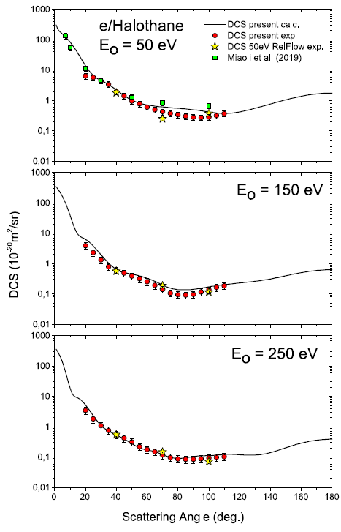
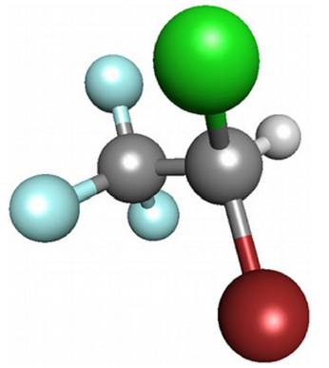
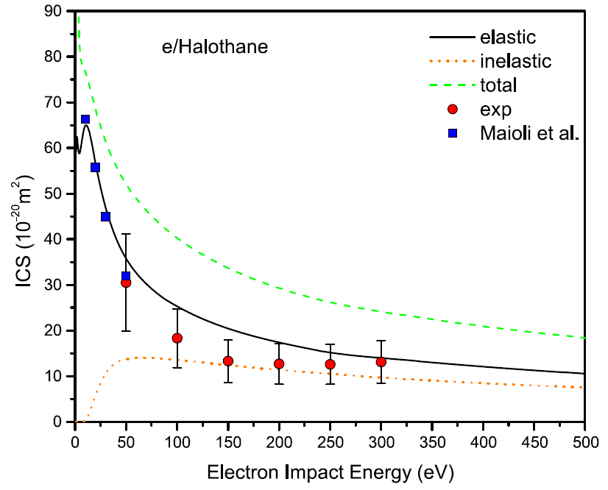
e/Halothane
C₂HBrClF₃
Jelena B. Maljković, Jelena Vukalović, Zoran D. Pešić, Francisco Blanco, Gustavo García, Bratislav P. Marinković,
“Experimental and theoretical study on elastic electron interaction with halothane molecule in the intermediate energy range”,
Eur. Phys.J. Plus 138, 349 (2023) [8pp] doi: 10.1140/epjp/s13360-023-03967-6

Slide 24
e/H₂O
Summary of the recommended electron collision cross sections for H2O. Cross sections smaller than 10E-18 cm2 are not shown.
Itikawa and Mason, J. Phys. Chem. Ref. Data, 34, 1-22 (2005).

Slide 25
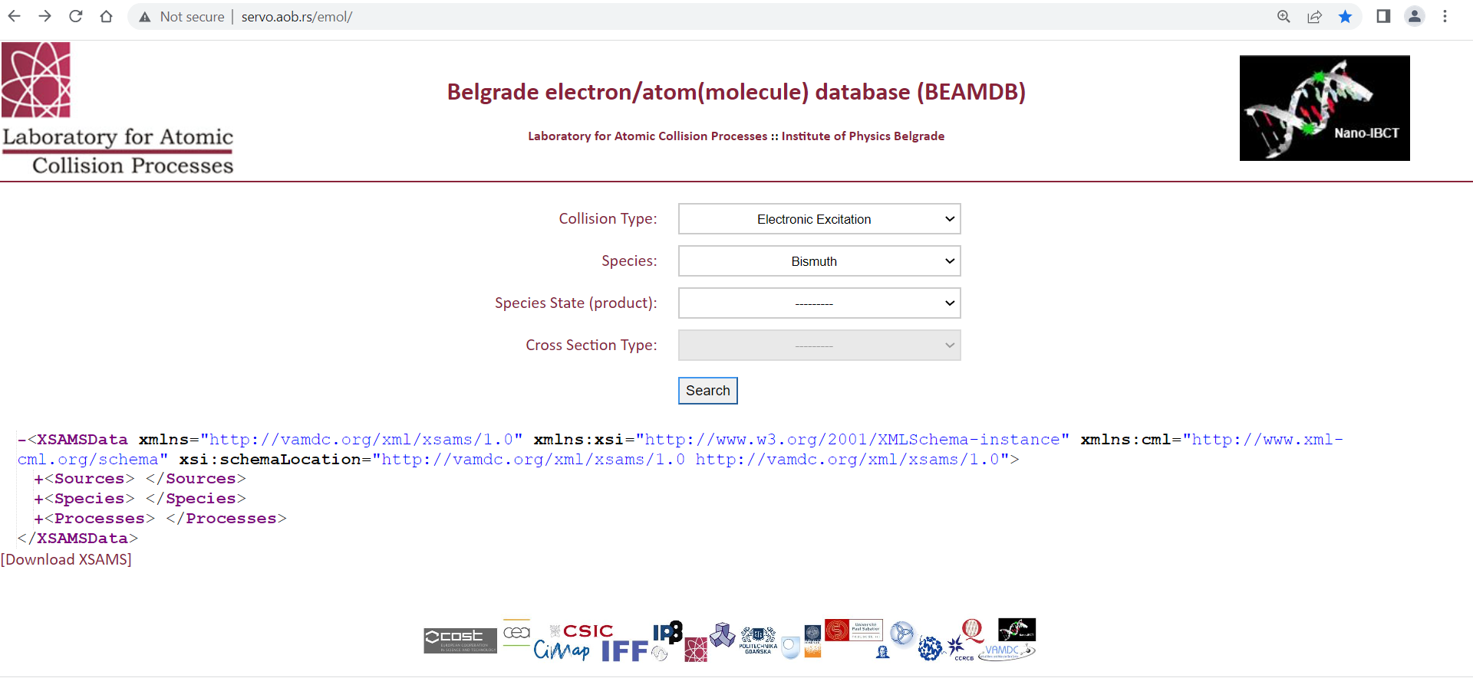
Data Base: LACP@IPB e/Mol database - BEAMDB
http://servo.aob.rs/emol/

Slide 26
Content: BEAMD: electron cross sections – elastic, excitation, ionization

Slide 27

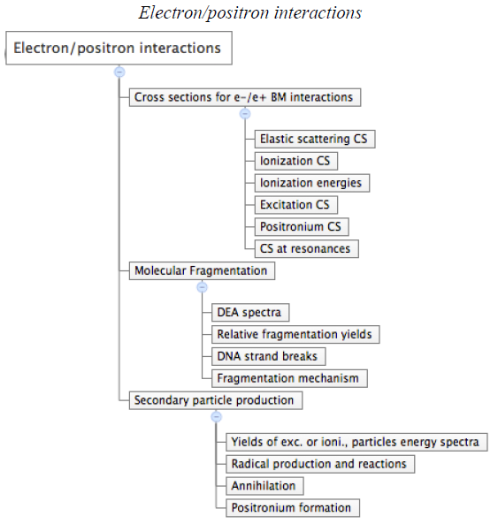
S Denifl, G Garcia, B A Huber, B P Marinković, N Mason, J Postler, H Rabus, G Rixon, A V Solov’yov, E Suraud, and A V Yakubovich,
“Radiation damage of biomolecules (RADAM) database development: current status”,
Proc. International Conference on Dynamics of Systems on the Nanoscale (DySoN2012), 30 Sept – 4 Oct 2012, St Petersburg, Russia, Ed. Andrey V Solov'yov. ISSN: 1742-6588
Journal of Physics: Conference Series 438 012016 (2013). doi:10.1088/1742-6596/438/1/012016

Slide 28
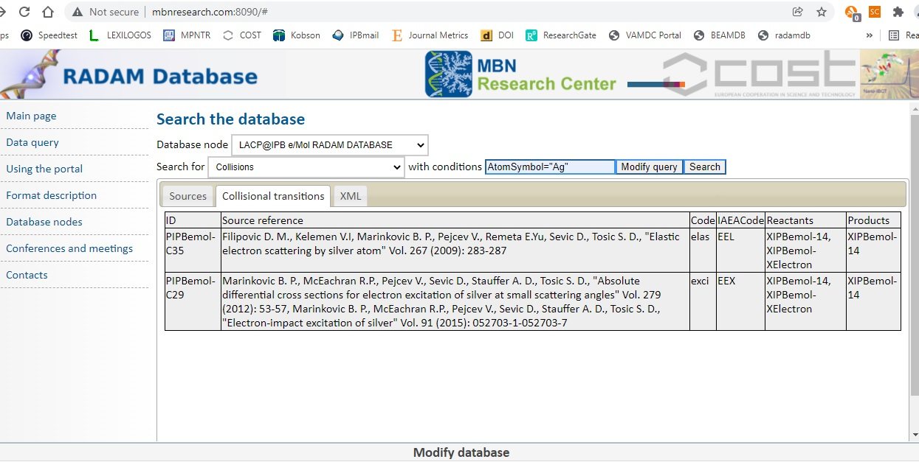

Slide 29

SWOT Analysis:
Strengths:
Many experience in electron/atom
(molecule) collisions and measuring
cross-sections.
Many experience in
photoluminescence measuring and
analysis.
Weaknesses:
No new students
Time-demanding
No automated process of data input
Opportunities:
Small number of such data databases
Expertise in electron collision processes
Threats:
Local: What if do not receive
project submitted to the
Science Fund?
Global: No present funding for
VAMDC Consortium

Slide 30
Conclusions
Electron and particle scattering data (not only photo-processes data) are needed to better understand processes in astrophysical observations
VAMDC as a distributed databases with a common portal is a powerful aid
Settling the Information System in a specific field of research (like the field of Atomic Collision Physics) could be very useful for each Lab or research group
Need for improved accuracy of CS measurements and smaller error bars – consistency of data.
Still we need refinements in theoretical approaches to the electron scattering problem.
Work with more complex systems (larger biomolecules, molecules being precursors for FEBID-focused electron beam induced deposition, radio-sensitizers, drugs, chelators, bio-chemically active compounds…) is challenging task ahead
Urgent need for settling the panel for critical assessment of e/Mol data and normalization procedures
Institute of Physics,
University of Belgrade

Slide 31
Future plan
Data Base: Judd- Ofelt database – (JO)
Database of rare earth doped phosphors which includes the Judd-Ofelt parameters. The database will be used for survey of known and virtually designed novel phosphors.
Lanthanides ions 3+ with the configuration [Xe]4f^{q} (q=2-13) i.e. Pr³⁺, Nd³⁺, … Yb³⁺.
Electric dipole (ED) optical transitions between these ^{2S+1}L_{J} states are forbidden because they all have the same parity (-1)^{q}
When embedded in a host material the spherical symmetry of a free ion is broken by the perturbation caused by crystal field. As a result the degeneracy (2J+1) of an energy level is partially or totally lifted allowing the induced ED optical transitions between them.
Partial energy diagram for Eu³⁺(4f⁶) ions, showing the related magnitude of
the interelectronic repulsion, spin-orbit coupling and ligand field effects.

Slide 32
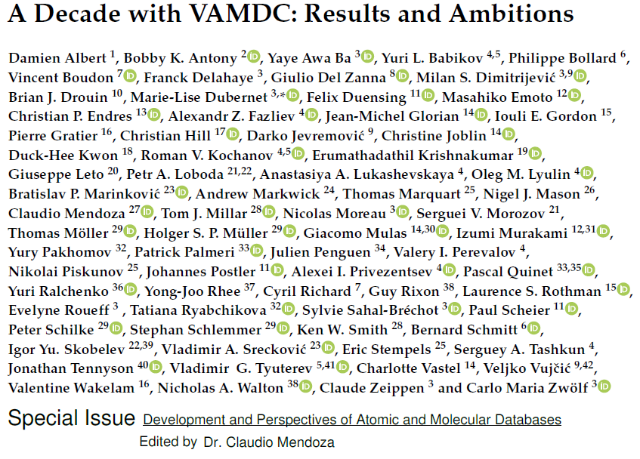
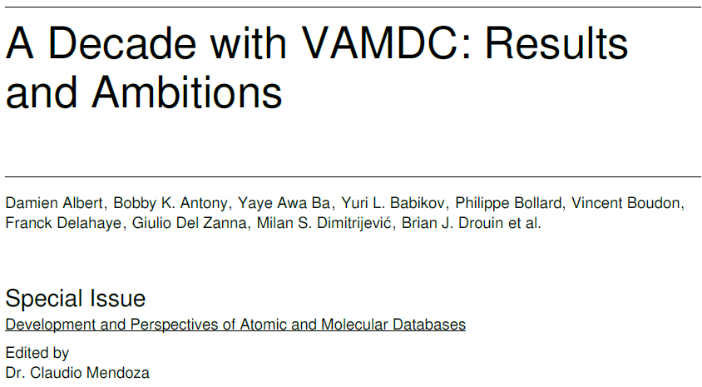
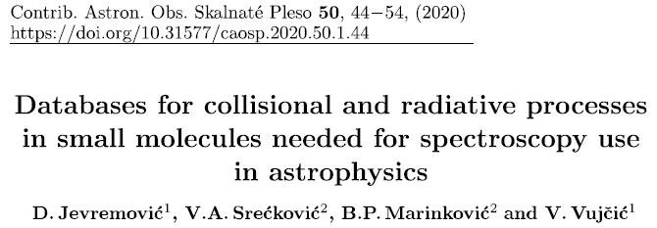
Atoms, 7(1), 11 (2019) [14pp]. doi: 10.3390/atoms7010011
Atoms, 8(1), 76 (2020) [45pp].
doi: 10.3390/atoms8040076

Slide 33




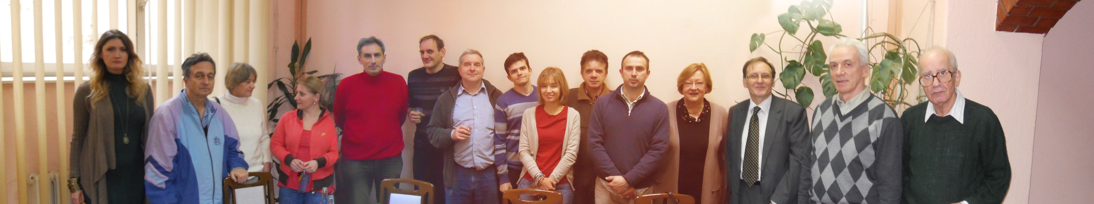
ACKNOWLEDGEMENTS:
DATABASES: Milan Dimitrijević, Darko Jevremović, Vladimir Srećković, Veljko Vujičić, ...
IPB – LACP team
†Michael Brunger

Slide 34
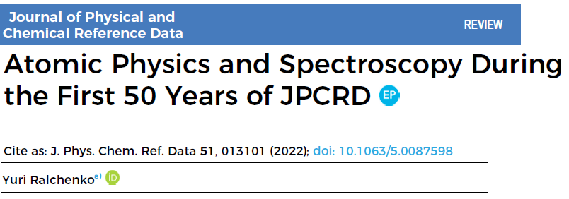

Slide 35
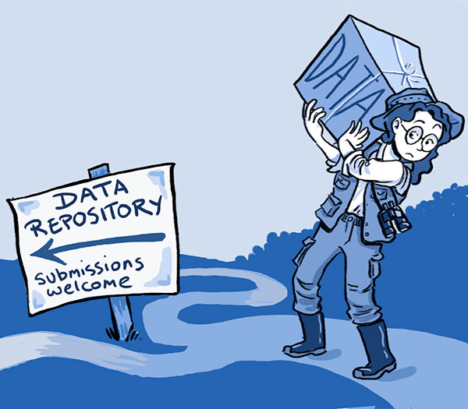



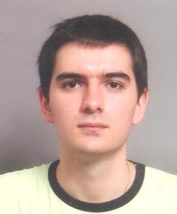
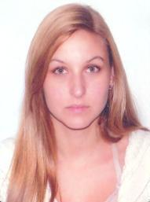
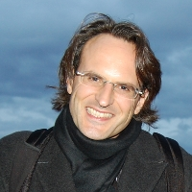


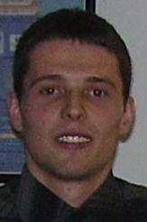
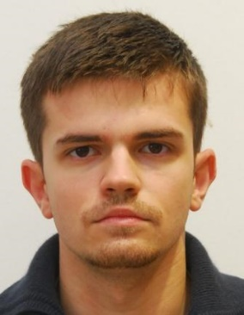


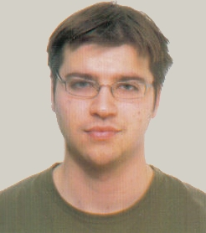
Instead of acknowledging all people who have been working on databases

