Slide 1
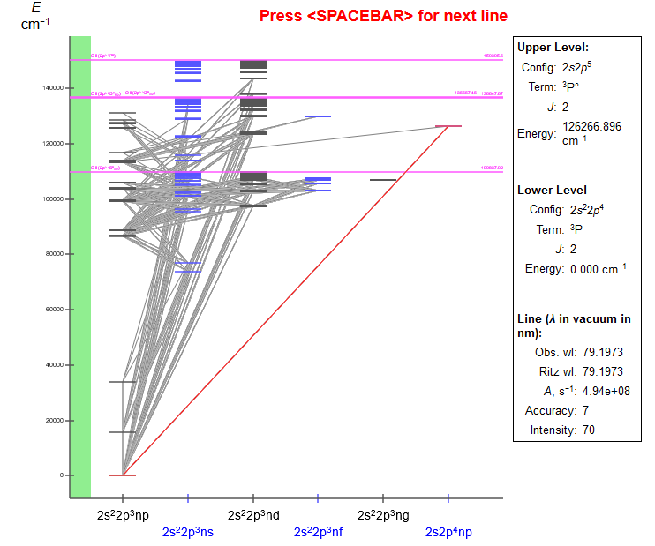
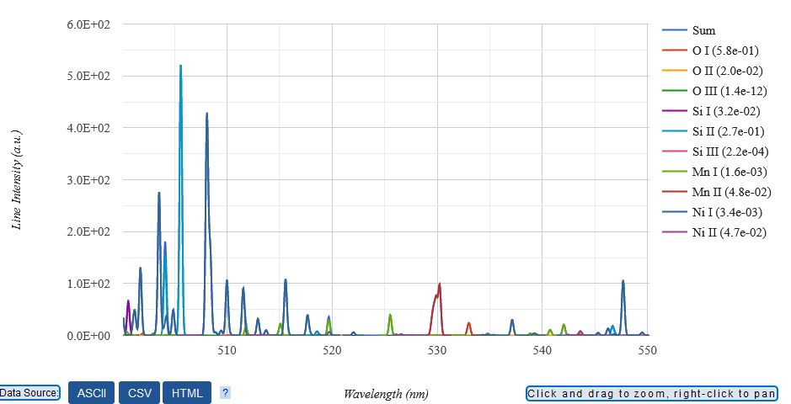

NIST Atomic Databases: data evaluation, uncertainties, online tools
Yuri Ralchenko
National Institute of Standards and Technology
Gaithersburg, MD 20899, USA
June 19, 2023
14th SCSLSA, Bajina Bašta, Serbia

Slide 2
Acknowledgements
NIST Atomic Spectroscopy Group
A. Kramida
J. Reader
K. Olsen
G. Nave
R. Ibacache
…
Dipti (IAEA)
C.J. Fontes (LANL)
H.K. Chung (Korea)
C. Froese Fischer (UBC, NIST)
H. Kunari (India)
….

Slide 3
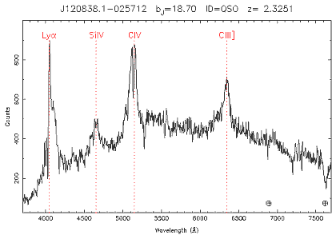
Spectral parameters
Line identification
Line splitting, EM fields
Wavelength, line shift
Background,
continuum
Line broadening
Line intensity
2dF Quasar Survey

Slide 4
Types of atomic data
Structure and radiation
Energy levels (E)
Hyperfine splittings
Level identifications
Transition wavelengths (λ)
Transition probabilities (A)
Collisional
Binary cross sections (σ)
  Electron impact
  Heavy-particle impact
  Photoabsorption and photoionization
Maxwellian rate coefficients (<σv>)
Typical uncertainties:
E, λ < 10⁻⁵ (even 10⁻¹² for one-electron ions)
A < 10%
σ < 20%
Mostly experimental
Mostly theoretical

Slide 5
Examples of atomic numerical databases
AtomDB (CfA-Harvard)
ADAS (UK)
ALADDIN (IAEA, Austria)
BEAMDB (Serbia)
CAMDB (China)
CCC (Australia)
CHIANTI (NASA, USA, UK)
CLOUDY (Univ.Kentucky)
Kurucz database (Harvard)
NIFS (Japan)
NIST Atomic Databases
PEARL (Korea)
Spectr-W3 (Russia)
Stark-B (France/Serbia)
TIP/TOPbase (NASA, Venezuela, UK)
TOPS (LANL)
VALD (Austria, Sweden, Russia)
…and more…

Slide 6
Why are these databases different?
Different atomic parameters (structure/radiation, collisions)
Coverage of data (species, ions,…)
Completeness of information (quantum numbers etc)
Sources of data
Online tools and options
Critical evaluation of the data

Slide 7
Critically-evaluated atomic databases
AtomDB (CfA-Harvard)
ADAS (UK)
ALADDIN (IAEA, Austria)
BEAMDB (Serbia)
CAMDB (China)
CCC (Australia)
CHIANTI (NASA, USA, UK)
CLOUDY (Univ.Kentucky)
Kurucz database (Harvard)
NIFS (Japan)
NIST Atomic Databases
PEARL (Korea)
Spectr-W3 (Russia)
Stark-B (France/Serbia)
TIP/TOPbase (NASA, Venezuela, UK)
TOPS (LANL)
VALD (Austria, Sweden, Russia)
…and more…

Slide 8

NIST Atomic Spectroscopy Program
The mission of the Atomic Spectroscopy Group is to measure, calculate, critically compile, and disseminate reference data on atomic properties and fundamental constants…
Level energies, spectral line wavelengths,
oscillator strengths (transition probabilities), ionization potentials

Slide 9
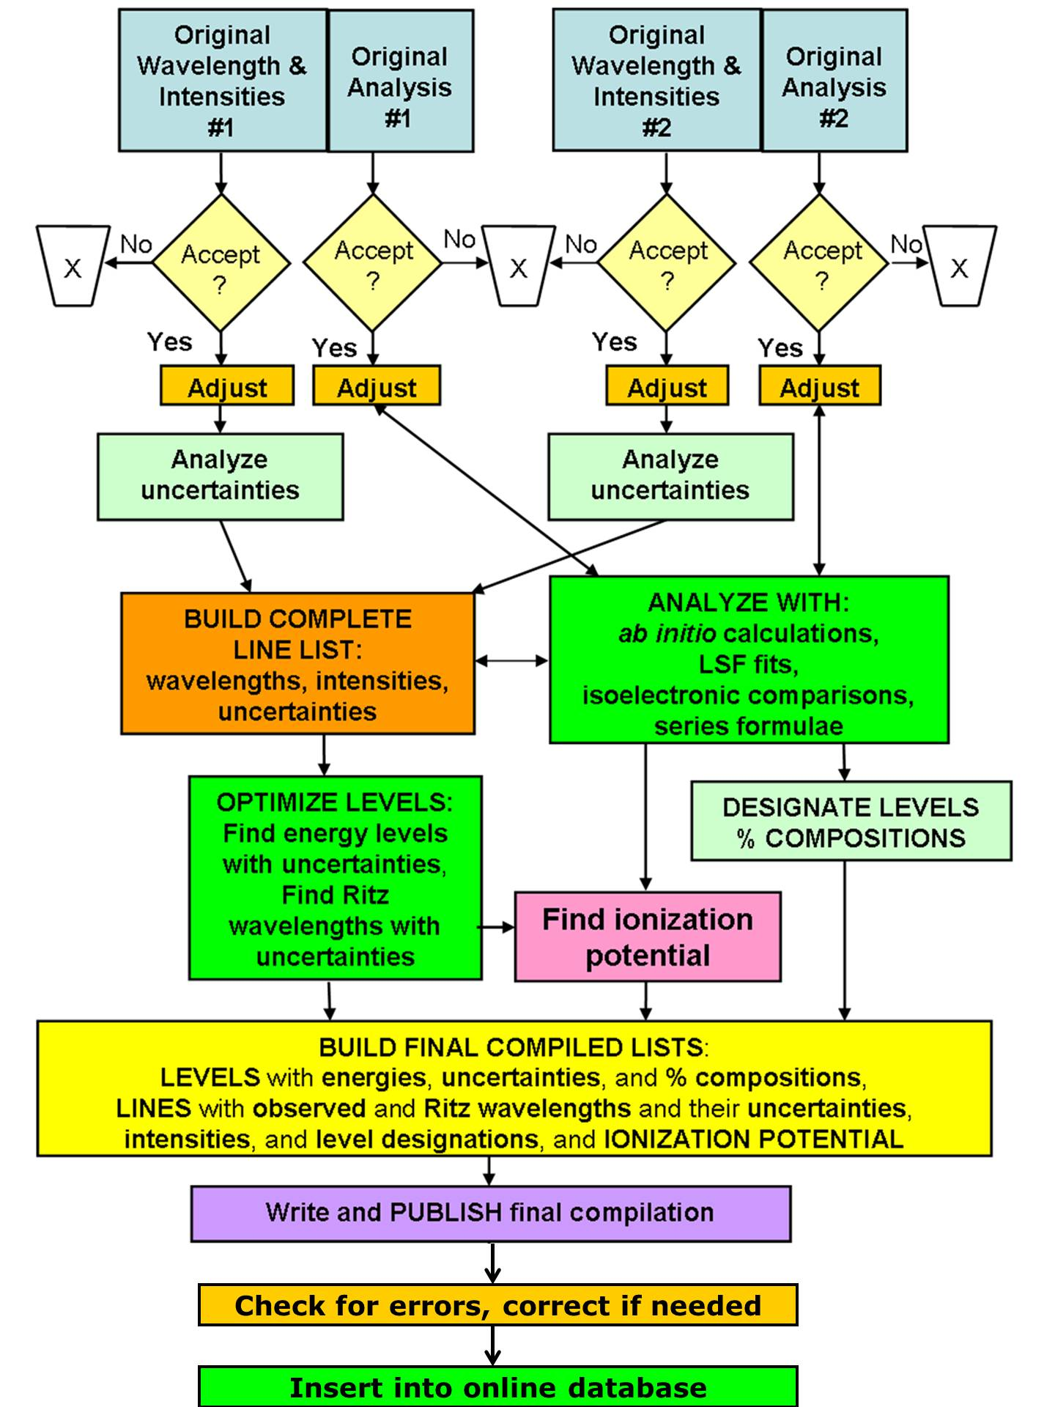
Workflow of critical evaluation of data
For the 16 energy levels of the 1s2l2l’ core-excited configurations of Li-like ions, 999 absolute and 35 relative experimental energy-level measurements from 101 publications have been collected and analyzed. Modern statistical theory methods (e.g., “dark uncertainty”) were applied to derive the final uncertainties.
A. Kramida
Fus. Sci. Tech. 63, 313 (2013)
Notes:
Experimental data

Slide 10
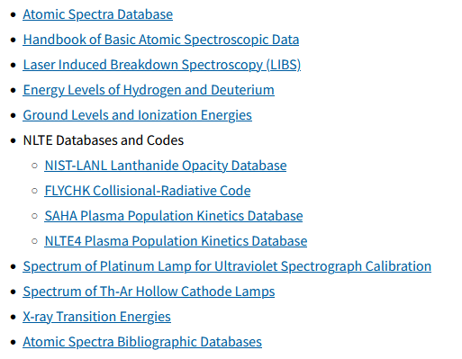




NIST Atomic Databases and Tools
https://www.nist.gov/pml/atomic-spectroscopy-databases

Slide 11
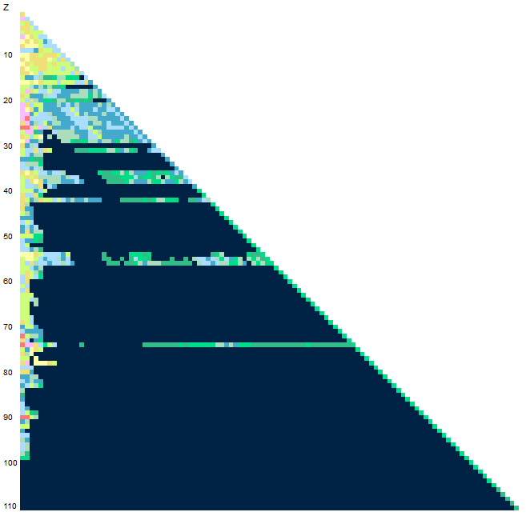
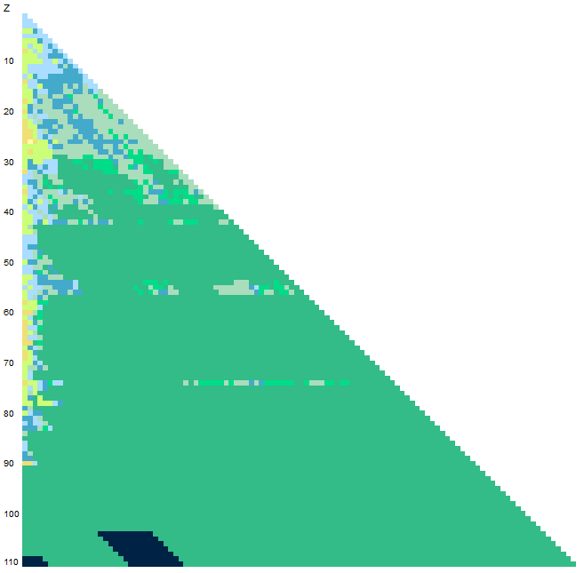
ASD v.5.10 (Oct 2022)
https://physics.nist.gov/asd
Levels: 114,283
1. Energy levels, spectral lines, and transition probabilities updated and extended for C II, Fe VII, Ac I-III.
2. Energy levels and spectral lines inserted for ¹²C II, ¹³C II, and ¹⁴C II.
3. A typo in the energy of the 1s²2s9p ¹P°₁ level in Be I has been corrected.
4. A misprint in the Landé g-factor value of one Yb II level (22960.80 cm⁻¹) has been corrected.
5. Transition probabilities of Rb I updated.
6. Ionization energies of C II, Fe VII, Se I, Dy I, Tm I, Rn II, Ac I, Cf I updated.
7. A misprint in the 4d¹⁰5s5d ³D₃ energy level of Cd I corrected.
8. Energy units of Hartree and GHz added to the choice of units for output of energy levels in Levels, Lines (including the multiplet layout and Grotrian diagram), and Ionization Energies sections of ASD.
9. Configuration labels corrected for several levels in Ni II, Rb IV, Rh II-III, Nd II, Hf I, Y IV, Xe II, Bi II. These errors were detected by Jon Grumer of Lund University, Sweden, whose help is gratefully acknowledged.
10. Lists of energy levels and spectral lines updated/extended for Kr IX, Kr XVIII-XXXVI.
11. A new option added for the intensity scale choice in LIBS and Saha-LTE plots (energy flux or photon counts). The new default setting is to display spectral intensities on a scale proportional to energy flux. Prior to this change, intensities displayed by both the Saha-LTE and LIBS plots were proportional to photon counts.
Lines: 296,759
Probabilities: 127,729
Mo
Nuclear charge
W
Ion charge

Slide 12
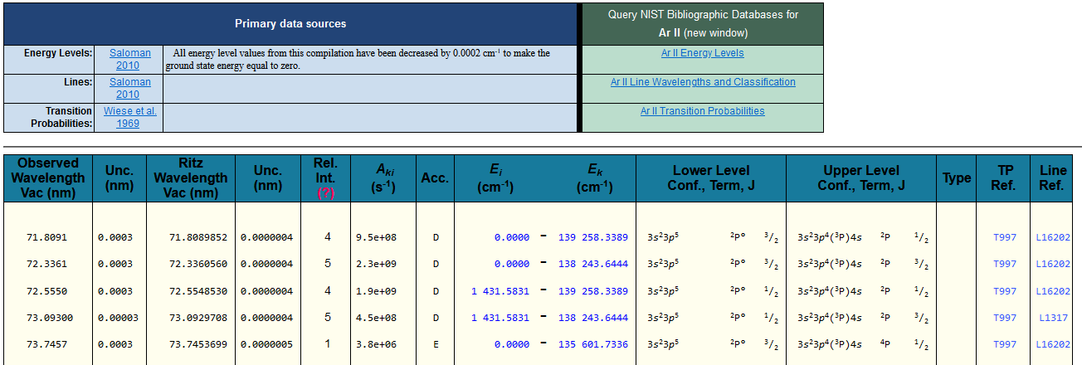
ASD Output
Data tables in different formats (HTML, ASCII, XSAMS, csv,…)
  Uncertainties!!!
Ar⁺
O I
614 levels
910 lines
https://physics.nist.gov/asd

Slide 13
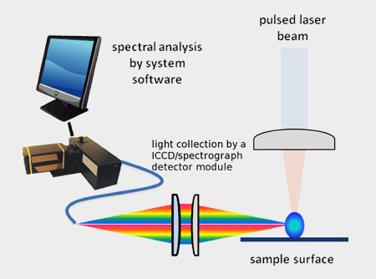
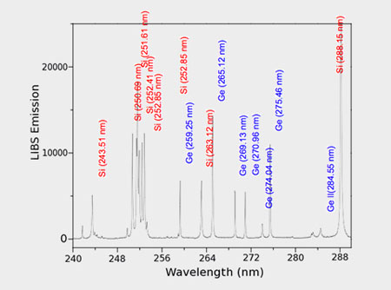
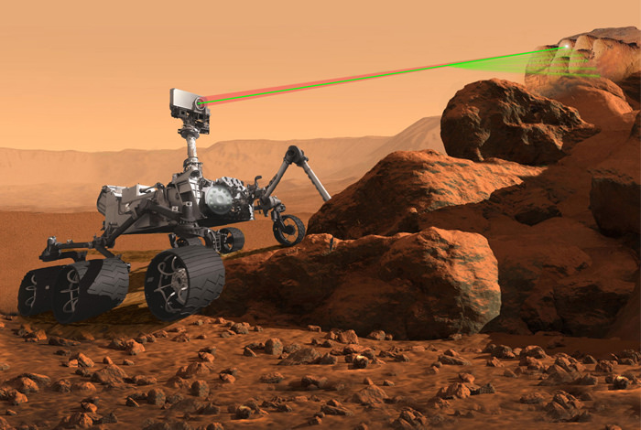
NIST LIBS Database: Laser Induced Breakdown Spectroscopy
https://physics.nist.gov/LIBS
© Applied Spectra
Numerous terrestrial and extra-terrestrial applications (ChemCam on Curiosity rover)
Credit: NASA

Slide 14
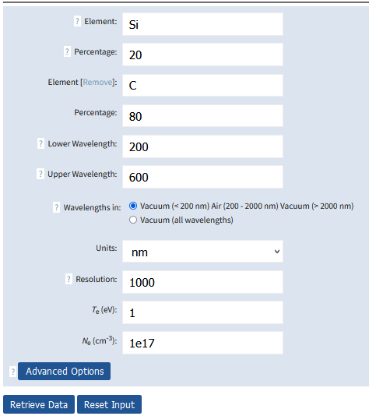

NIST LIBS Database
Low temperature, high density: Saha-LTE!
$$I=N_{0}\frac{g_{i}}{g_{0}}e^{−E/T}∙A$$
All needed data
are already in ASD
Calculation of Saha/LTE spectra for any element or combination thereof in ASD
Arbitrary plasma parameters (but Saha/LTE!) and spectrum resolution
ASD-based
Graphical services
Problem: not all ions, A’s
https://physics.nist.gov/LIBS
Credit: NASA

Slide 15
NIST LIBS Database
https://physics.nist.gov/LIBS
5% Mn + 5% Ni + 30% Si + 60% O
T_{e} = 1 eV
N_{e} = 10¹⁷ cm⁻³
R = 3000
Direct comparison with measured data
Credit: NASA

Slide 16
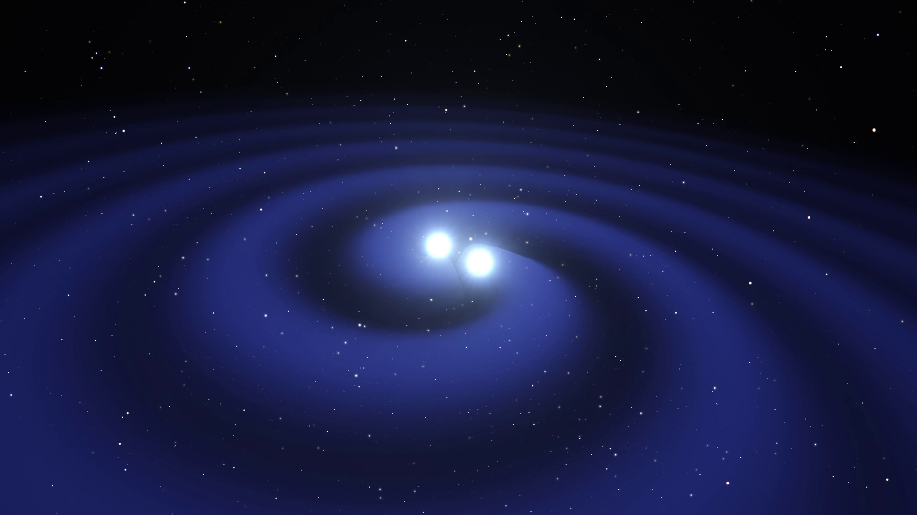
New NIST-LANL Opacity Database
https://nlte.nist.gov/OPAC
K. Olsen, C.J.Fontes, C.L.Fryer, A.L. Hungerford, R.T. Wollaeger, O. Korobkin, Yu. Ralchenko
Neutron star merger
Kilonova event
Rich EM spectrum in addition to GW
Z = 57-71 (4f shell) and Z = 89-102 (5f shell)
Lanthanide/actinide opacities are critically important for kilonova analysis
©ESO/L. Calçada
Credit: NASA

Slide 17
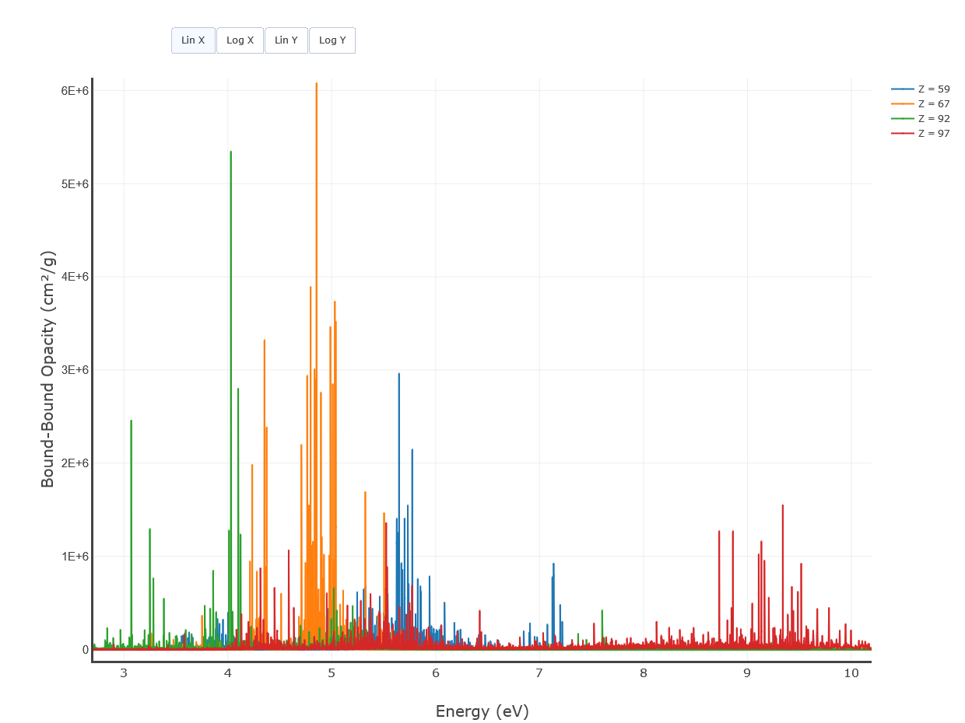
NIST-LANL Lanthanide/Actinide Opacity Database
https://nlte.nist.gov/OPAC
K. Olsen, C.J.Fontes, C.L.Fryer, A.L. Hungerford, R.T. Wollaeger, O. Korobkin, Yu. Ralchenko
Fontes et al, Mon. Not. Roy. Astron. Soc. 493, 4143 (2020)
LANL LTE opacities for 57 ≤ Z ≤ 70, 89 ≤ Z ≤ 102
Temperatures: 0.01—5 eV
Densities: 10⁻²⁰—10⁻⁴ g/cm³
Photon energy grid: 14,900 points
Fontes et al, Mon. Not. Roy. Astron. Soc. 519, 2862 (2023)
Tables and graphs:
  Total opacities
    Scattering
    Absorption
      Bound-bound
      Bound-free
      Free-free
Credit: NASA

Slide 18
Online Collisional-Radiative Modeling: FLYCHK
Collisional-radiative code developed at LLNL (H.-K. Chung, R.W. Lee)
Time-dependent, non-Maxwellian, opacity effects, radiation field,…
>1400 users (free registration)
Primarily dense plasmas (Z_{n} ≤ 79), ionization distributions, various spectra, radiative power losses…
https://nlte.nist.gov/FLY

Slide 19
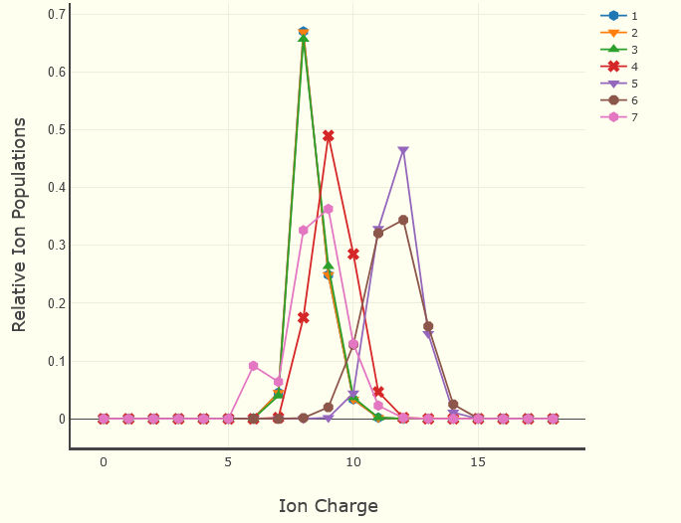
FLYCHK: ionization distribution for Ar (calculation time = 3 s)
Electron density (cm⁻³):
1e12
1e14
1e16
1e18
1e20
1e22
1e24
T_{e} = 100 eV
Credit: NASA

Slide 20
NIST Atomic Bibliographic Databases: THE latest data
Updated regularly (~2 weeks)
Atomic Energy Levels and Spectra
  22,615 references, 1802-2023
Atomic Transition Probabilities
  10,302 references, 1914-2023
Atomic Lines Broadening and Shifts
  7,175 references, 1889-2023
Search options
  Elements/ions
  Isoelectronic sequence
  Word/pattern
  Publication years
  Publication source
  Method type
  Keywords
  General category
  Specific subjects of interest

Slide 21
Final notes
Atomic (spectroscopic) data becomes more and more accessible through availability of high-quality computer codes, databases and online tools
New infrastructure for A&M data access is being actively developed
NIST Atomic Data Center maintains an active program on collection, evaluation, and dissemination of accurate atomic spectroscopic data relevant to various fields of research
New data compilations are added regularly
We extremely appreciate feedback from the users
Yu. Ralchenko and A. Kramida, Atoms 8, 56 (2020)

Slide 22
International School on Atomic and Molecular Data Evaluation and Curation
Oct 22-25 2023, Valladolid, Spain
https://eventos.uva.es/go/isamdec

