Slide 1

The Enigmatic Sanduleak’s star
Francesco Di Mille
Las Campanas Observatory
14th Serbian Conference on Spectral Line Shapes in Astrophysics
Bajina Bašta,Serbia, 20 June 2023

Slide 2
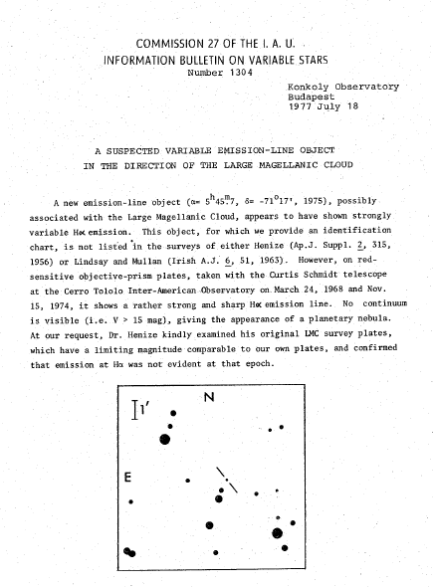
In 1977 N. Sanduleak reported on the discovery of a suspected
variable emission-line object in the direction of LMC
It became known as Sanduleak’s star (or also as LMC Anonymous)
The object has been catalogued among symbiotic stars
but the absence of any late-type stellar signatures in the optical spectra leaves this classification controversial

Slide 3
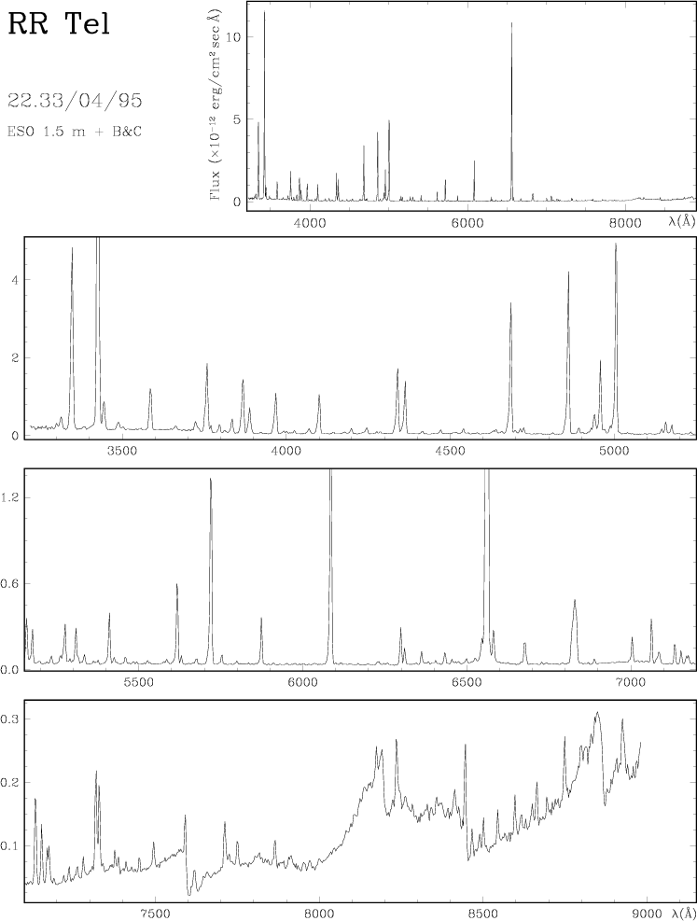
Symbiotic Stars
Symbiotic stars are long-period interacting binaries consisting of a cold component , usually a K or M giant, and a hot compact component accreting matter from the atmosphere of its companion.
During their evolution symbiotic stars show spectral variability determined on one hand from the orbital motion, eclipses and heating/reflection effects and on the other hand from the outburst events of the hot component. The outburst are often accompanied by intensive loss of mass in the form of optically thick shells, stellar wind outflows, and bipolar collimated jets.
Presence of the absorption features of a late-type giant; in practice, these include (amongst others) TiO, H₂O, CO, CN and VO bands, as well as CaI, CaII, FeI and NaI absorption lines;
Presence of strong emission lines of HI and HeI and either emission lines of ions with an ionization potential of at least 35 eV (e.g. [OIII]), or an A- or F-type continuum with additional shell absorption lines from HI, HeI, and singly-ionized metals;
The presence of the λ6825 Å emission feature, even if no features of the cool star (e.g. TiO bands) are found.
Munari & Zwitter 2002
Notes:
On the basis of the near-infrared (NIR) colours, a classification into two types, S and D, was originally proposed by Webster & Allen (1975) according to whether the cool star (S type) or dust (D type) dominates the 1−4 µm spectral range. Some years later Allen (1982) introduced a third class, designated as D’ type, characterised by very red colours in the far infrared (FIR) and by a cool star of spectral type F or G, in contrast to ordinary symbiotics where the cool giant is a M-type star (S type) or a Mira variable (D type). The D’ types are quite rare objects, and nowadays only eight out of about 200 SS are known to belong to this class (Belczynski et al. 2000)
<number>

Slide 4
Sanduleak’s Star
In this talk I will present archive and new data mainly obtained at the Las Campanas Observatory.
The work has been developed in close collaboration with
Rodolfo Angeloni (Gemini Observatory)
Stefano Ciroi (Padua University)
I particularly I will zhow:
Imaging and long-slit spectroscopy of the:
Extended emission
Central source
I will also show an attempt to characterize the spectral energy distribution of the object
Sanduleak’s star

Slide 5
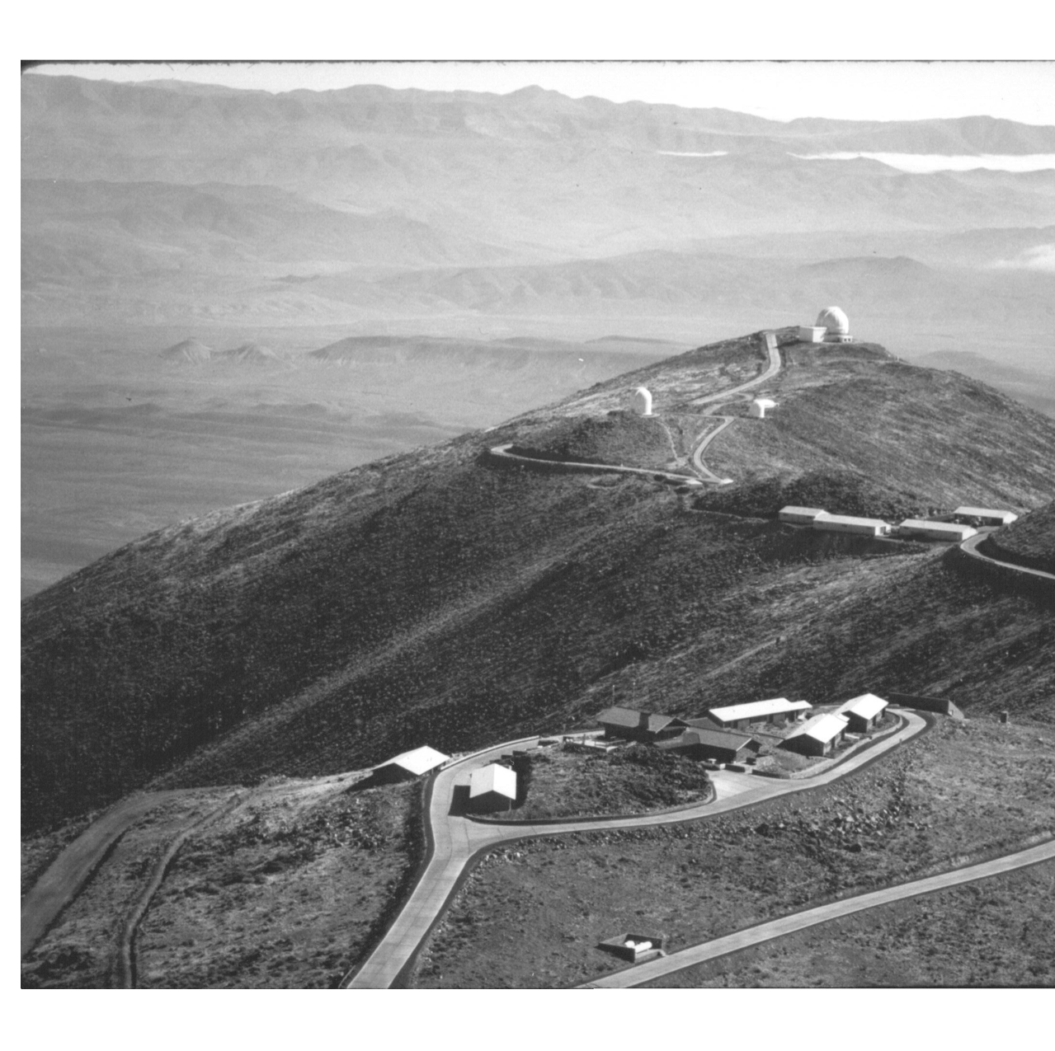
LCO OVERVIEW
The Las Campanas observatory (LCO) history spread over more than five decades.
It was established in northern Chile by the Observatories of the Carnegie institute of Washington at the end of the 1960s.
The Science operations began in 1971 with the 1-m telescope donated to the observatory by Hernietta Swope. The 2.5m duPont telescope followed in 1977

Slide 6
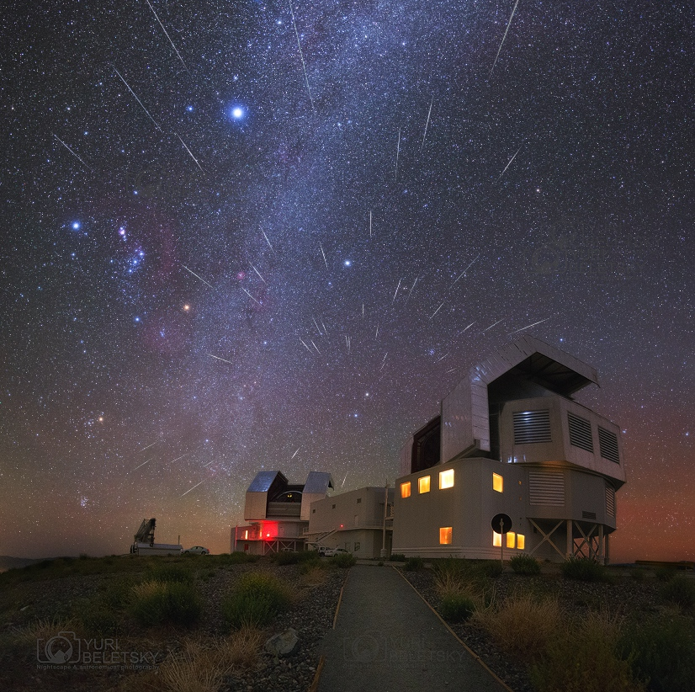
LCO OVERVIEW
The twin6.5 m Magellan telescopes became operational at the beginning of 2000s
In addition to the four telescopes operated by Carnegie the observatory hosts few independent projects like OGLE, Hat, HAT-PI and one of the station of the Birmingham Solar Oscillation Network (BISON)
Furthermore, the Campanas peak is the site for the Giant Magellan Telescope (GMT).
Pic Y. Beletsky

Slide 7
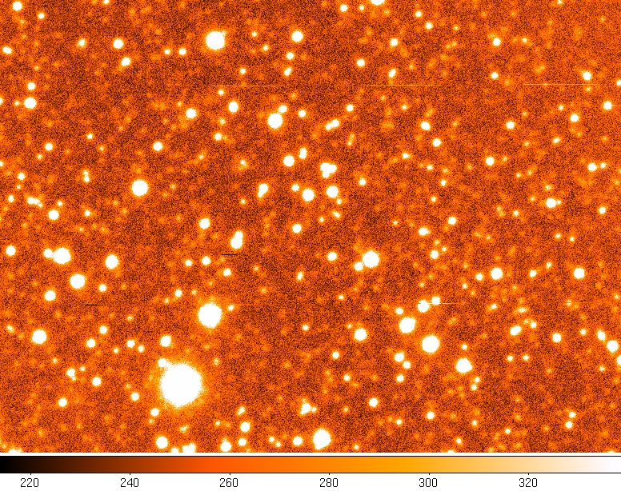
Sanduleak’s star Jet
Discovery Image

Slide 8
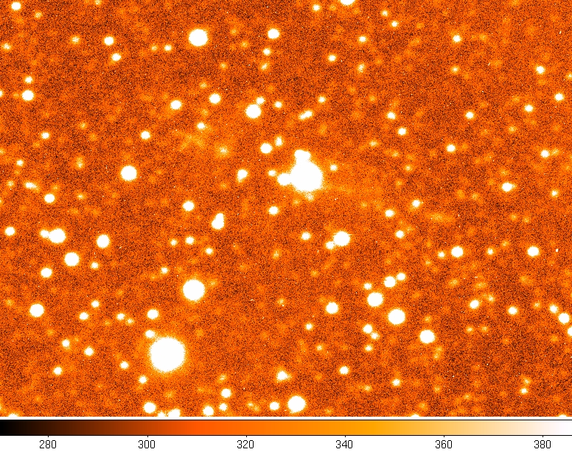
Sanduleak’s star Jet
Discovery Image

Slide 9
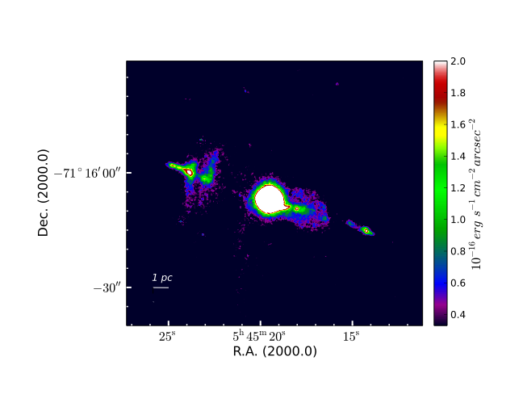
Magellan-Clay + MagIC
Continuum-subtracted Hα+[NII] image
FoV: 1.4’ x 1.4’
Pixel scale: 0.07arc/pix
Exp. time: 3x900 sec (900 sec off-band )
Angeloni, R., Di Mille, F., Bland-Hawthorn, J., Osip, D. J. 2011, ApJ 743, L8

Slide 10
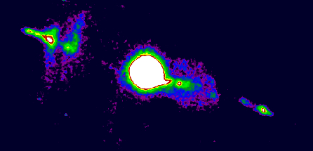
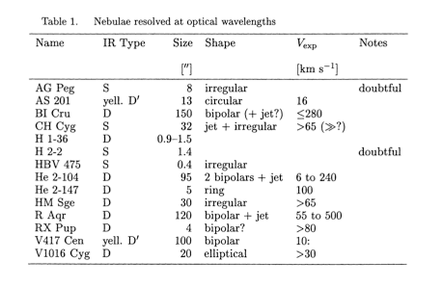
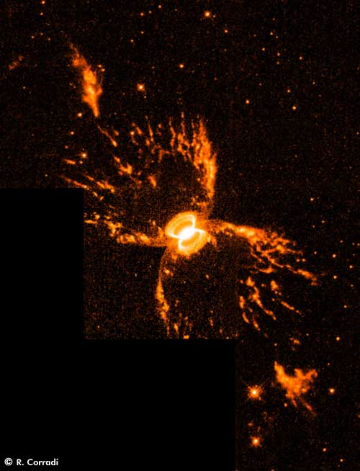
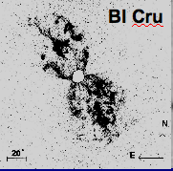
Corradi. R. 2003 ASPC,303,393
Southern Crab
BI Cru
Notes:
Hen2-104 3.3 kpc
R aqr distance 250 pc ; at the same distance sandulea’s jet >3 degrees

Slide 11
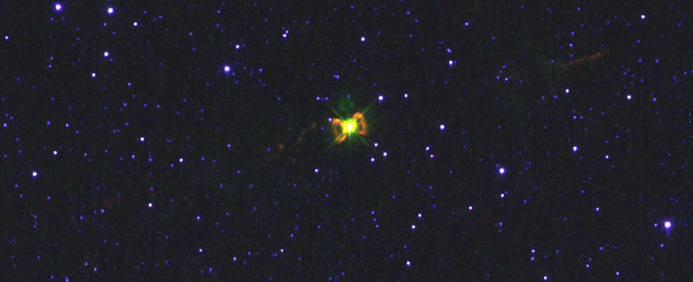
Hubble Space telescope
Narrow Band Images
Southern Crab
BI Cru
Notes:
Hen2-104 3.3 kpc
R aqr distance 250 pc ; at the same distance sandulea’s jet >3 degrees

Slide 12
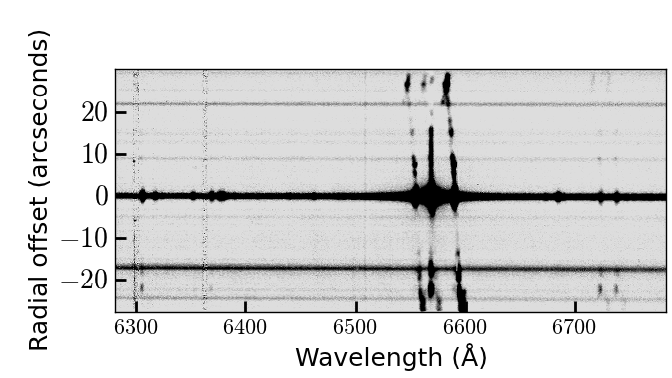
Low Resolution spectroscopy performed with the LDSS3 spectrograph.
Setup VPH-All + Slit 1” oriented along the Jet
FoV: 1.4’ x 1.4’
Pixel scale: 0.07arc/pix
Exp. time: 3x900 sec
900 sec off-band
Angeloni, R., Di Mille, F., Bland-Hawthorn, J., Osip, D. J. 2011, ApJ 743, L8
Notes:
1 Parsec = 3.08568025 × 10¹³kilometers =30 millon of million
1 Parsec = 206 264.806 Astronomical Units
1 parsec

Slide 13
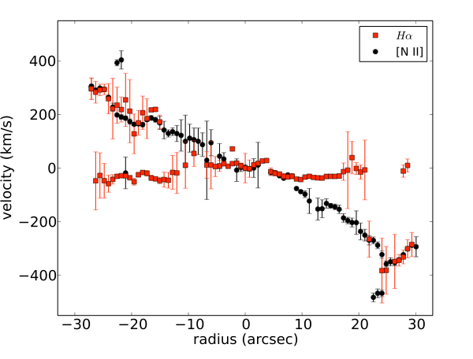
Low Resolution spectroscopy performed with the LDSS3 spectrograph.
Setup VPH-All + Slit 1” oriented along the Jet
Jet Kinematics
Camps-Fariña+ 2018 estimated the angle between the outflow axis and the plane of the sky ~21
Deprojected maximum velocity ~ 1100 km/s
Notes:
<number>

Slide 14
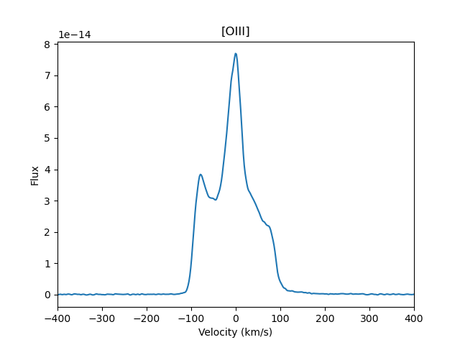
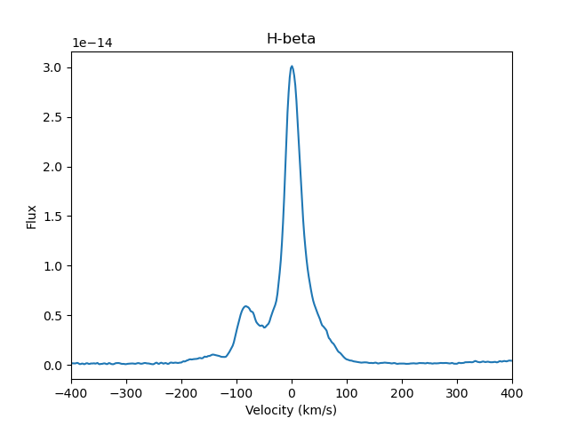
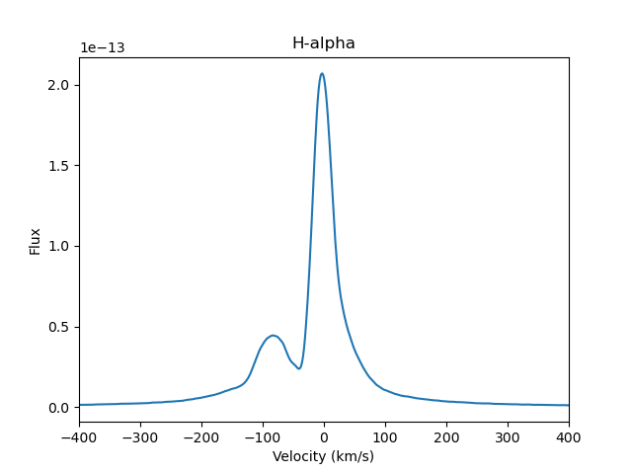
High Resolution Spectroscopy
MIKE is the double arm high-resolution optical spectrograph installed on Magellan Clay telescope in Nasmyth East port.
The two arms (Blue and Red) can be used either simultaneously or separately. The spectrograph delivers full wavelength coverage from about 3350-5000 (blue) and 4900-9500A (red).
These observations were performed in 2019
Resolution was about 13000

Slide 15
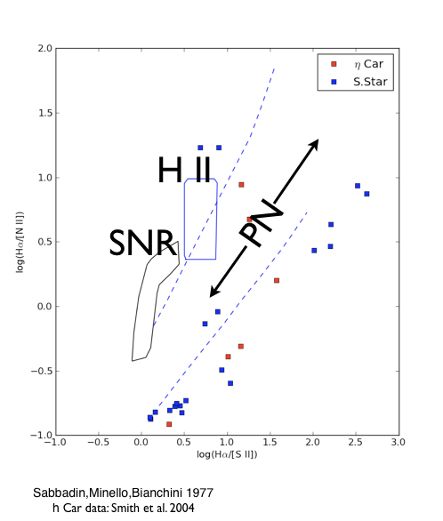
Emission line ratios
Left: Ratios of the brightest lines in the jet recorded the diagnostic diagram of Sabbadin+
Right: Balmer decrement compared with values expected for interstellar extinction (black line) and optical depth effects (red curve). Plot adapted from Luna & Costa 2005
Notes:
Balmer line intensities in planetary nebulae are usually determined b y assuming that Ly α optical depths are high, and that case B conditions prevail. This leads to ratios H α/H β , H γ/H β , and so forth, whic h are only weakly dependen t upon densit y and temperature. Ho wever, these ratios may change appreciably where level 22S populations are large, and Hα optical depths are appreciable. Under these circumstances, whilst Hα intensities would remain relatively unchanged, those of Hβ and Hγ may vary quite appreciably . The self-absorption of H β photons leads to their transformation into Pα and Hα, and similar processes apply for H γ as well. Where shell H α optical depths are large, therefore, then the ratios Hγ/Hβ, Hα/Hβ and Hδ/Hγ are all expected to increase
<number>

Slide 16
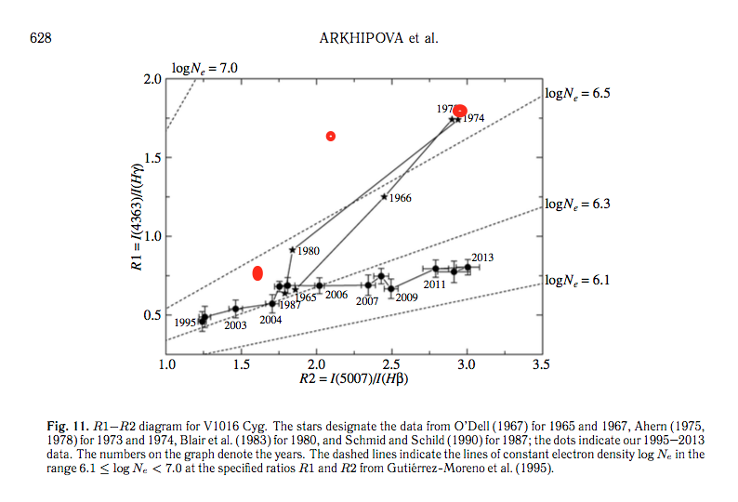
Emission line ratios
Rigth: [OIII] ratios show typical values of symbiotic stars
Left: Evolution of ratios compatible with values showed by the symbiotic nova V1016 Cyg (Arkhipova el al. 2015)

Slide 17
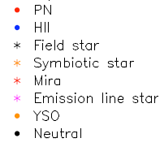
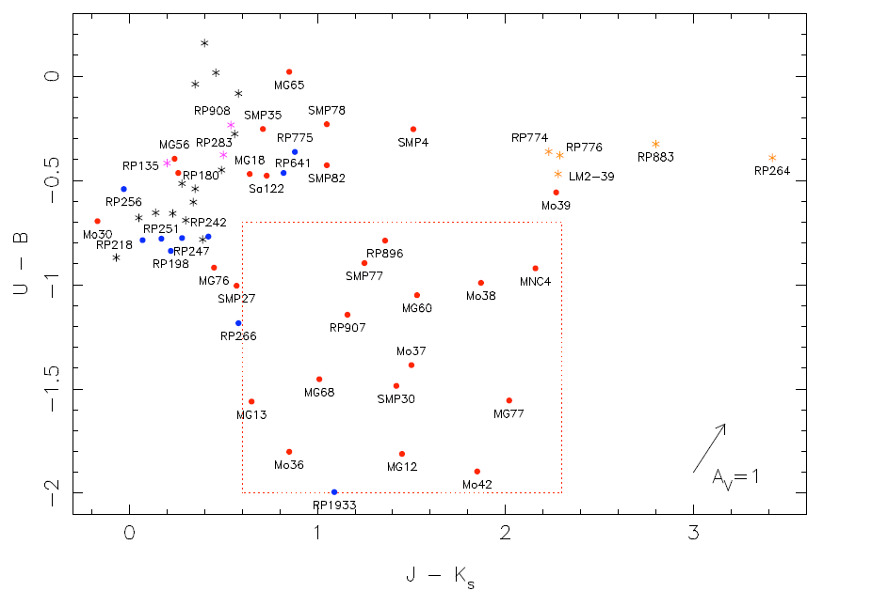
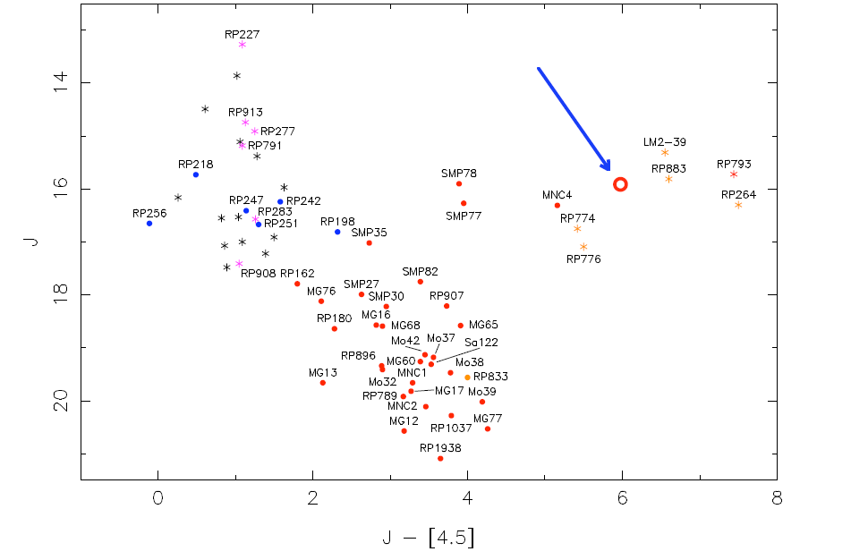
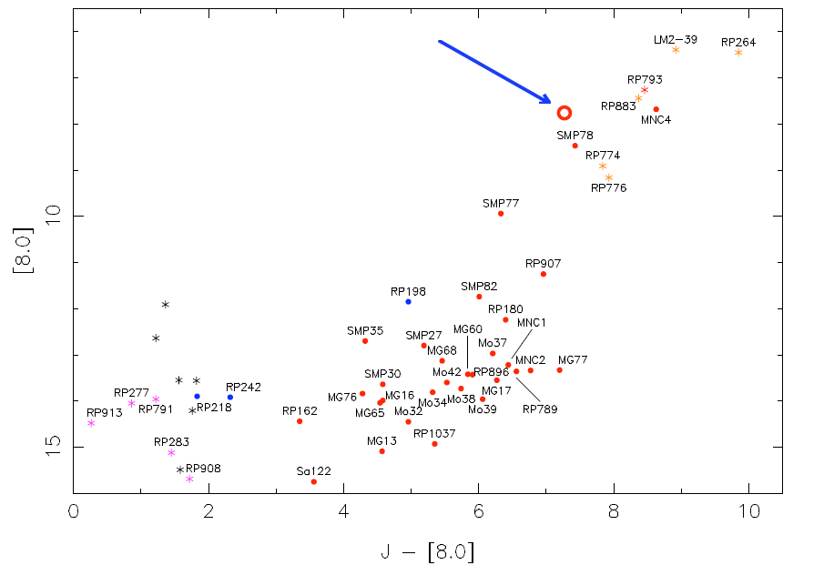
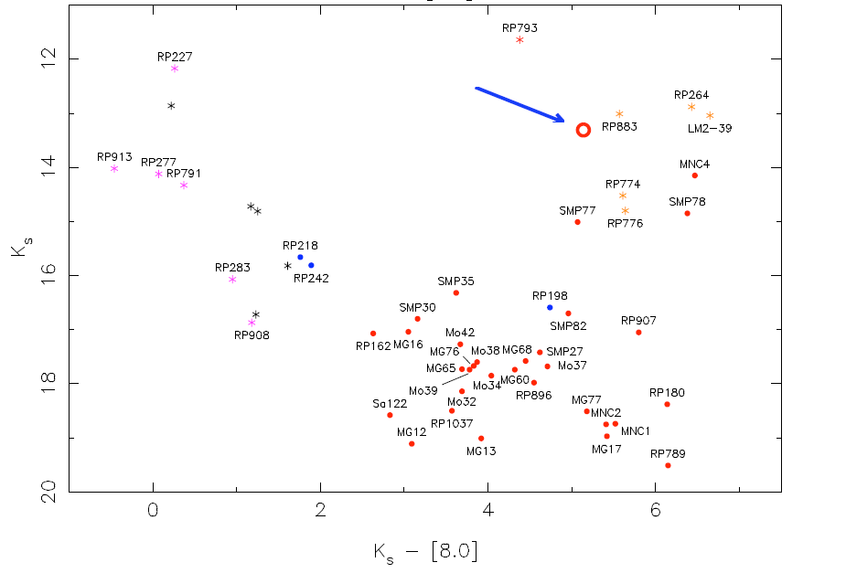
Infrared photometry locate the Sanduleak’s stars in the symbiotic stars region
A direct comparison of the spectral energy distribution show a good match with the galactic symbiotic star HD 330036

Slide 18
Given the inclination from the HST imaging we can get an order-of-magnitude estimate of its kinematical age which is ∼10⁴ years.
The symmetry in the point/velocity distribution of corresponding pair of knots strongly suggests the idea of different ejection episodes.
Diagnostic diagrams and Infrared photometry are in agreement with a symbiotic star classification
The evolution of the [O III] lines similar to V1016 Cyg make us wonder if we are seeing a
Recurrent nova-like outbursts
Notes:
<number>

Slide 19
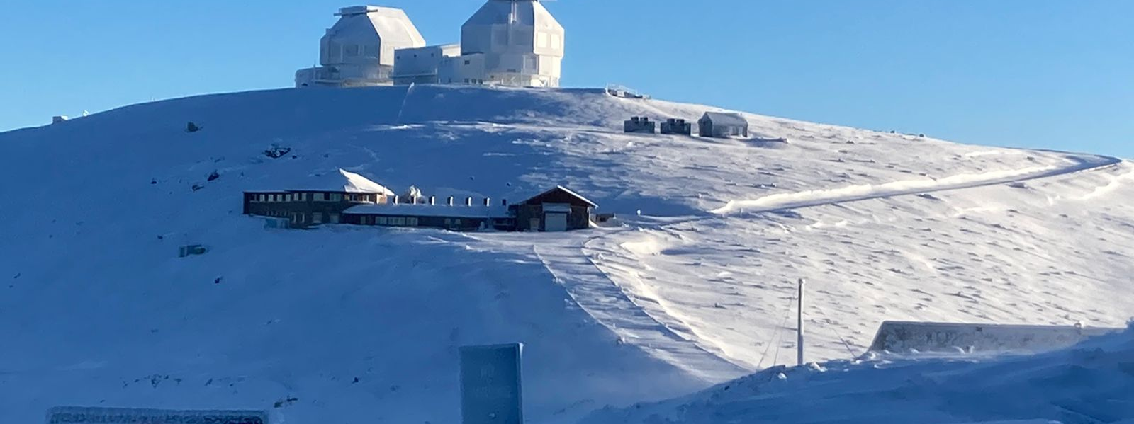
Thanks

