Slide 1


Application of deep-learning to line spectra in magnetic fusion plasmas
Provocative title “how to shoot oneself in the foot”
Mohammed KOUBITI
Physics of Interactions of Ions and Molecules (PIIM)
UMR 7345 Aix-Marseille Université-CNRS, Marseille, France
∣ 14th SCSLSA 2023 ∣ ∣ 20 JUNE 2023 ∣ ∣ M. KOUBITI ∣

Slide 2
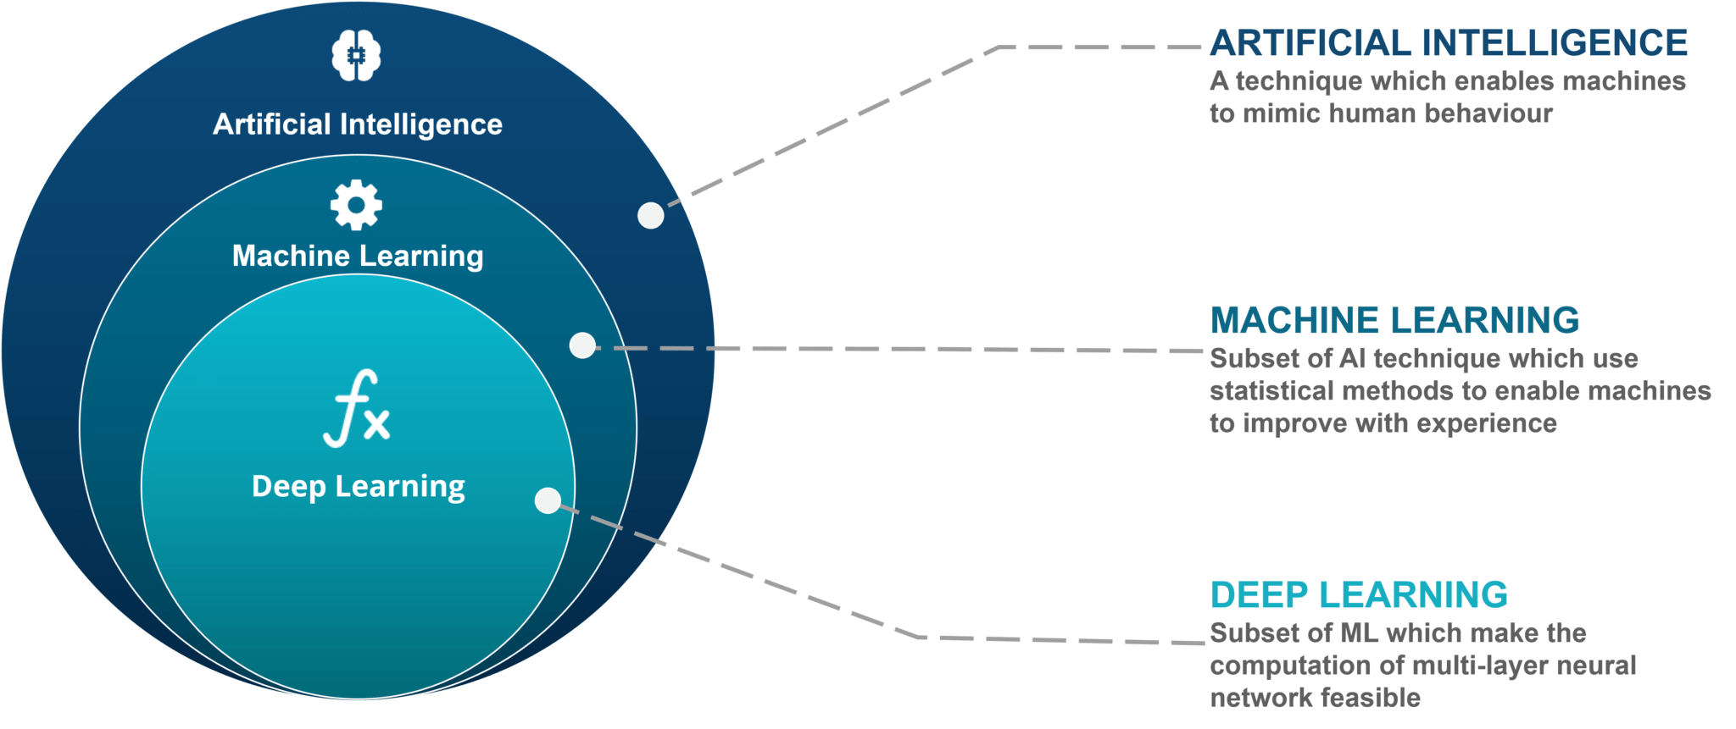
A bit of terminology (AI, ML and DL…)
Artificial Intelligence (AI): ability of a computer/machine to imitate human brain.
Machine learning (ML): Application of AI using algorithms allowing a computer/machine to learn from experiences without being programmed explicitly.
Deep Learning (DL): Application of ML which uses complex algorithms or deep neural nets to solve complicated issues by learning from its own methods.
Artificial Neural Networks (ANNs) make up the backbone of DL, they mimic the human brain through a set of algorithms.
https://www.edureka.co/blog/ai-vs-machine-learning-vs-deep-learning/
∣ 14th SCSLSA 2023 ∣ ∣ 20 JUNE 2023 ∣ ∣ M. KOUBITI ∣

Slide 3
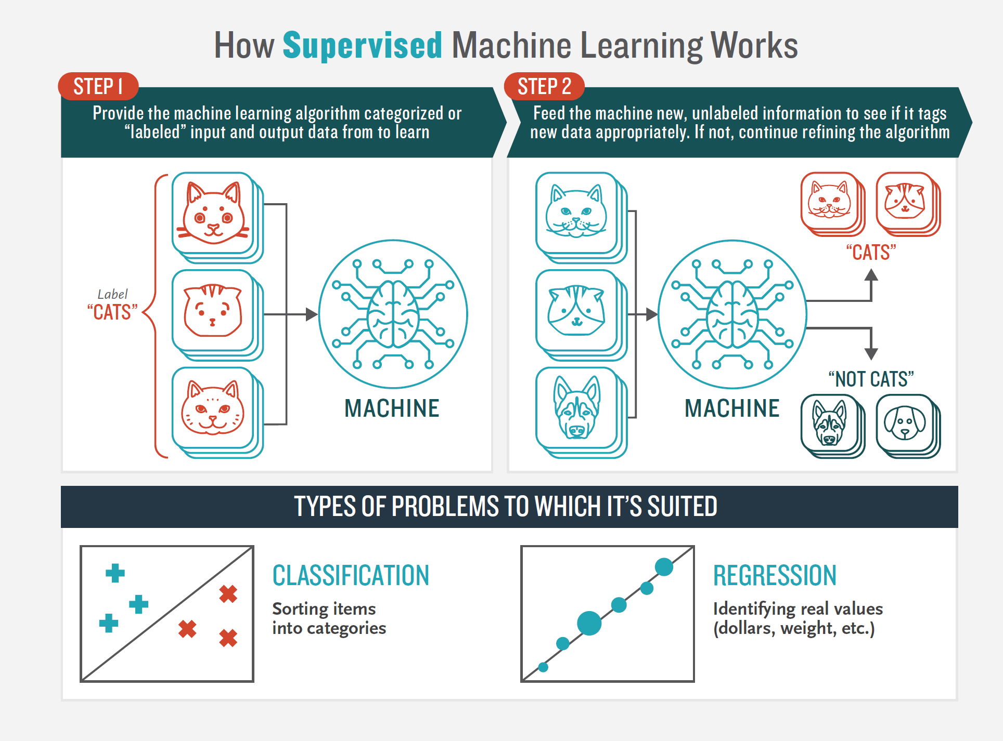
Supervised Machine Learning
Okan Bulut and Christopher Desjardins, Exploring, Visualizing, and Modeling Big Data with R (2019)
https://github.com/okanbulut/bigdata
∣ 14th SCSLSA 2023 ∣ ∣ 20 JUNE 2023 ∣ ∣ M. KOUBITI ∣

Slide 4
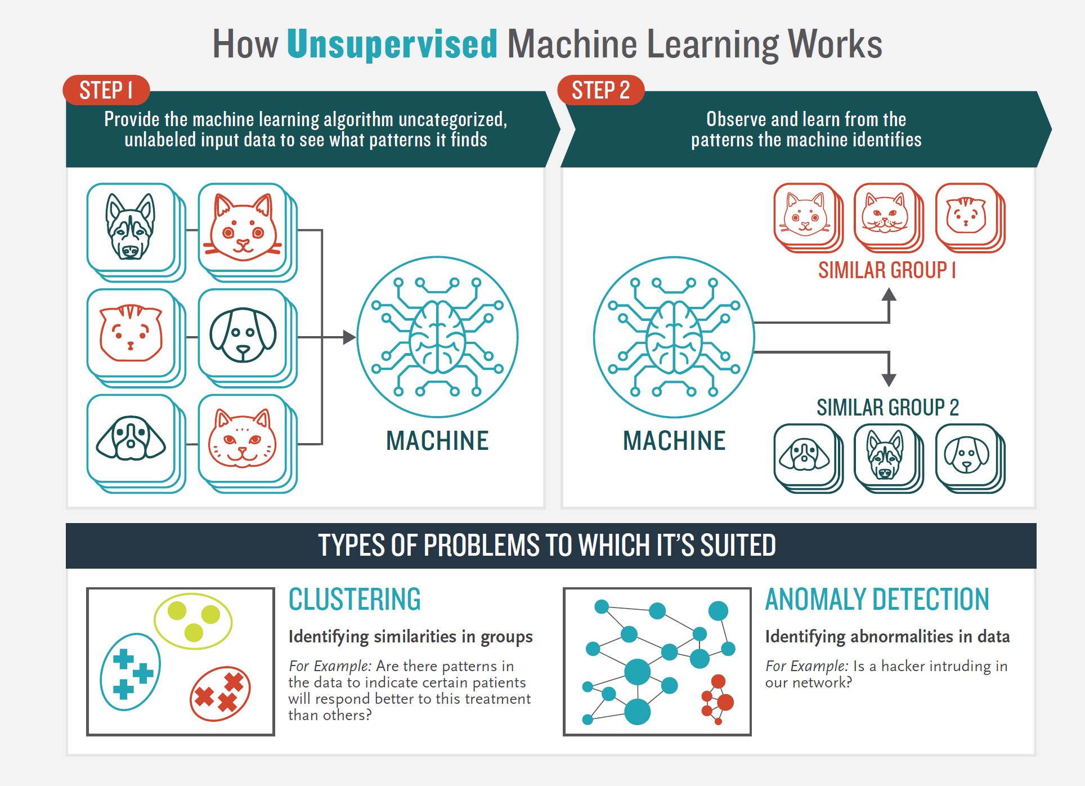
Unsupervised Machine Learning
Okan Bulut and Christopher Desjardins, Exploring, Visualizing, and Modeling Big Data with R (2019)
https://github.com/okanbulut/bigdata
∣ 14th SCSLSA 2023 ∣ ∣ 20 JUNE 2023 ∣ ∣ M. KOUBITI ∣

Slide 5
ML and DL, the differences?
 | Machine Learning (ML) | Deep Learning (DL)
Data volume | ~1000 points | ~10⁶
Outputs | Numerical value (score, classification) | Anything: text, sound, numerical value
How it works? | Uses different types of algorithms to learn model from data and make predictions | Uses ANN to process data, interpret its features and relationships
Management | Algorithms directed by analysts | Algorithms self-directed
∣ 14th SCSLSA 2023 ∣ ∣ 20 JUNE 2023 ∣ ∣ M. KOUBITI ∣

Slide 6
Benefit of combining ML/DL with spectroscopy?
Simplify and speed up spectroscopic data analysis while keeping the major information., i.e., use alternative ways to extract the same information without losing accuracy.
Make use of experimental spectroscopic features to search for correlations with plasma physical quantities.
Make predictions in complement to synthetic diagnostics
∣ 14th SCSLSA 2023 ∣ ∣ 20 JUNE 2023 ∣ ∣ M. KOUBITI ∣

Slide 7
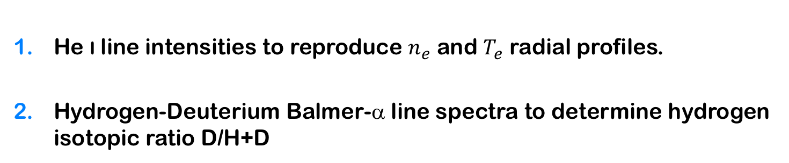
Illustration of ML/DL & Spectroscopy
He i line intensities to reproduce $n_{e}$ and $T_{e}$ radial profiles.
Hydrogen-Deuterium Balmer-α line spectra to determine hydrogen isotopic ratio D/H+D
∣ 14th SCSLSA 2023 ∣ ∣ 20 JUNE 2023 ∣ ∣ M. KOUBITI ∣

Slide 8
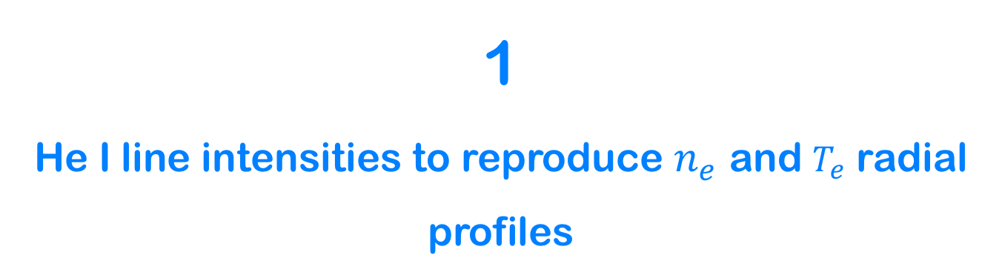
1
He I line intensities to reproduce $n_{e}$ and $T_{e}$ radial profiles
∣ 14th SCSLSA 2023 ∣ ∣ 20 JUNE 2023 ∣ ∣ M. KOUBITI ∣

Slide 9
Neutral Helium (He i) line intensities
E(eV)
Singlet states
Triplet states
3 ¹D
3 ³D
23
3 ¹S
3 ¹P
3 ³P
3 ³S
22
728.1 nm
667.8 nm
706.5 nm
21
2 ¹S
2 ¹P
2 ³P
20
2 ³S
0
1 ¹S
∣ 14th SCSLSA 2023 ∣ ∣ 20 JUNE 2023 ∣ ∣ M. KOUBITI ∣

Slide 10


Plasma characterization using helium line spectra
CRM (Collisional-Radiative Modelling):
Integrate the spectral intensity over λ.
Line intensity ratio technique:
Singlet/Singlet
Singlet/Triplet
E(eV)
Singlet states
Triplet states
3 ¹D
3 ³D
23
3 ¹S
3 ¹P
3 ³P
3 ³S
22
728.1 nm
667.8 nm
706.5 nm
21
2 ¹S
2 ¹P
2 ³P
$$\frac{I_{667.8}}{I_{728.1}} ∝n_{e}$$
20
2 ³S
0
1 ¹S
He I 728.1 nm (2p¹P⁰–3s¹S)
He I 667.8 nm (2p¹P⁰–3d¹D⁰)
He I 706.5 nm (2p³P⁰–3s³S)
$$\frac{I_{728.1}}{I_{706.5}} ∝T_{e}$$
∣ 14th SCSLSA 2023 ∣ ∣ 20 JUNE 2023 ∣ ∣ M. KOUBITI ∣

Slide 11
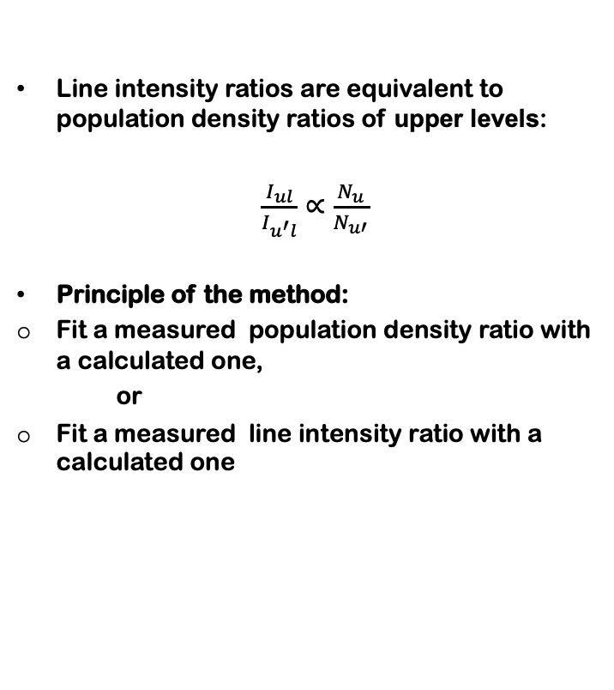
Plasma parameters from line intensity ratios
Line intensity ratios are equivalent to population density ratios of upper levels:
$\frac{I_{ul}}{I_{u^{′}l}}∝\frac{N_{u}}{N_{u′}}$
Principle of the method:
Fit a measured population density ratio with a calculated one,
or
Fit a measured line intensity ratio with a calculated one
From S. Kajita et al 2006 Phys Plasma 13, 013301
∣ 14th SCSLSA 2023 ∣ ∣ 20 JUNE 2023 ∣ ∣ M. KOUBITI ∣

Slide 12
He Beam diagnostics in magnetic fusion devices
RFX (Italy), LHD (Japan), WEST (France), ASDEX (Germany)
PISCES-A linear divertor simulator (USA), NAGDIS-II (Japan)
M. Agostini et al 2018, Review of Scientific Instruments 89 10D102.
M. Goto and K. Sawada 2014, JQSRT 137 23.
O. Jones et al, 43rd EPS plasma physics, P5.022 (http://ocs.ciemat.es/EPS2016PAP/pdf/P5.022.pdf)
M. Griener et al 2018, PPCF 60 025008.
D. Nishijima and E. Hollmann 2007, PPCF 49 791.
S. Kajita et al 2006, Physics of Plasma 13 013301
∣ 14th SCSLSA 2023 ∣ ∣ 20 JUNE 2023 ∣ ∣ M. KOUBITI ∣

Slide 13
Application of ML to He i line intensities
Overcome the difficulties related to the need of sophisticated modeling of the population densities.
Use independent diagnostics (Langmuir probes, Thomson scattering) to validate the model
D. Nishijima, S. Kajita and G. R. Tynan, Review of Scientic Instruments 92 (2021) 023505
S. Kajita et al, PPCF 63 (2021) 055018
∣ 14th SCSLSA 2023 ∣ ∣ 20 JUNE 2023 ∣ ∣ M. KOUBITI ∣

Slide 14
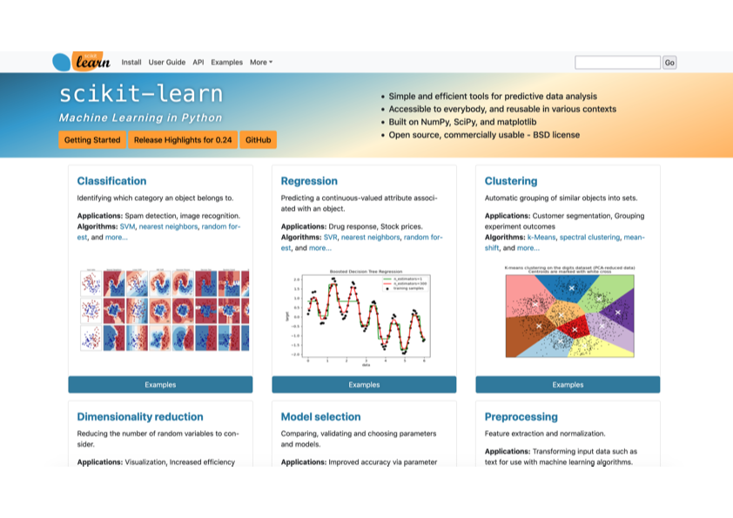
Sickit-Learn: a python-based open-access ML platform
Pedregosa et al., JMLR 12, pp. 2825-2830, 2011 https://scikit-learn.org/stable/index.html
∣ 14th SCSLSA 2023 ∣ ∣ 20 JUNE 2023 ∣ ∣ M. KOUBITI ∣

Slide 15
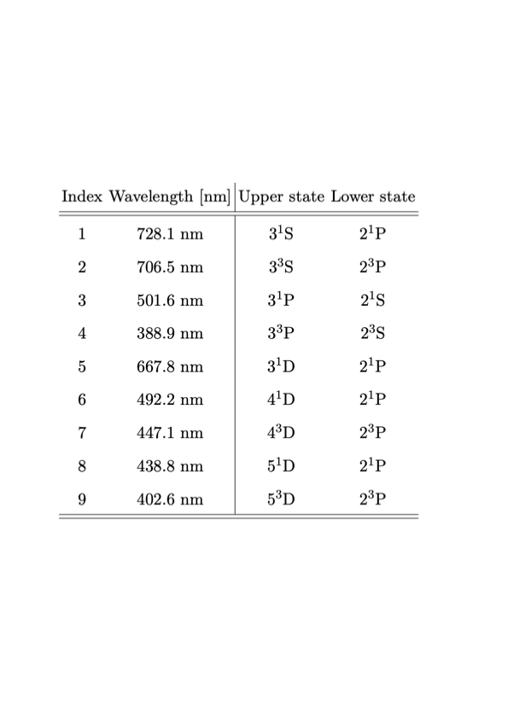
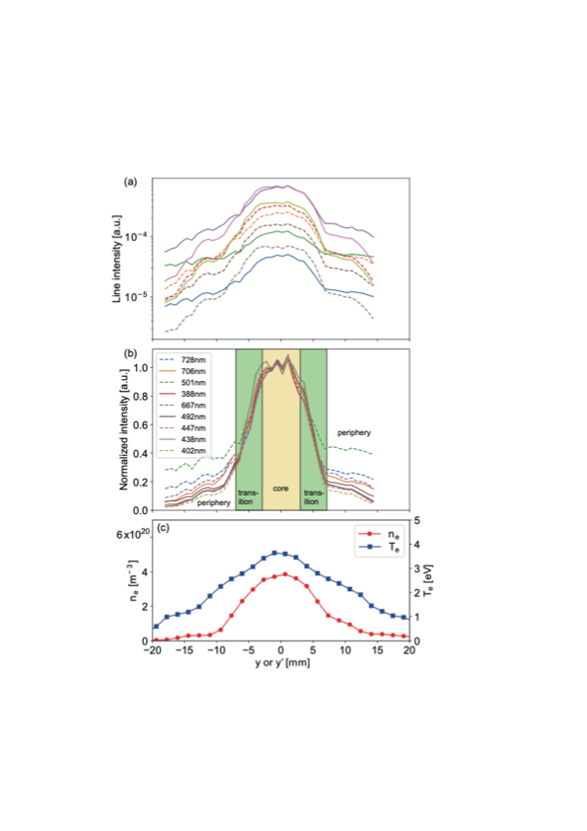
Sickit-Learn applied to He i OES from Magnum-PSI
24 discharges in which 9 He i line spectra were simultaneously measured
Use of Sickit-learn regression module with 16 discharges chosen randomly as training dataset and 8 discharges used for test dataset (validation step).
singlet
triplet
singlet
From S. Kajita et al 2021, PPCF 63 055018
∣ 14th SCSLSA 2023 ∣ ∣ 20 JUNE 2023 ∣ ∣ M. KOUBITI ∣

Slide 16
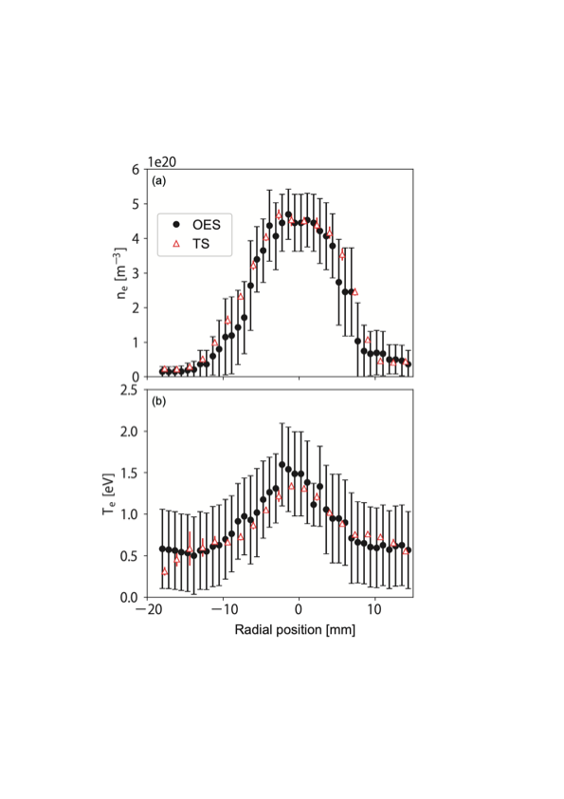
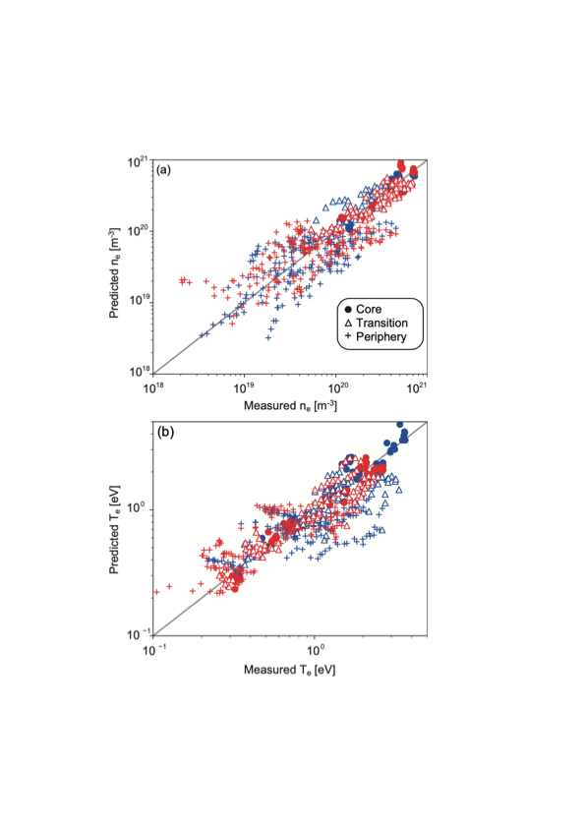
ML predictions for Magnum-PSI
S. Kajita et al, PPCF 63 (2021) 055018
∣ 14th SCSLSA 2023 ∣ ∣ 20 JUNE 2023 ∣ ∣ M. KOUBITI ∣

Slide 17
2
Balmer-α line spectra emitted in tokamak divertors to determine hydrogen isotopic ratios
Objectives: predict isotopic ratios D/H+D or T/D+T from parameters other than spectroscopic ones (paradox!)
∣ 14th SCSLSA 2023 ∣ ∣ 20 JUNE 2023 ∣ ∣ M. KOUBITI ∣

Slide 18
Original plan
Step 1: use Hα/Dα spectra to deduce the isotopic ratio in H-D mixtures
Step 2: repeat step 1 for D-T mixtures.
Step 3: make predictions (e.g., for ITER prior to its operation).
∣ 14th SCSLSA 2023 ∣ ∣ 20 JUNE 2023 ∣ ∣ M. KOUBITI ∣

Slide 19
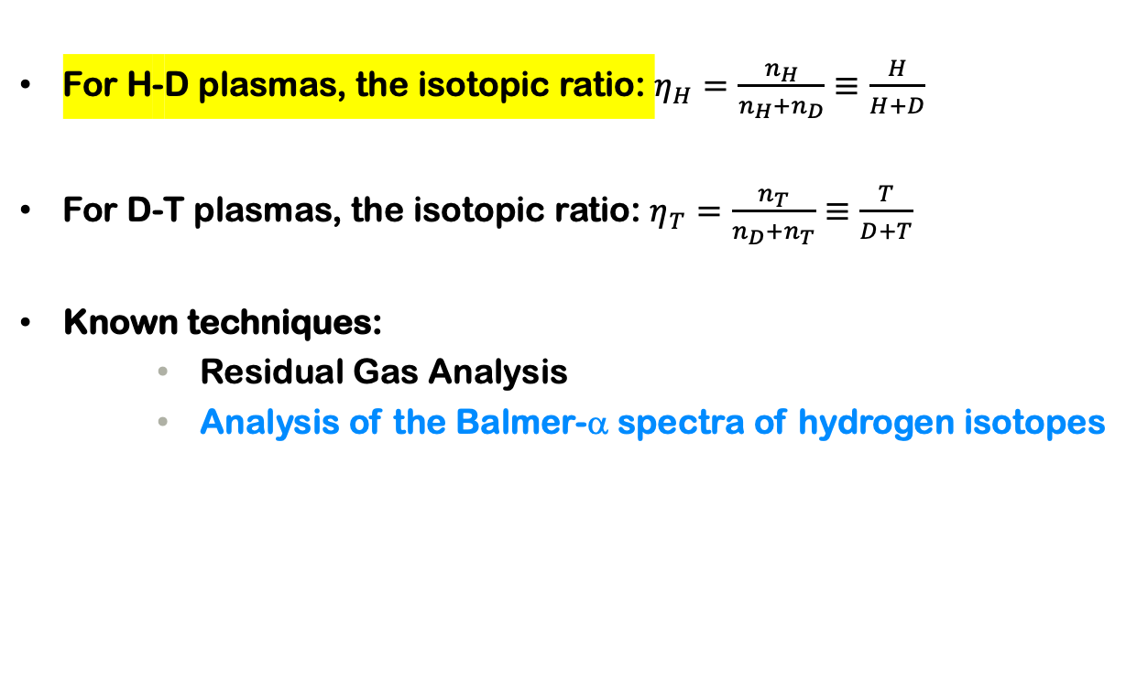
Hydrogen isotopic ratio in fusion plasmas
For H-D plasmas, the isotopic ratio: $η_{H}=\frac{n_{H}}{n_{H}+n_{D}}≡\frac{H}{H+D}$
For D-T plasmas, the isotopic ratio: $η_{T}=\frac{n_{T}}{n_{D}+n_{T}}≡\frac{T}{D+T}$
Known techniques:
  Residual Gas Analysis
  Analysis of the Balmer-α spectra of hydrogen isotopes
∣ 14th SCSLSA 2023 ∣ ∣ 20 JUNE 2023 ∣ ∣ M. KOUBITI ∣

Slide 20
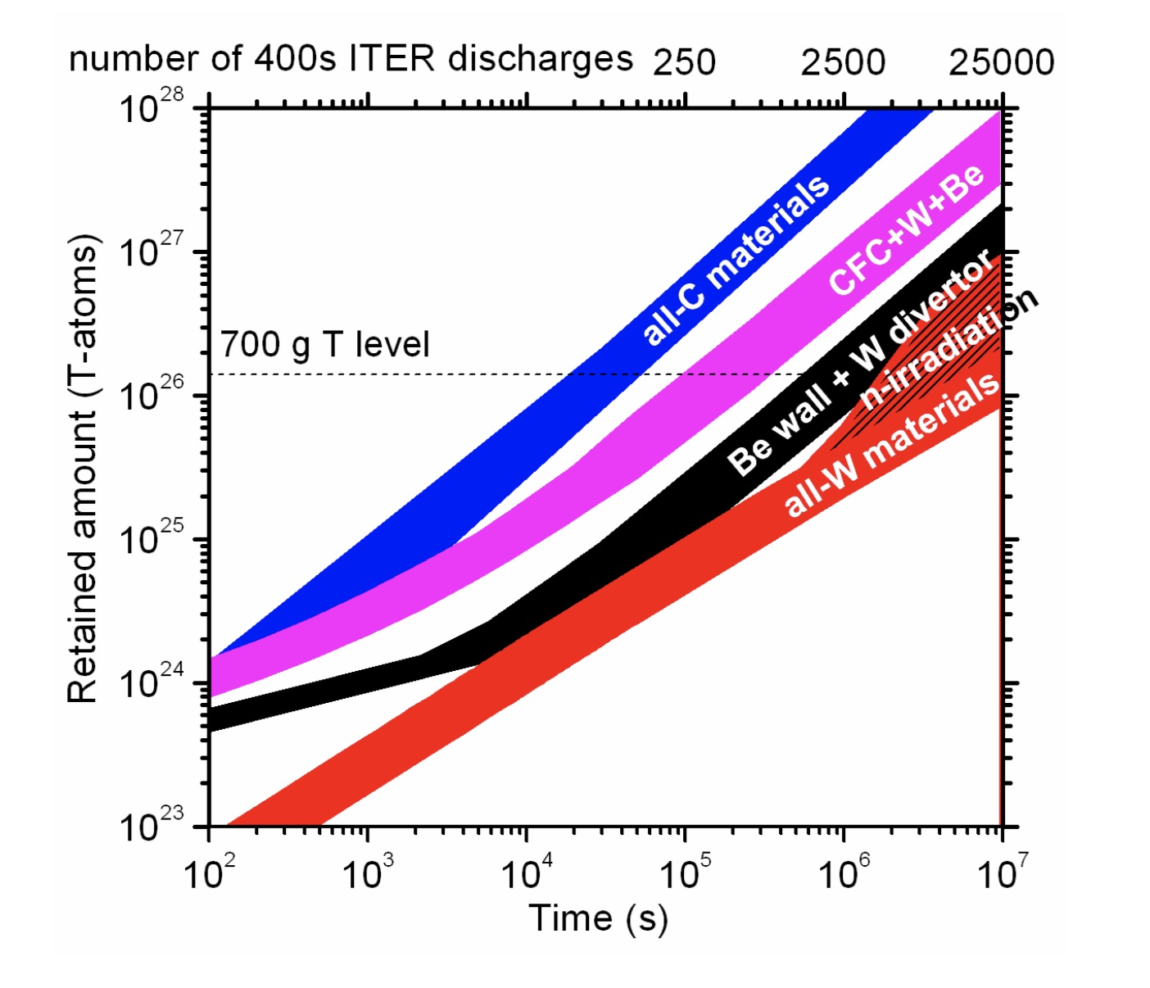
Why it is important to determine the H isotopic ratio
The issue of tritium retention: for Safety reasons, the quantity of tritium is limited by Safety Authorities to about 700g inside ITER.
The control of the fusion plasma performances may require the real-time knowledge of tritium concentration in D-T fusion devices.
Roth et al 2008 PPCF 50, 103001
∣ 14th SCSLSA 2023 ∣ ∣ 20 JUNE 2023 ∣ ∣ M. KOUBITI ∣

Slide 21
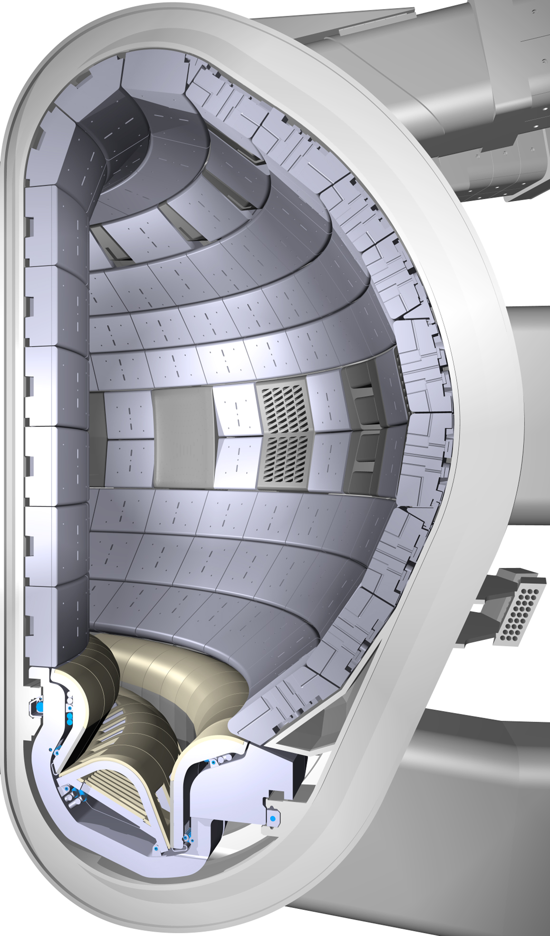
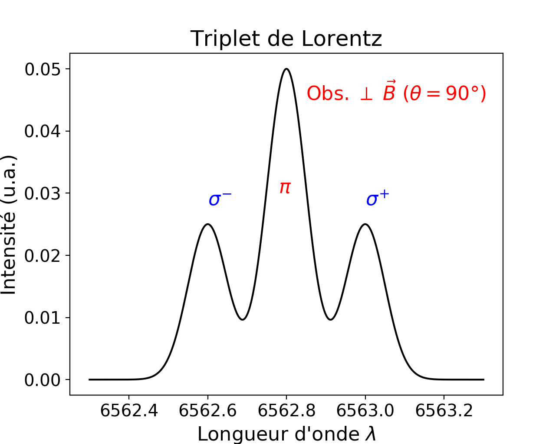
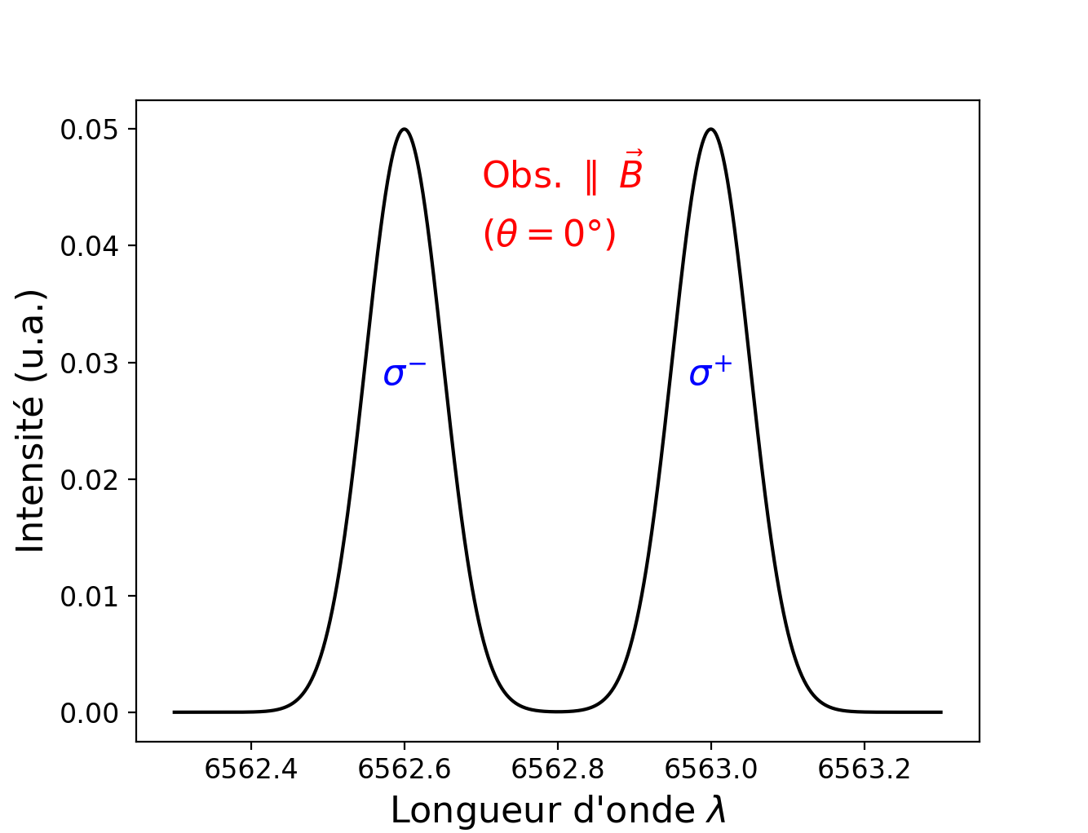
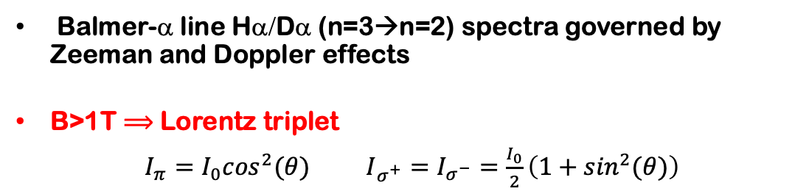
Spectroscopic diagnostics of Tokamak divertor plasmas
Balmer-α line Hα/Dα (n=3→n=2) spectra governed by Zeeman and Doppler effects
B>1T $⟹$ Lorentz triplet
$I_{π}=I_{0}\cos^{2}(θ)$ $I_{σ^{+}}=I_{σ^{−}}=\frac{I_{0}}{2}\left(1+\sin^{2}(θ)\right)$
Divertor
T_{e}〜1-100 eV
n_{e}〜10¹³- 10¹⁴ cm⁻³
Recycling → coexistence of several neutral populations produced by chemical and physical sputtering
∣ 14th SCSLSA 2023 ∣ ∣ 20 JUNE 2023 ∣ ∣ M. KOUBITI ∣

Slide 22
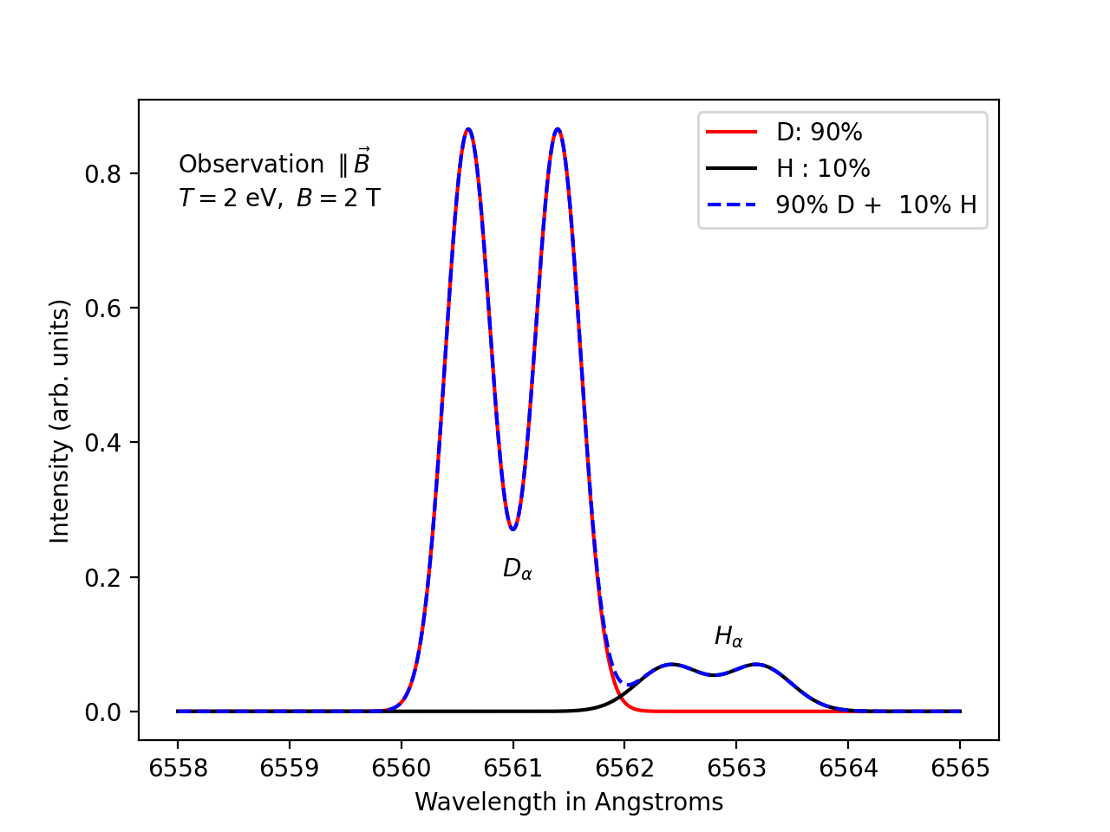
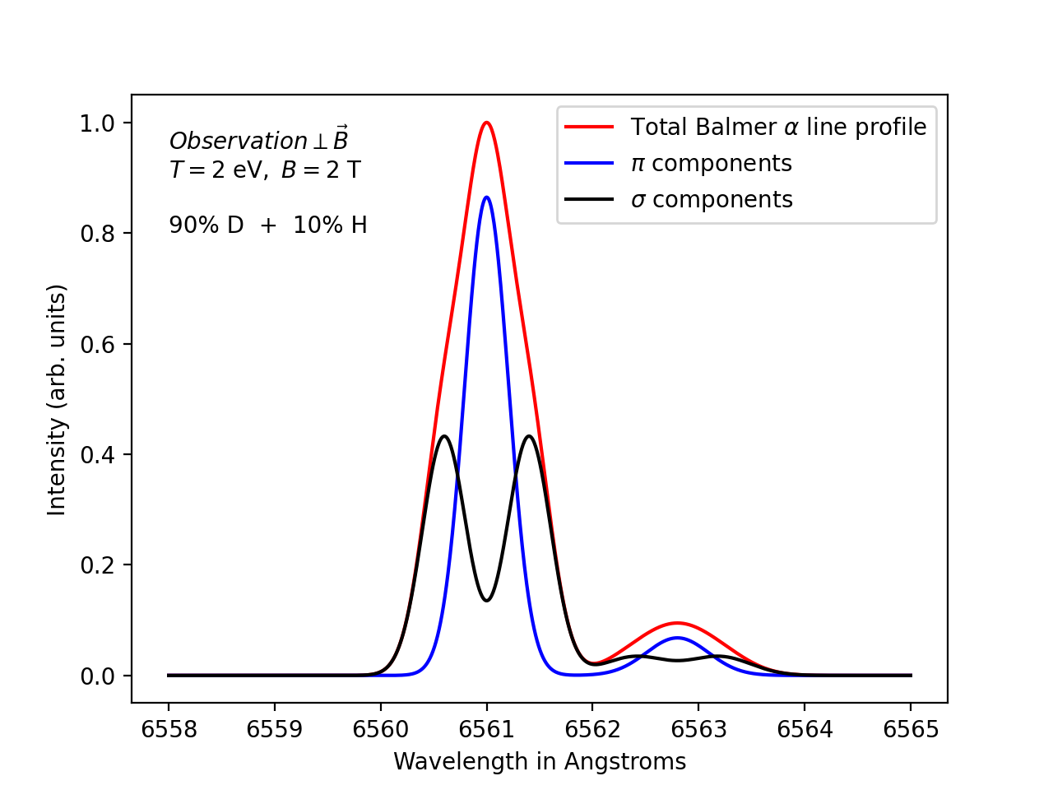
Hα/Dα line profile of cold atoms (90%D+10%H mixture)
Hα/Dα/Tα have the following wavelengths: 6562.8 Å, 6561.04 Å, and 6560.45 Å
Hα/Dα: Δλ~1.8 Å but Dα/Tα: Δλ~0.6 Å
M. Koubiti and M. Kerebel 2022 Appl. Sci. 12 9891
∣ 14th SCSLSA 2023 ∣ ∣ 20 JUNE 2023 ∣ ∣ M. KOUBITI ∣

Slide 23
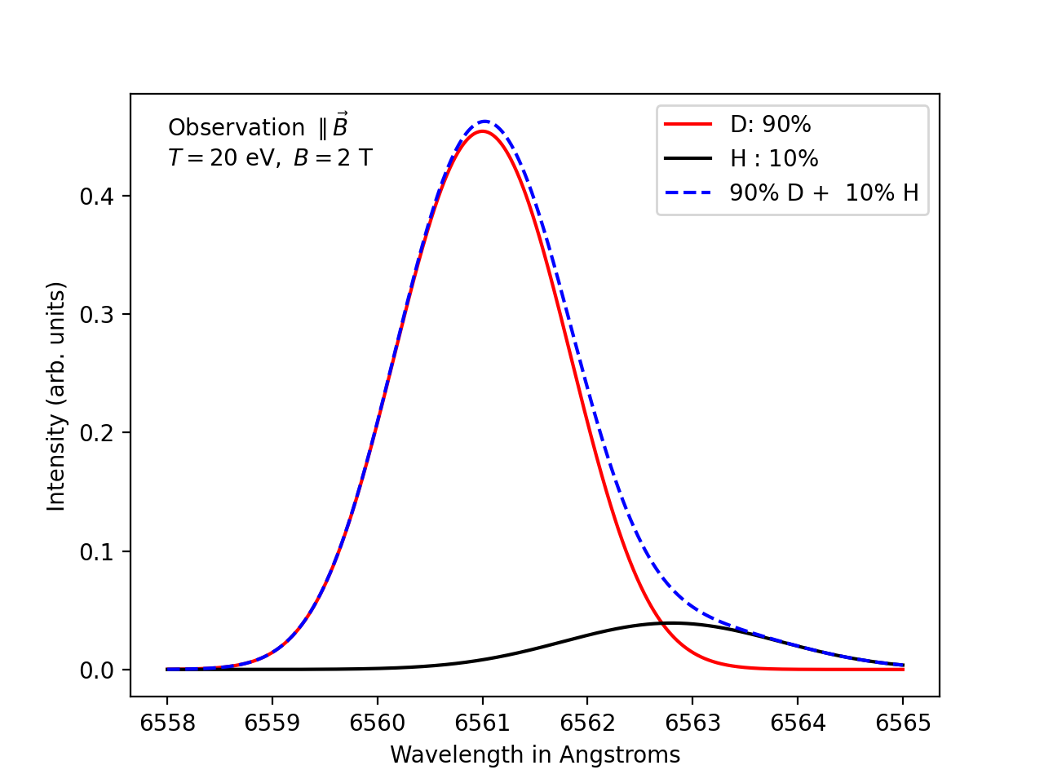
Hα/Dα line profile of warm atoms (90%D+10%H mixture)
∣ 14th SCSLSA 2023 ∣ ∣ 20 JUNE 2023 ∣ ∣ M. KOUBITI ∣

Slide 24
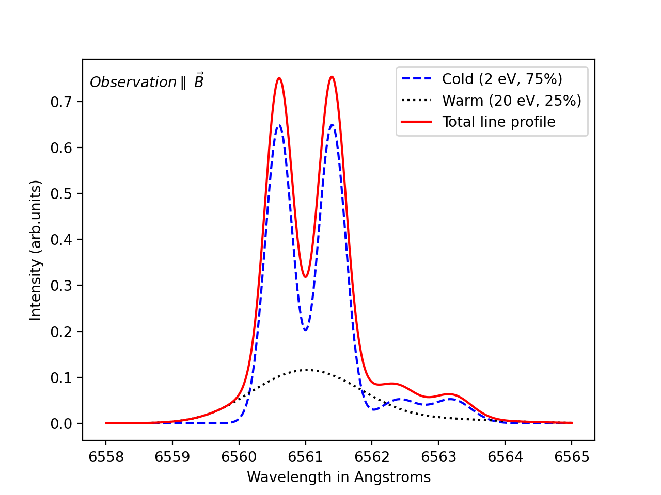
Hα/Dα line profile calculated for two populations
∣ 14th SCSLSA 2023 ∣ ∣ 20 JUNE 2023 ∣ ∣ M. KOUBITI ∣

Slide 25
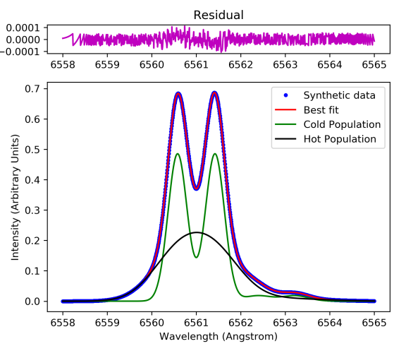
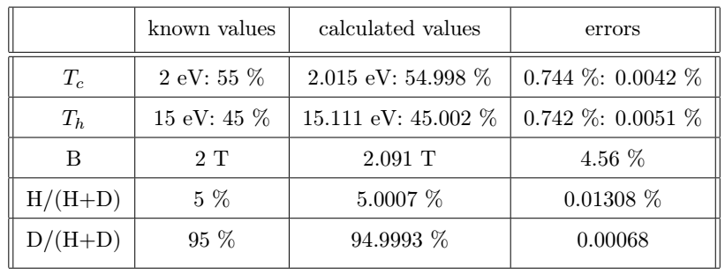
Getting the H/H+D ratio by fitting a synthetic Hα/Dα line spectrum: an optimization issue
Hot or warm (same)
∣ 14th SCSLSA 2023 ∣ ∣ 20 JUNE 2023 ∣ ∣ M. KOUBITI ∣

Slide 26
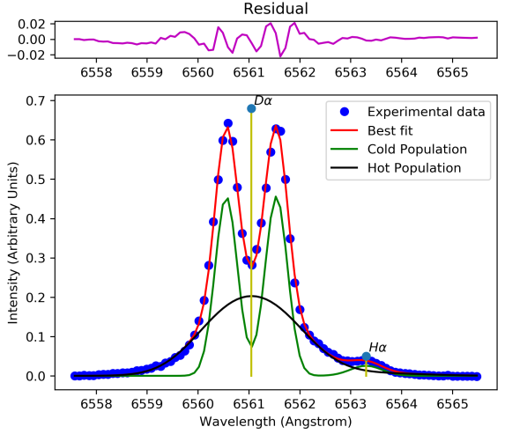
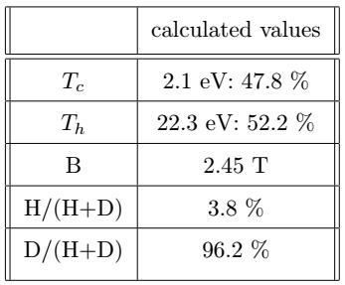
Getting the H/H+D ratio by fitting an experimental Hα/Dα line spectrum
Hot=warm
∣ 14th SCSLSA 2023 ∣ ∣ 20 JUNE 2023 ∣ ∣ M. KOUBITI ∣

Slide 27
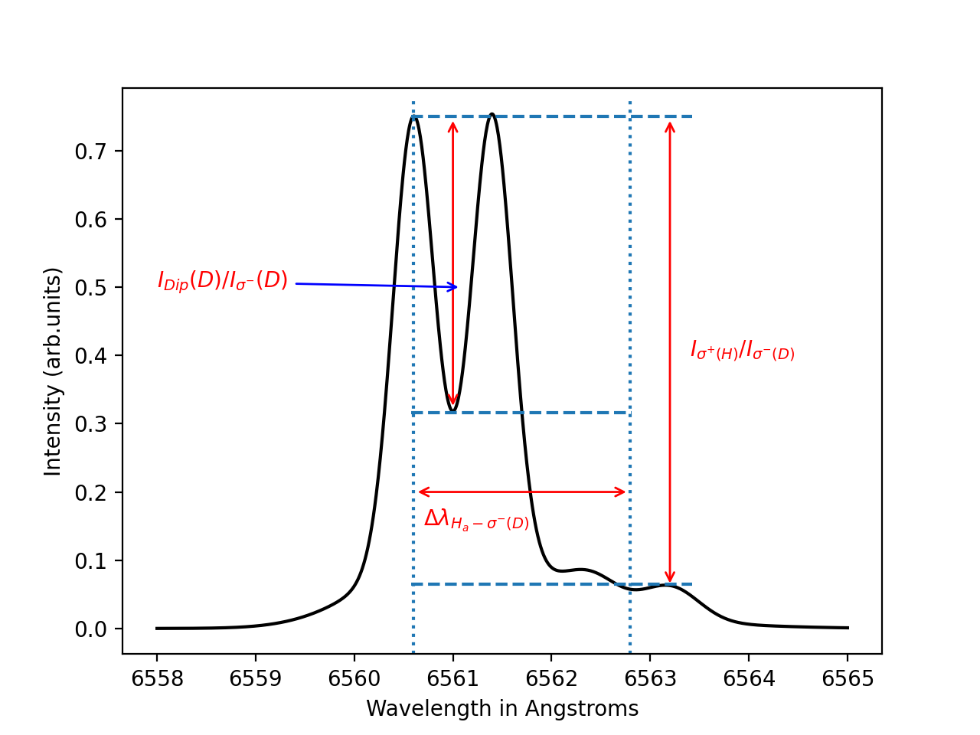

Getting H/H+D ratio using an alternative method
Use a DL algorithm combined with few spectroscopic features (instead of whole spectra) to determine the H/H+D ratios:
B-field
Neutral temperatures T_{c} and T_{w}
Wavelength separation: ${Δλ}_{H_{α}−σ^{−}(D)}$
Peak-to-peak intensity ratio: $I_{σ^{+}(H)}/I_{σ^{−}(D)}$
Dip-to-peak intensity ratio: $I_{ Dip(D)}/I_{σ^{−}(D)}$
∣ 14th SCSLSA 2023 ∣ ∣ 20 JUNE 2023 ∣ ∣ M. KOUBITI ∣

Slide 28
Generation of synthetic spectra and extraction of input features for the DL algorithm
Synthetic spectra were generated by varying the H/H+D, the B-field and the neutral population temperatures and fractions
B in the range 1-5 T
(100-x)%D-x%H mixtures where x varies between 1% and 25%
Varied neutral temperatures 2±0.2 eV & 20±2 eV
200 000 profiles for training & 2000 profiles for validation
Preprocessing code to extract the DL input features: The code determines the spectral minima and maxima and then calculate the input features (wavelength separation, peak-to-peak and dip-to-peak intensity ratios) for DL algorithm.
∣ 14th SCSLSA 2023 ∣ ∣ 20 JUNE 2023 ∣ ∣ M. KOUBITI ∣

Slide 29
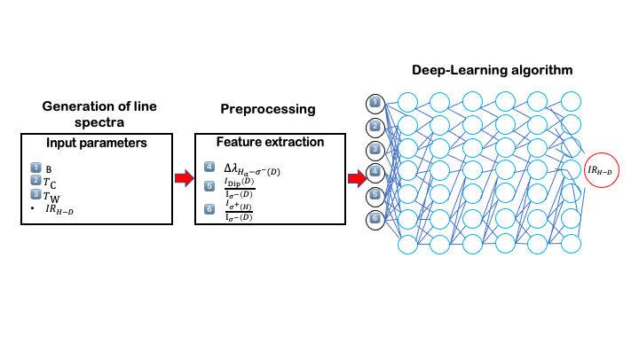

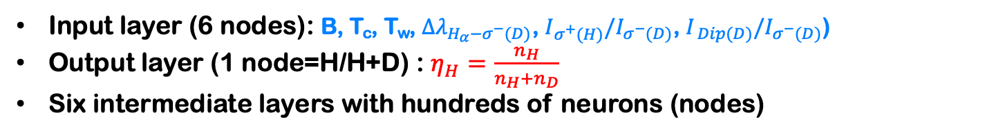
Application of a DL algorithm: TensorFlow ML platform
Input layer (6 nodes): B, T_{c}, T_{w}, ${Δλ}_{H_{α}−σ^{−}(D)}$, $I_{σ^{+}(H)}/I_{σ^{−}(D)}$, $I_{ Dip(D)}/I_{σ^{−}(D)}$)
Output layer (1 node=H/H+D) : $η_{H}=\frac{n_{H}}{n_{H}+n_{D}}$
Six intermediate layers with hundreds of neurons (nodes)
M. Koubiti and M Kerebel 2022 Appl. Sci. 12 9891
https://www.tensorflow.org/guide
https://keras.io/api/optimizers/adam/
∣ 14th SCSLSA 2023 ∣ ∣ 20 JUNE 2023 ∣ ∣ M. KOUBITI ∣

Slide 30
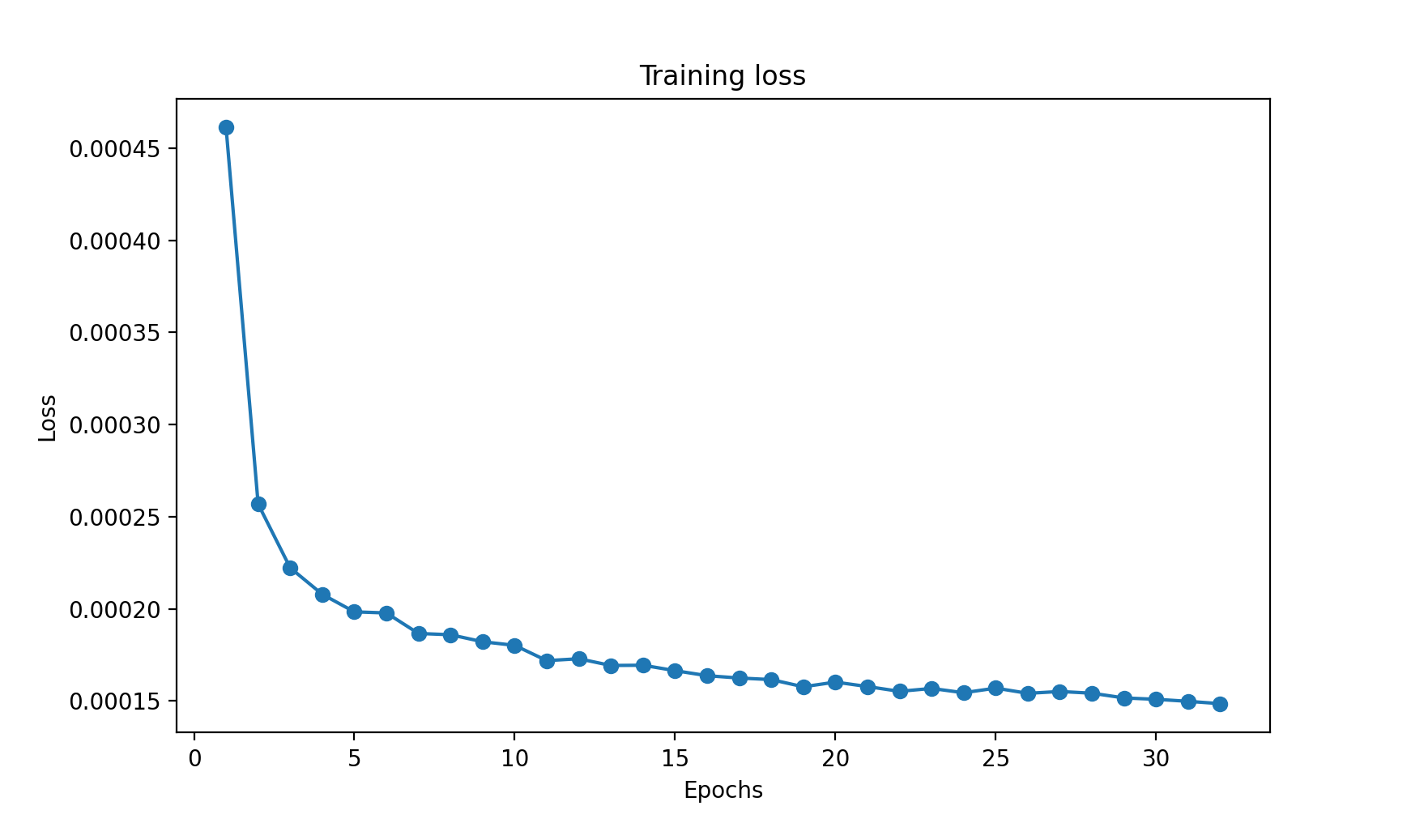
Loss function for the Keras ADAM optimizer
ADAM optimizer: https://keras.io/api/optimizers/adam/
∣ 14th SCSLSA 2023 ∣ ∣ 20 JUNE 2023 ∣ ∣ M. KOUBITI ∣

Slide 31
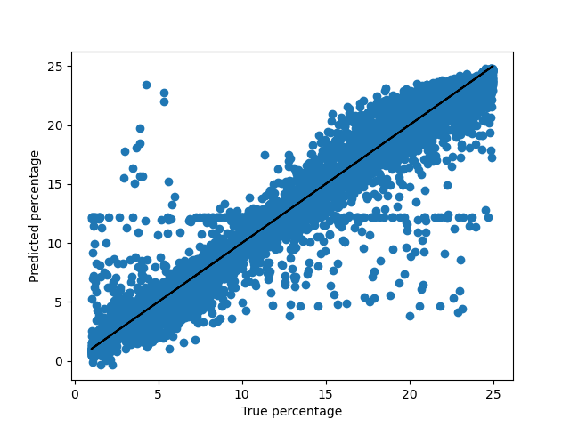
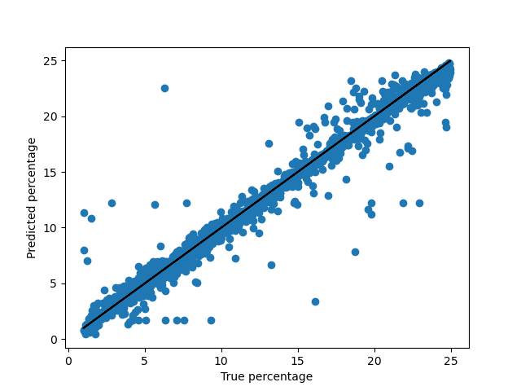
H/H+D predictions for noisy synthetic spectra
Training
Validation
MSE: 7.6% Median error: 2.4%
MSE: 7.9% Median error: 2.6%
These errors are not inherent to the DL algorithm but to the inaccuracy in the extraction of the spectroscopic features by the preprocessing code (maxima determination).
∣ 14th SCSLSA 2023 ∣ ∣ 20 JUNE 2023 ∣ ∣ M. KOUBITI ∣

Slide 32
Application to an experimental spectrum
Isotopic ratio of hydrogen from the spectral fit: 3.8%
Isotopic ratio predicted by the DL algorithm: 4.4%
Relative error of about 15%.
∣ 14th SCSLSA 2023 ∣ ∣ 20 JUNE 2023 ∣ ∣ M. KOUBITI ∣

Slide 33
Updated plan
Step 1: use Hα/Dα spectra to deduce the isotopic ratio in H-D mixtures
Step 2: repeat step 1 for D-T mixtures. The Tα line being very close to Dα, dips and peaks are often not resolved to extract from spectra the input features for the DL algorithm
Step 2a: Identify and use non-spectroscopic parameters that can be measured in real-time as input features for DL regression algorithm to determine D/H+D ratios
Step 2b: Extend to D-T plasmas
Step 4: make predictions (e.g., for ITER prior to its operation).
∣ 14th SCSLSA 2023 ∣ ∣ 20 JUNE 2023 ∣ ∣ M. KOUBITI ∣

Slide 34
SUMMARY
A method combining ANN algorithm with spectroscopic characteristics of the Hα/Dα line is proposed for the D/H+D isotopic ratio determination.
The proof-of-principle of the method was demonstrated through the use of a set of ~200 000 profiles for typical conditions of tokamak divertors.
A lot of work remains to be done before reaching the objectives:
  Extend and refine the conditions of divertors, improve the preprocessing code and generalize to available multi-machine experimental data.
  Do without spectroscopy: identify and use parameters (other than spectroscopic, measured in real-time) as input features for the DL regression algorithm to determine D/H+D ratios.
  Make predictions to both H-D and D-T plasmas
  “Can the use of AI with spectroscopy lead to its end?”
∣ 14th SCSLSA 2023 ∣ ∣ 20 JUNE 2023 ∣ ∣ M. KOUBITI ∣

Slide 35

Acknowledgement to the Federation of Research on Magnetically Confined Fusion for the funding
THANK YOU FOR YOUR ATTENTION
∣ 14th SCSLSA 2023 ∣ ∣ 20 JUNE 2023 ∣ ∣ M. KOUBITI ∣

