Slide 1
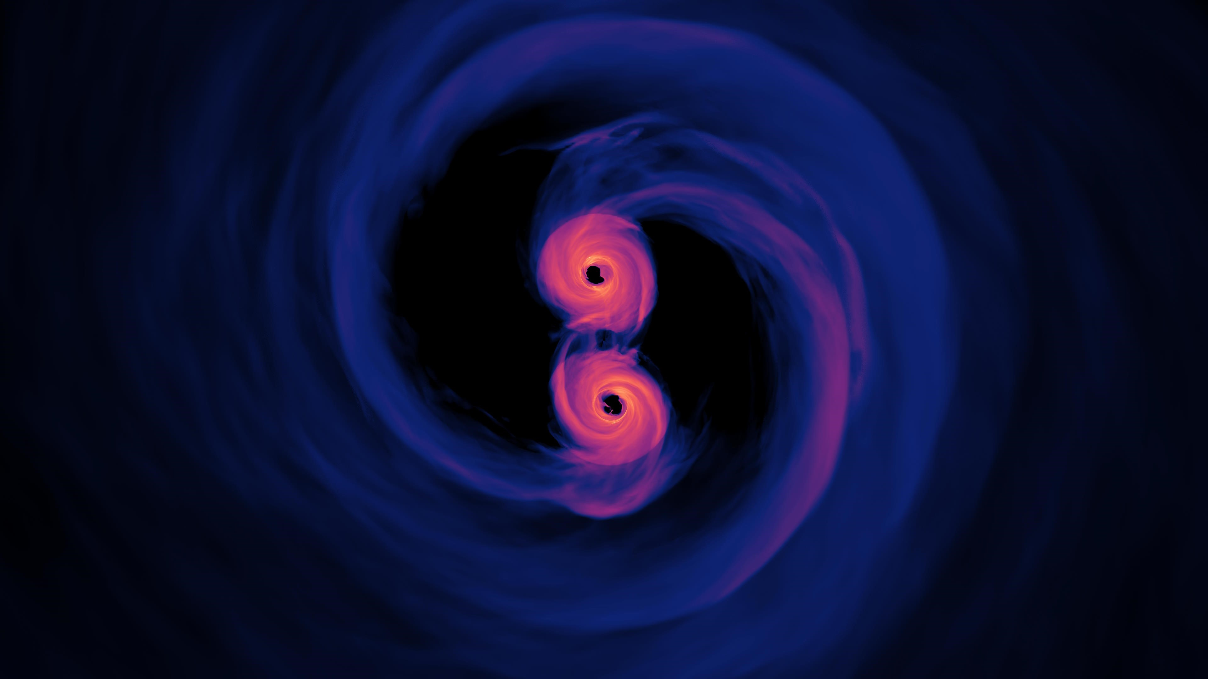
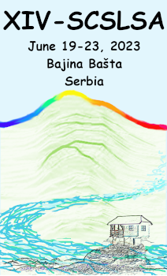
Resolving close binaries of supermassive black holes
in the era of optical interferometry
Yu-Yang Songsheng
Institute of High Energy Physics, Chinese Academy of Sciences
Bajina Basta, June 2023, 14th SCSLSA
Notes:
Thank you every one here. I am Yu-Yang Songsheng from Institute of High Energy Physics, Chinese Academy of Sciences. I am very glad to have the opportunity to introduce our progress on resolving close binaries of supermassive black holes in the era of optical interferometry.

Slide 2
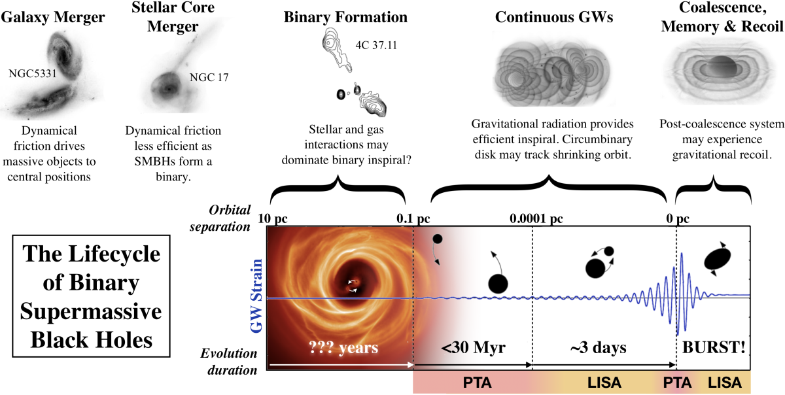
CB-SMBHs and gravitational waves
Burke-Spolaor+ 2018

Slide 3
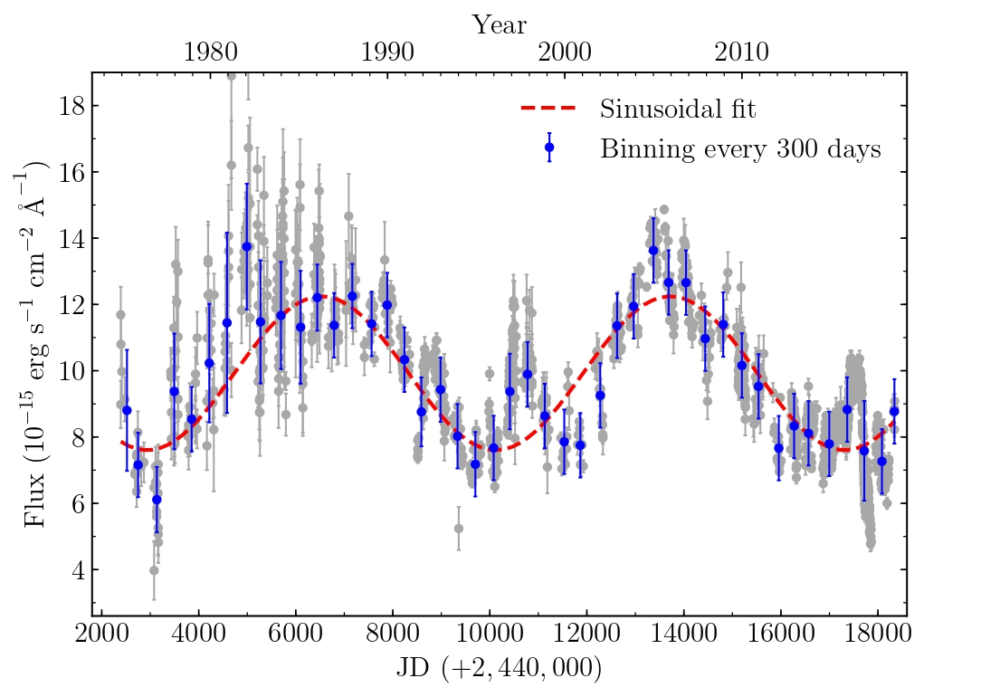
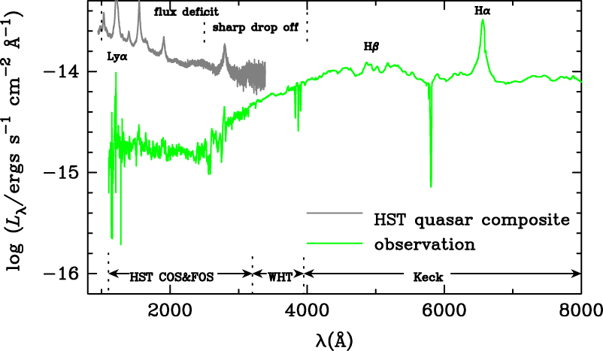
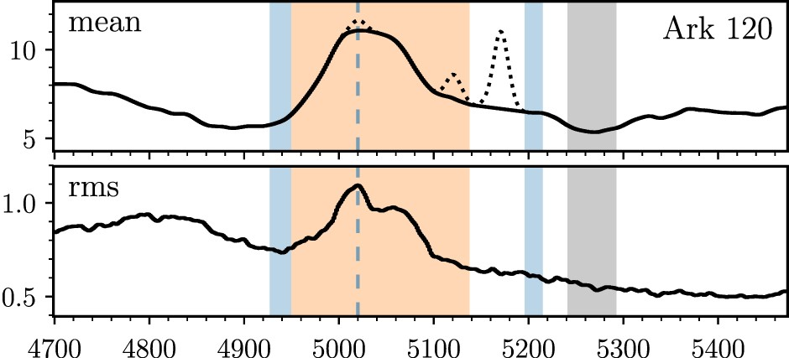
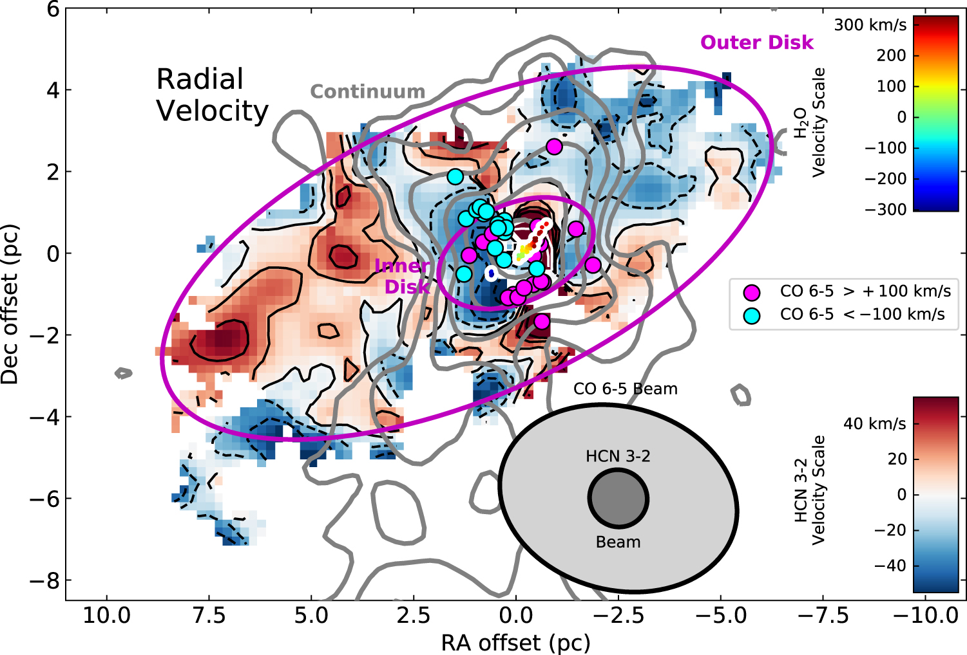
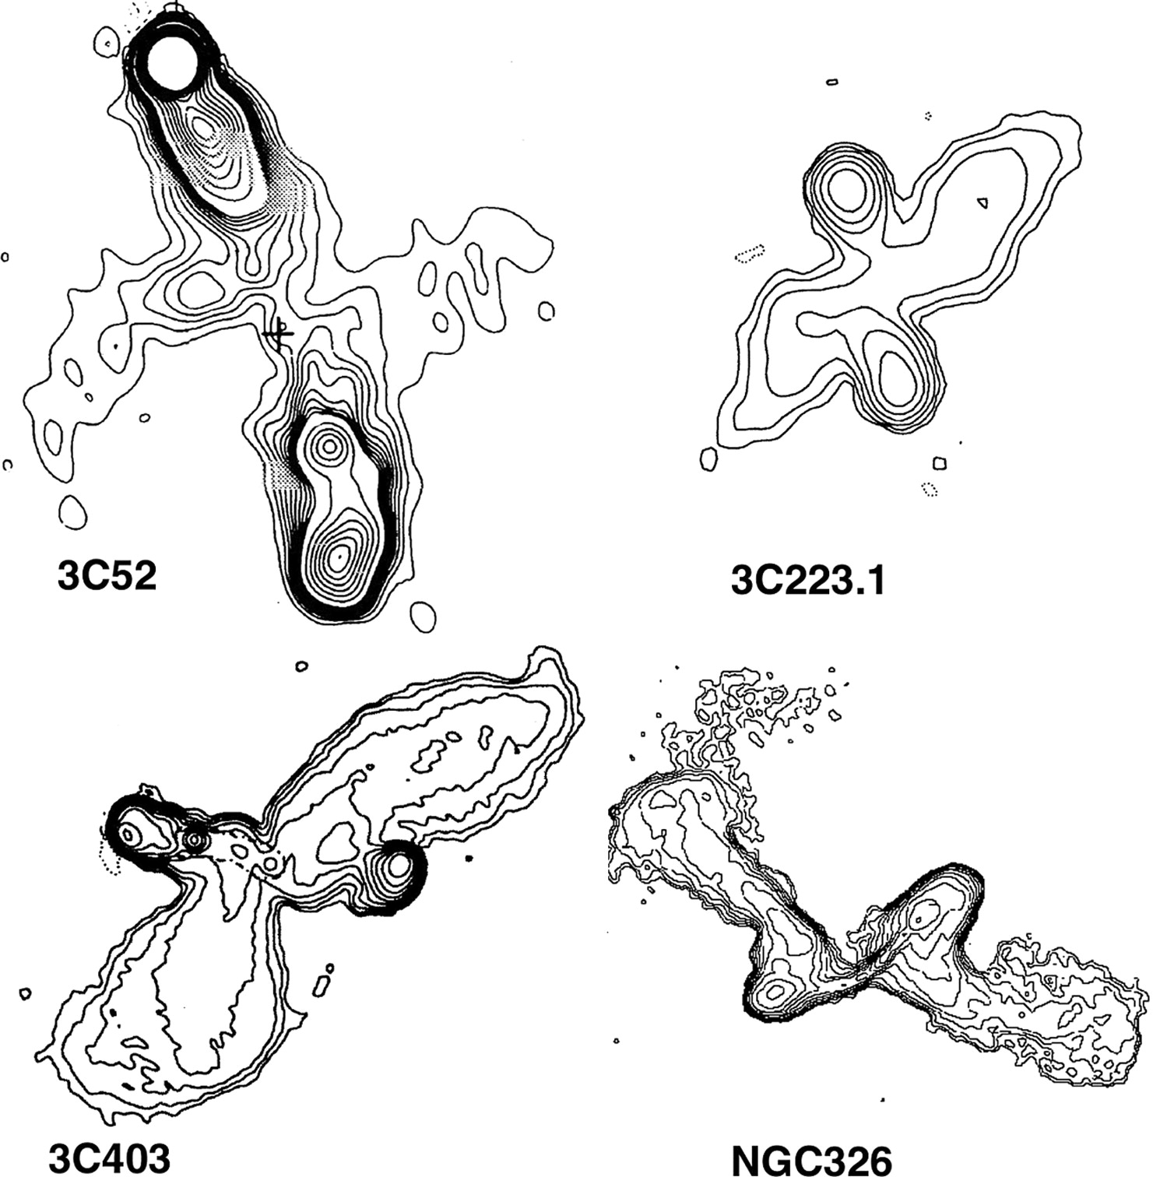
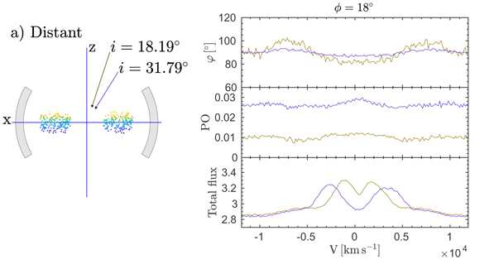
Electromagnetic signatures of CB-SMBHs
periodic variations (Li+ 2019)
profile asymmetry (Du+ 2018)
ultraviolet deficit (Yan+ 2014)
counterotating disks (Wang+ 2020)
X-shaped radio lobe (Merritt+ 2002)
Polarization (Savic+ 2019)

Slide 4
Current problems
Rule out other explanations
  Fake periodic variations caused by damped random walk
  Profile asymmetries caused by complex BLR
Measuring orbital parameters
  Degeneracies between parameters
  Information of gas dynamics
Rule out other explanations
  Fake periodic variations caused by damped random walk
  Profile asymmetries caused by complex BLR
Measuring orbital parameters
  Degeneracies between parameters
  Information of gas dynamics
Detecting dynamics of gas around CB-SMBHs with high precision and reconstruct the gravitational field of the binary

Slide 5
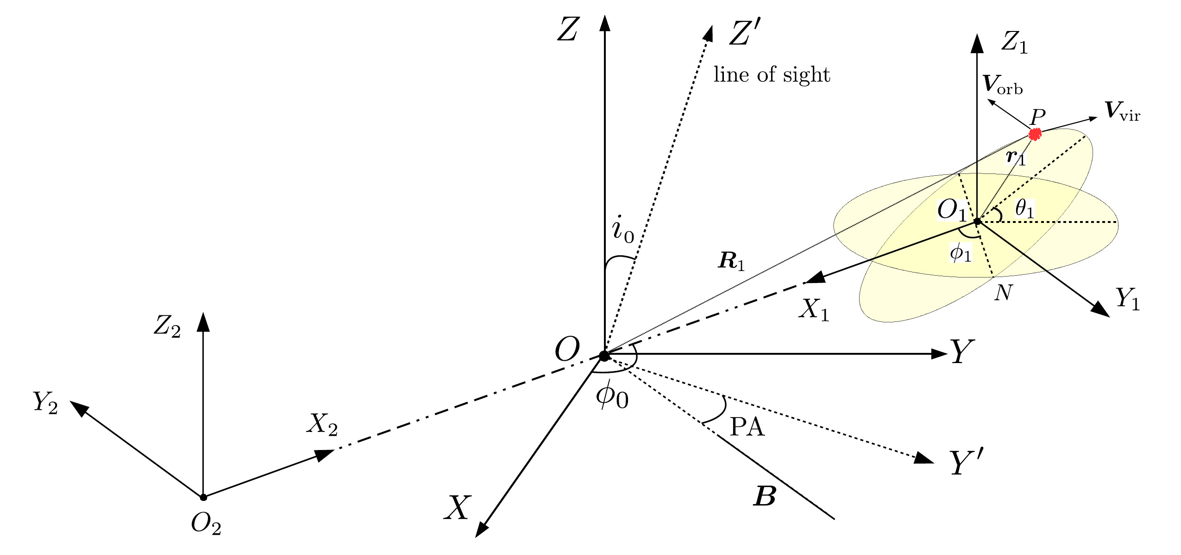
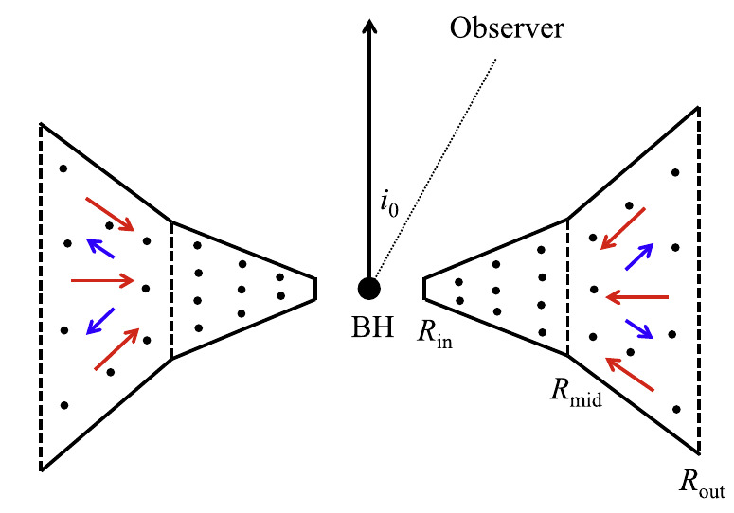
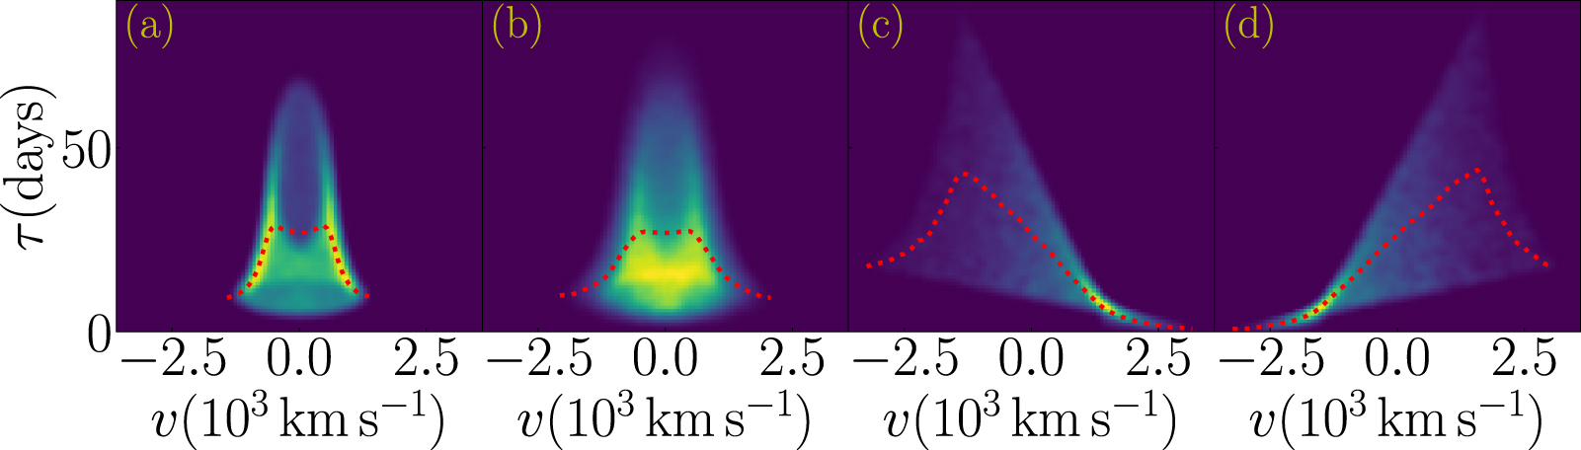
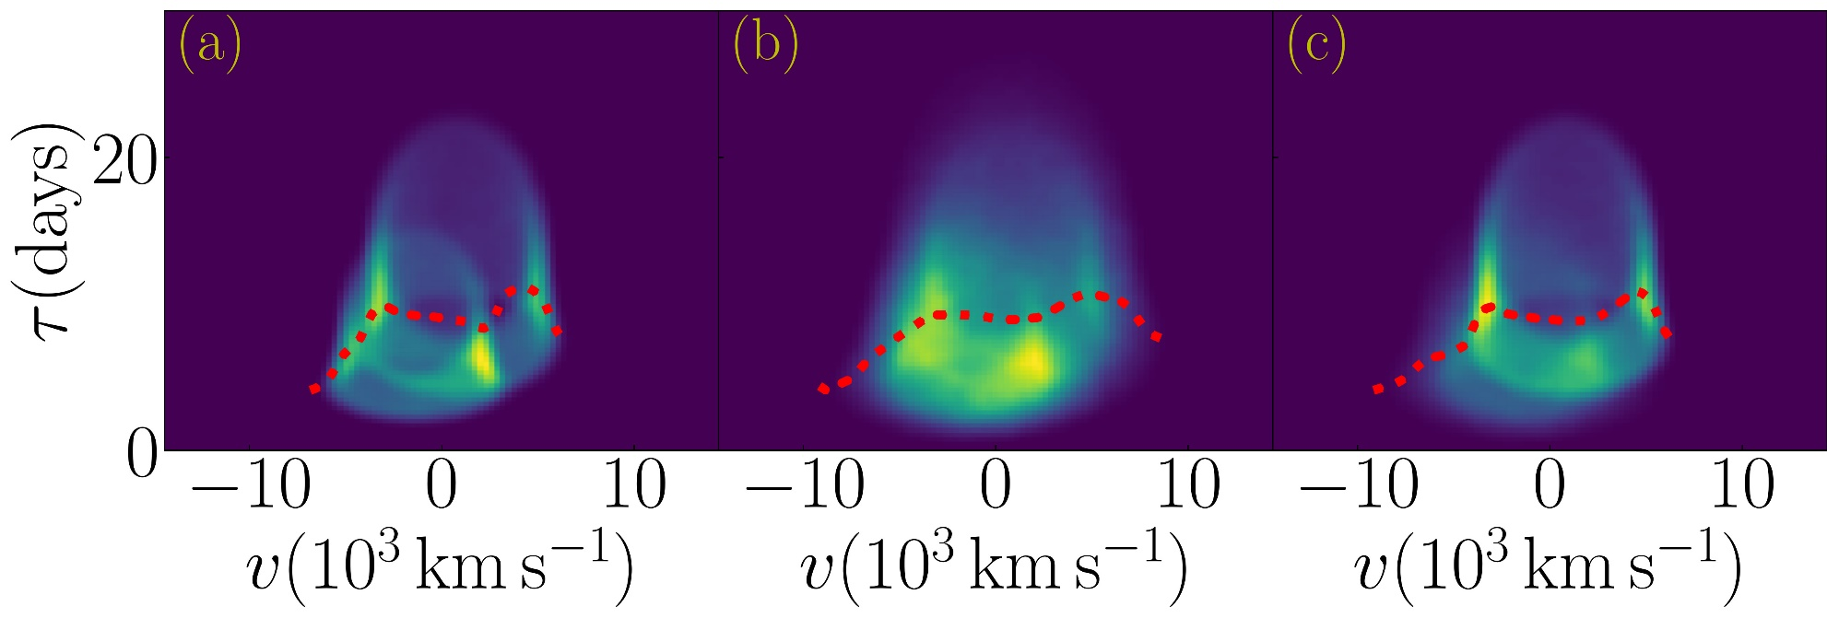
Traditional method: reverberation mapping
Wang+ 2018
Single BH
Binary BH

Slide 6
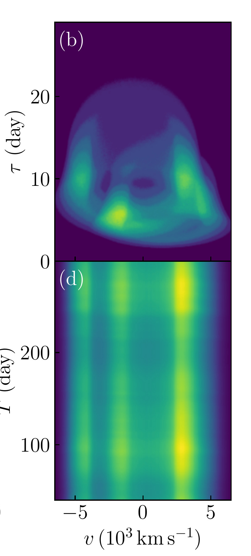
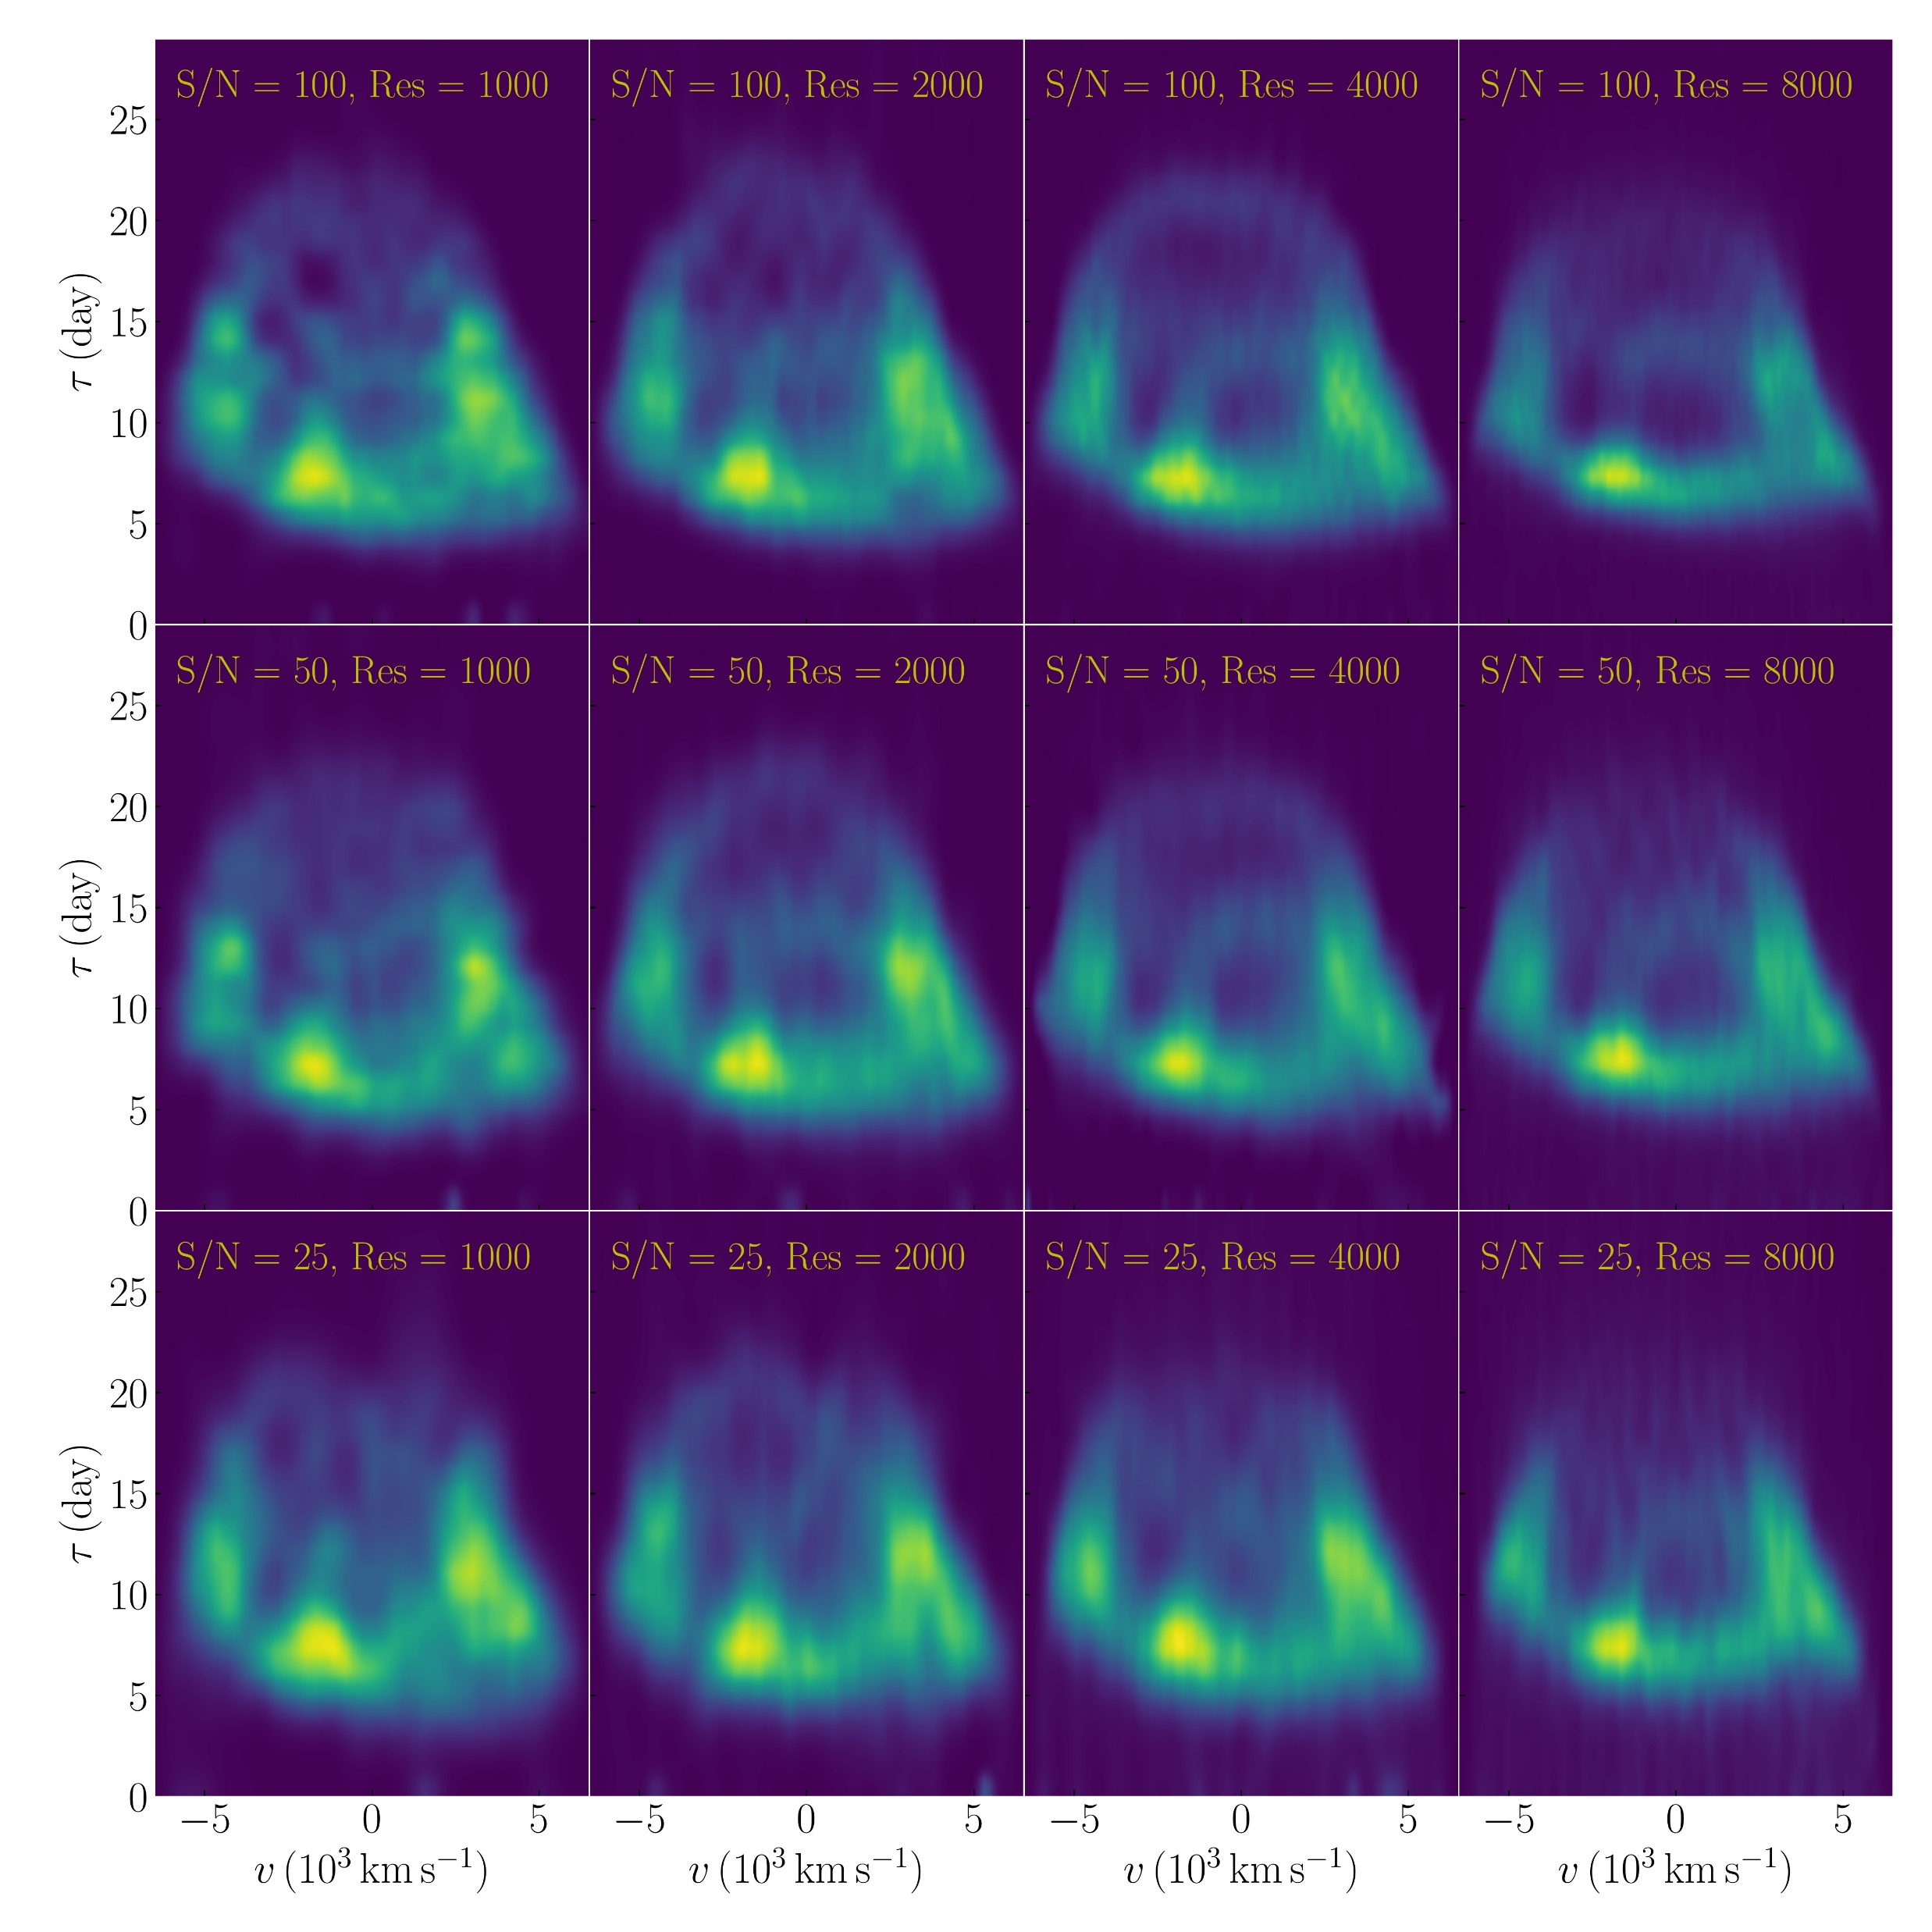
Reconstructing 2D transfer function from mock data
Songsheng+ 2020
maximum entropy

Slide 7
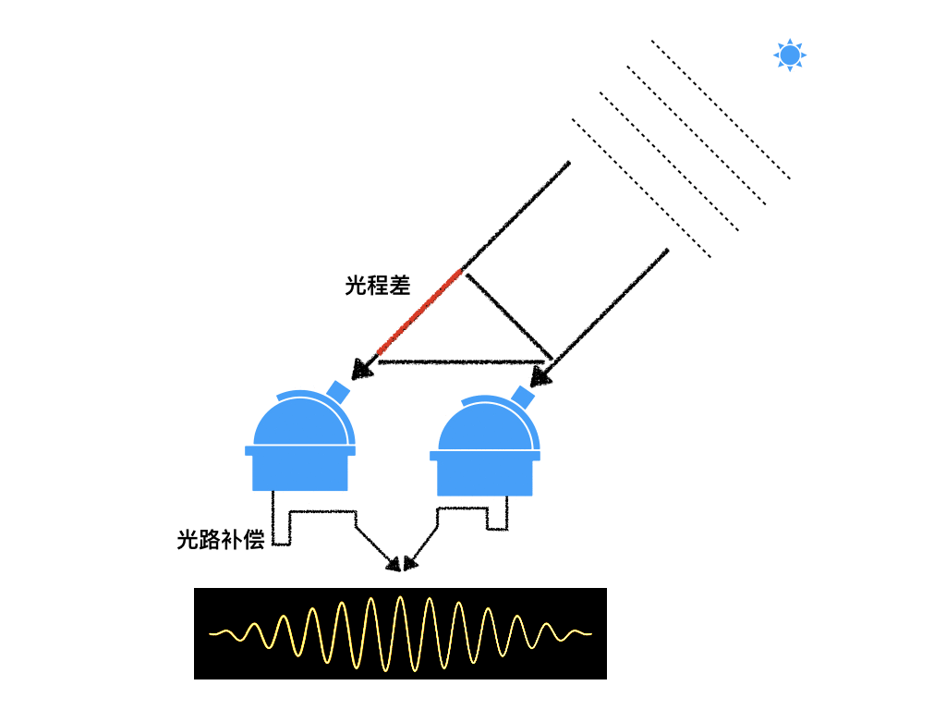
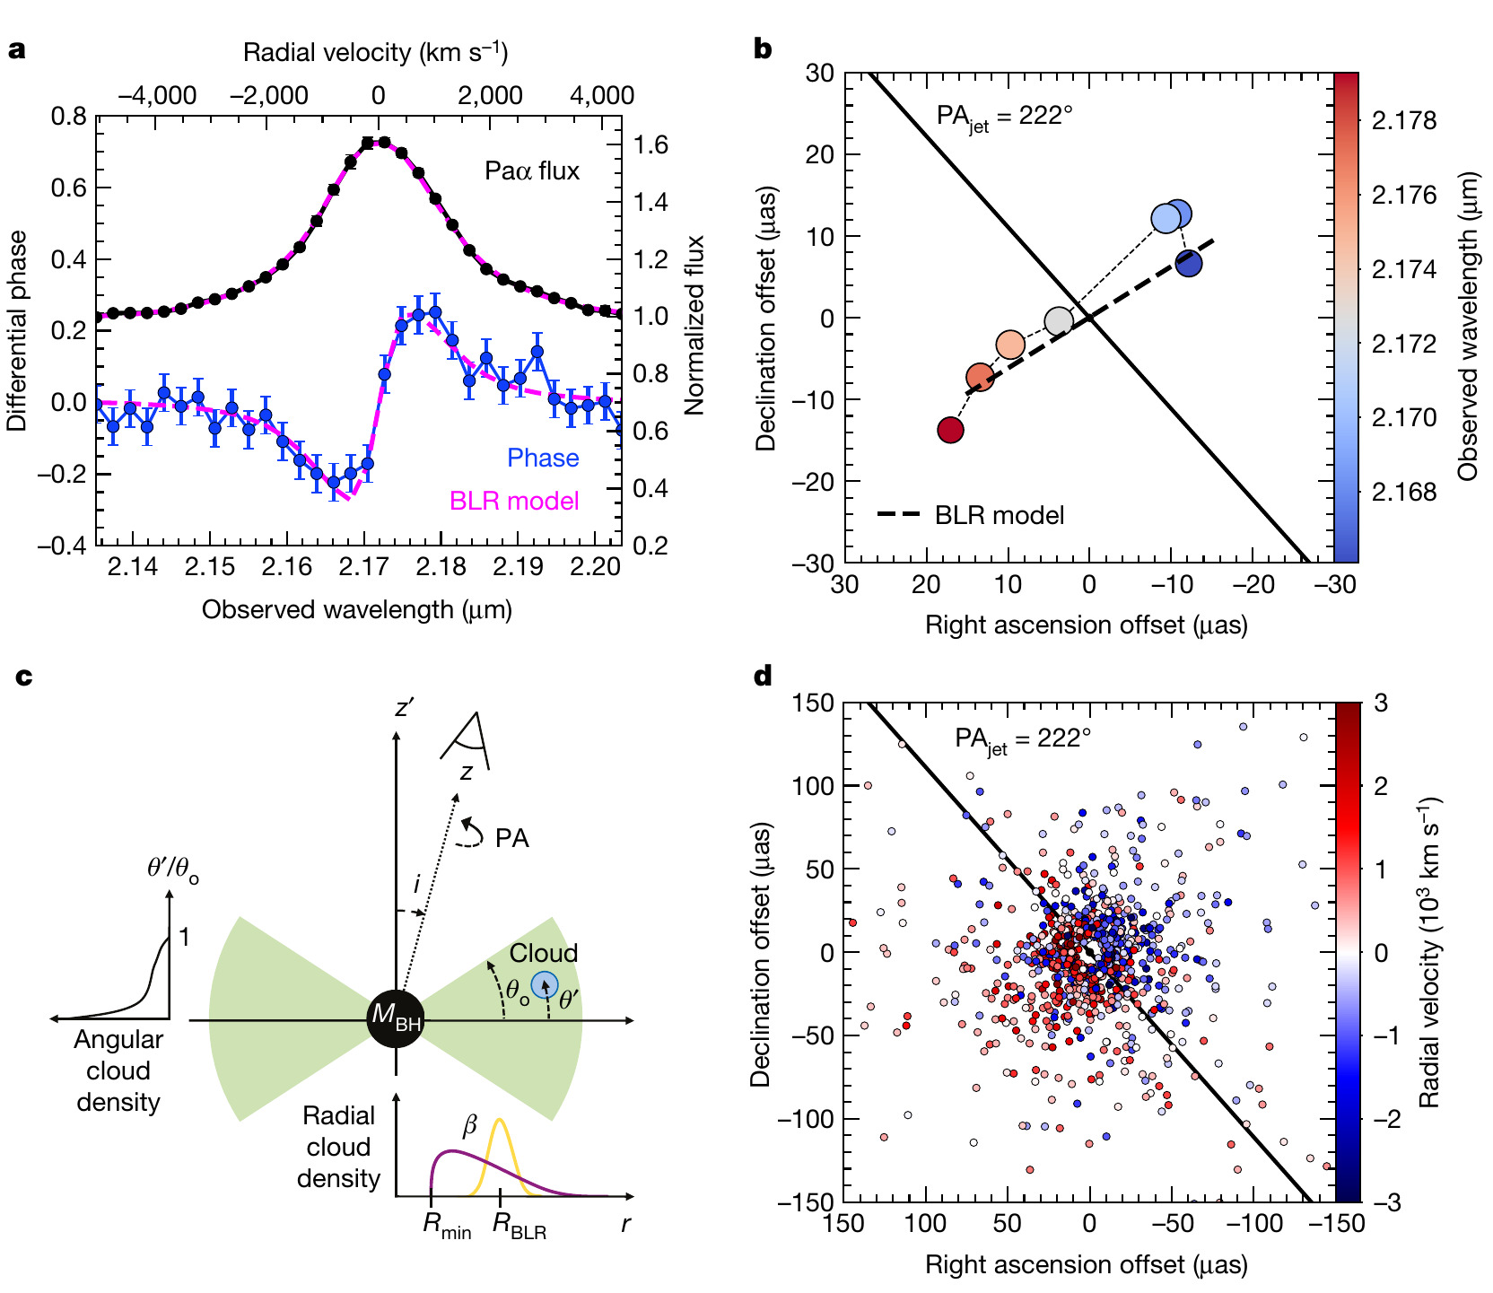
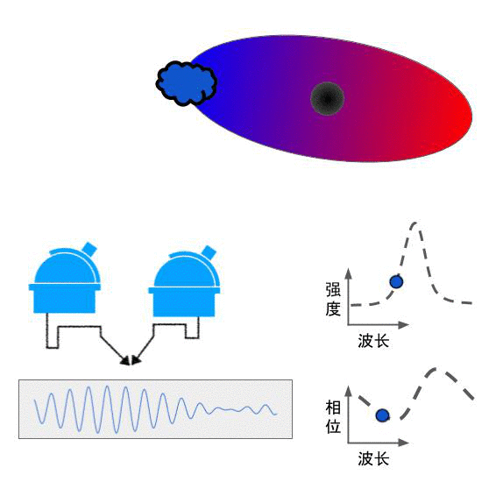
New method: optical interferometry
GRAVITY Collaboration+ 2018
Resolving BLR of 3C 273

Slide 8


Interferometric signatures of CB-SMBH
Songsheng+ 2019
BLR
BLR1
BLR2
$$v_{los}$$
BH
Phase
Phase
Wavelength
Wavelength

Slide 9
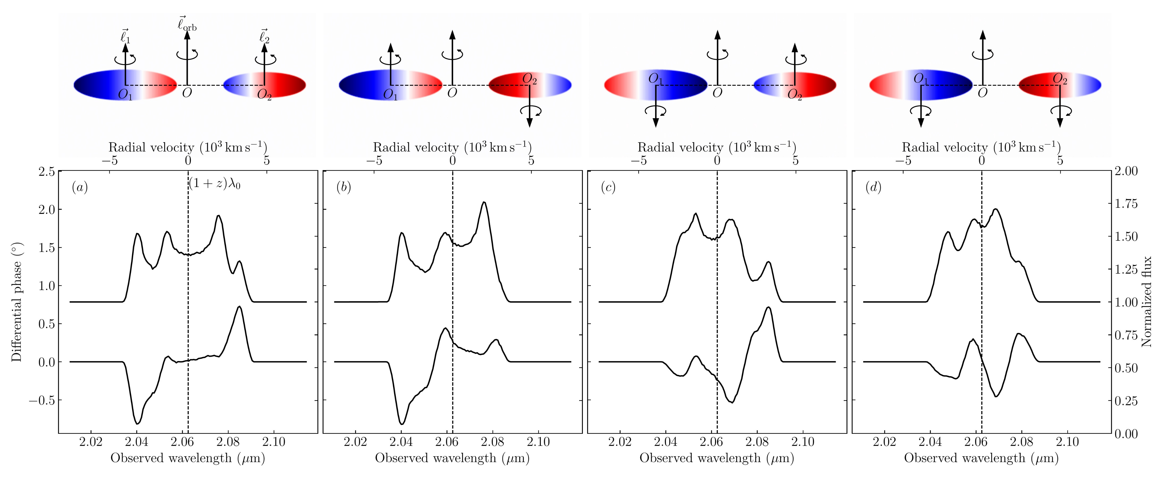
Alignment of BLR angular momentum is important

Slide 10
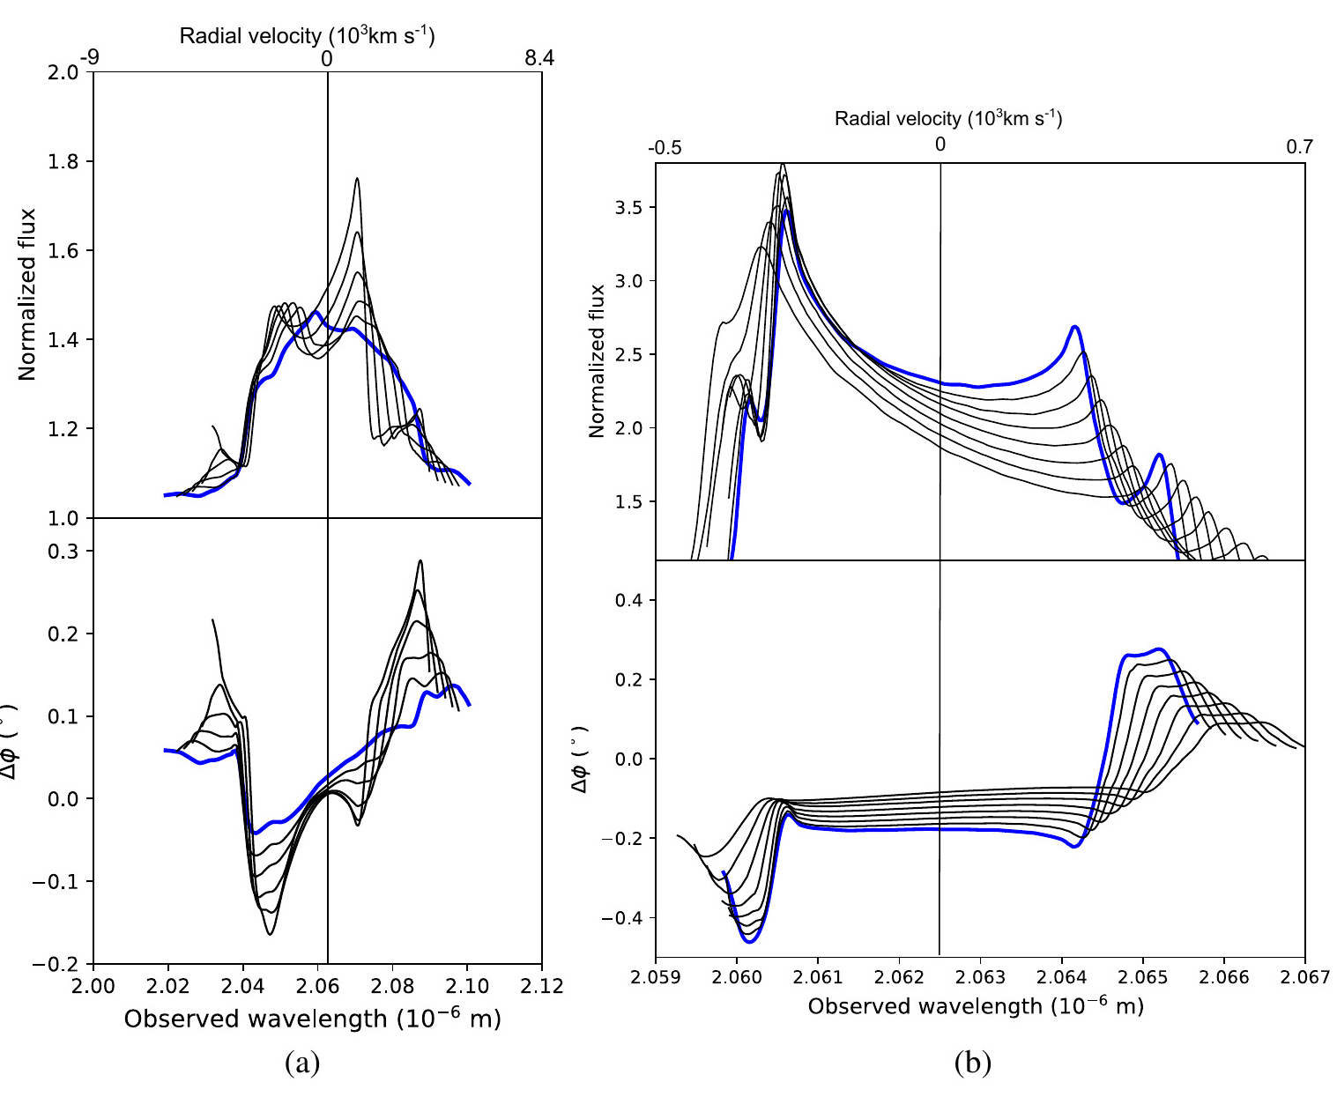
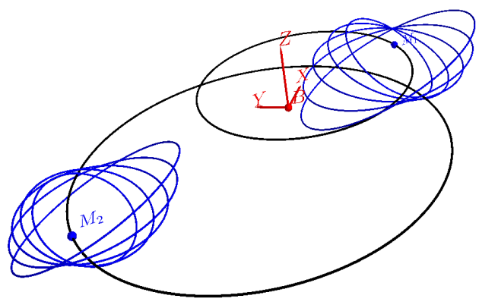
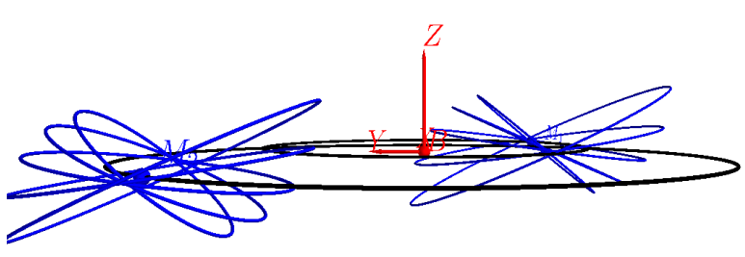
Elliptical orbit and non-coplanar orbit
Kovacevic+ 2020

Slide 11
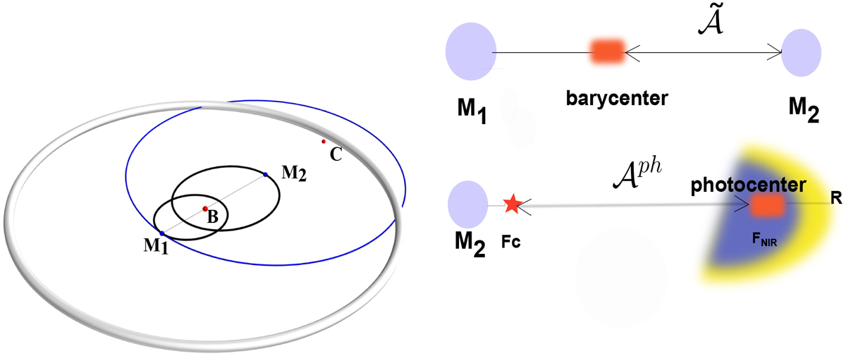
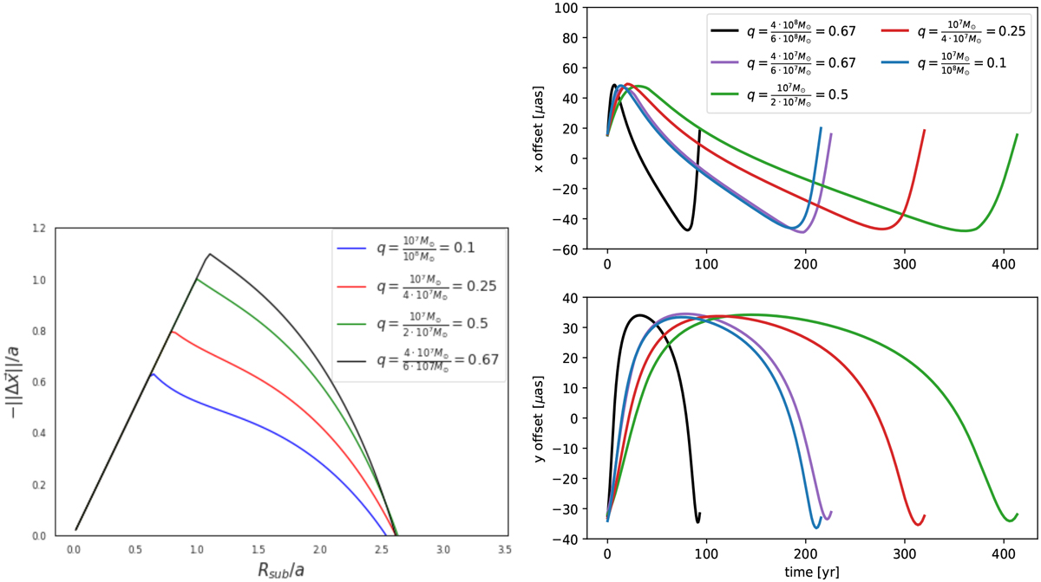
Mapping out the binary orbit
Dexter+ 2020
Kovacevic+ 2020
Kovacevic+ 2020
measuring the photocenter difference between a broad emission line and the hot dust continuum

Slide 12
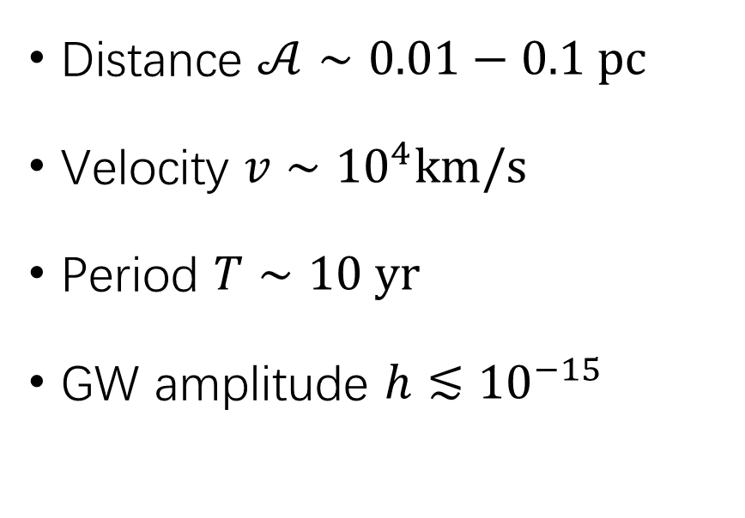
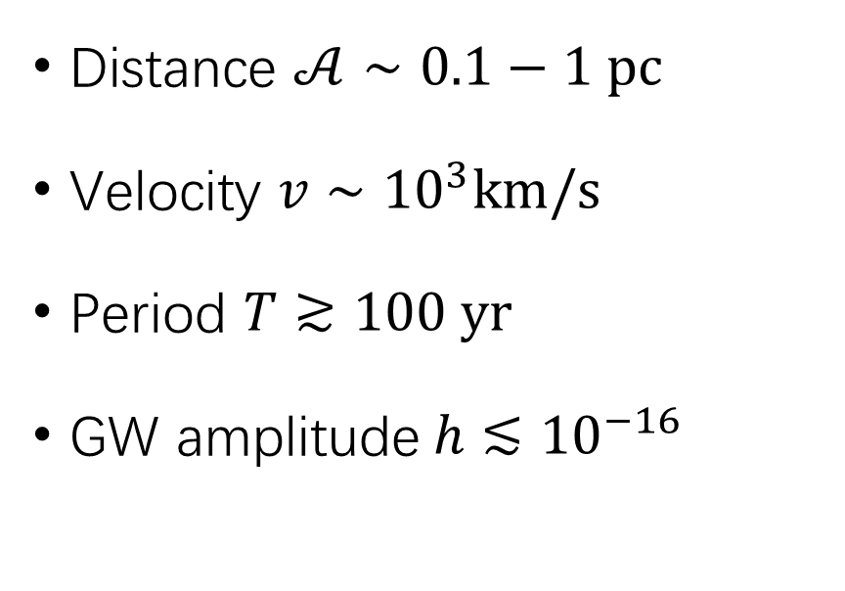
From detached BLRs to merged BLR
Detached BLRs
Merged BLR
Distance $𝒜∼0.1−1 pc$
Velocity $v∼{10}^{3}km/s$
Period $T≳100 yr$
GW amplitude$h≲{10}^{−16}$
Distance $𝒜∼0.01−0.1 pc$
Velocity $v∼{10}^{4}km/s$
Period $T∼10 yr$
GW amplitude $h≲{10}^{−15}$

Slide 13
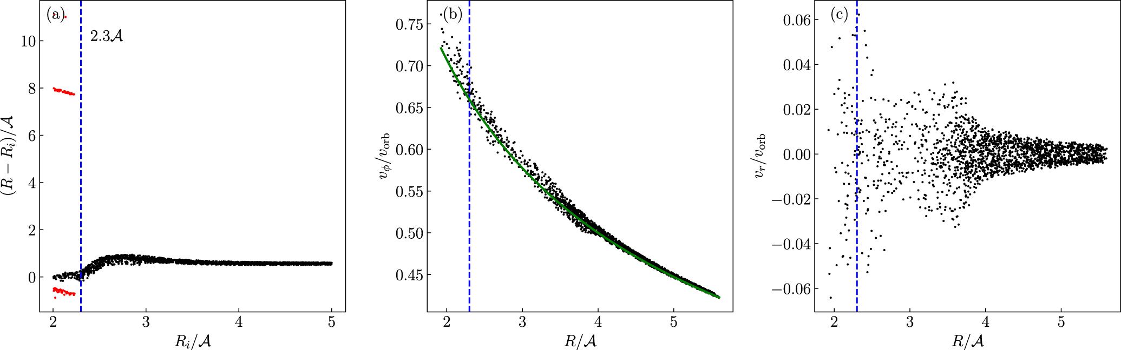
Dynamics of Merged BLR
Songsheng+ 2023
Stable region
Nearly Keplerian
Random velocities

Slide 14
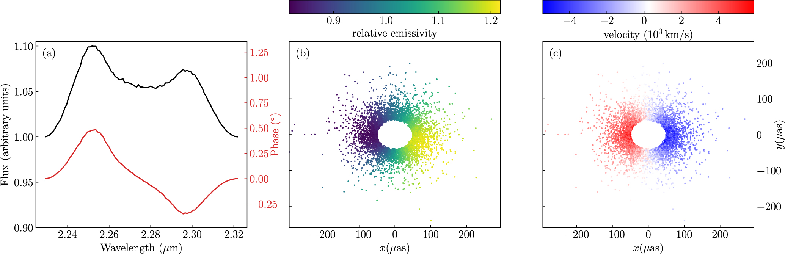
Interferometric signals by Doppler boosting
$$\frac{v_{orb}}{c}=0.05, 𝒜=0.02 pc, D=200 Mpc, M={10}^{9}M_{⊙},\frac{R_{BLR}}{𝒜}=4$$

Slide 15
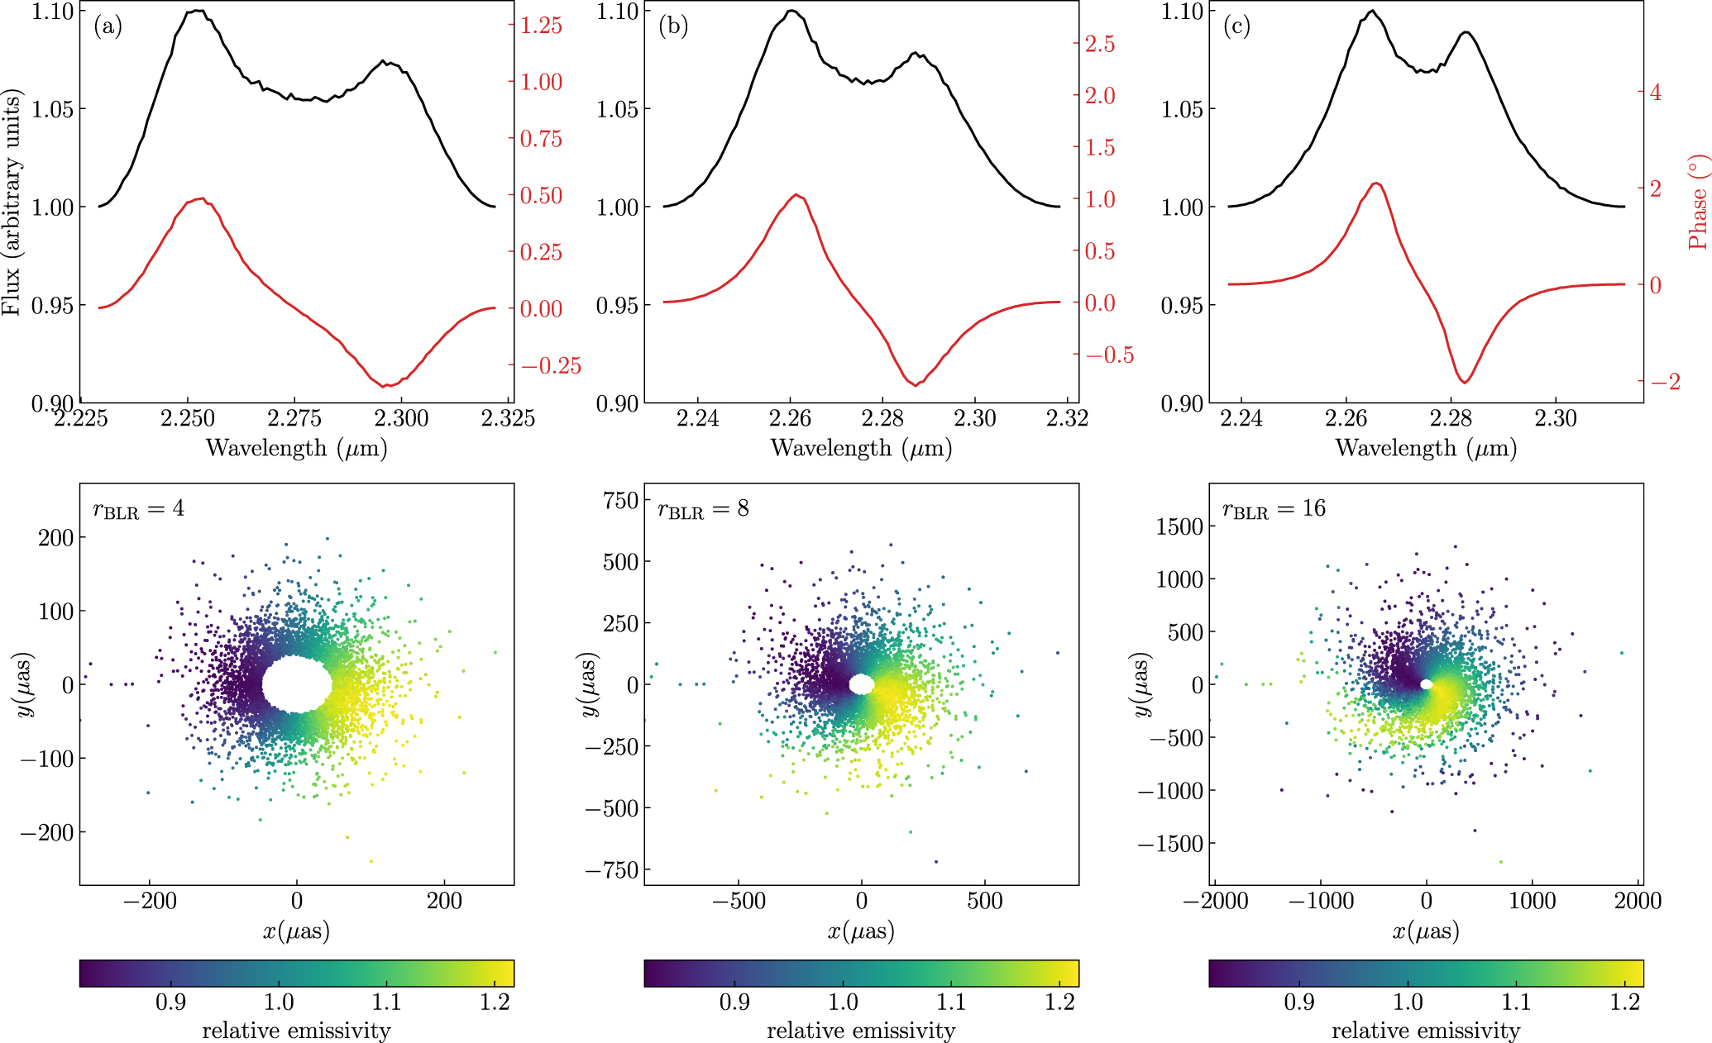
Effects of BLR size

Slide 16
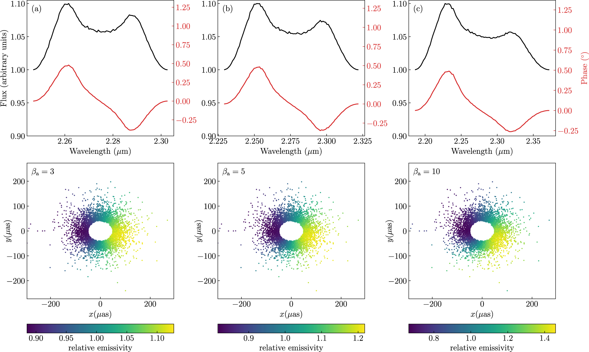
Effects of orbital velocities

Slide 17
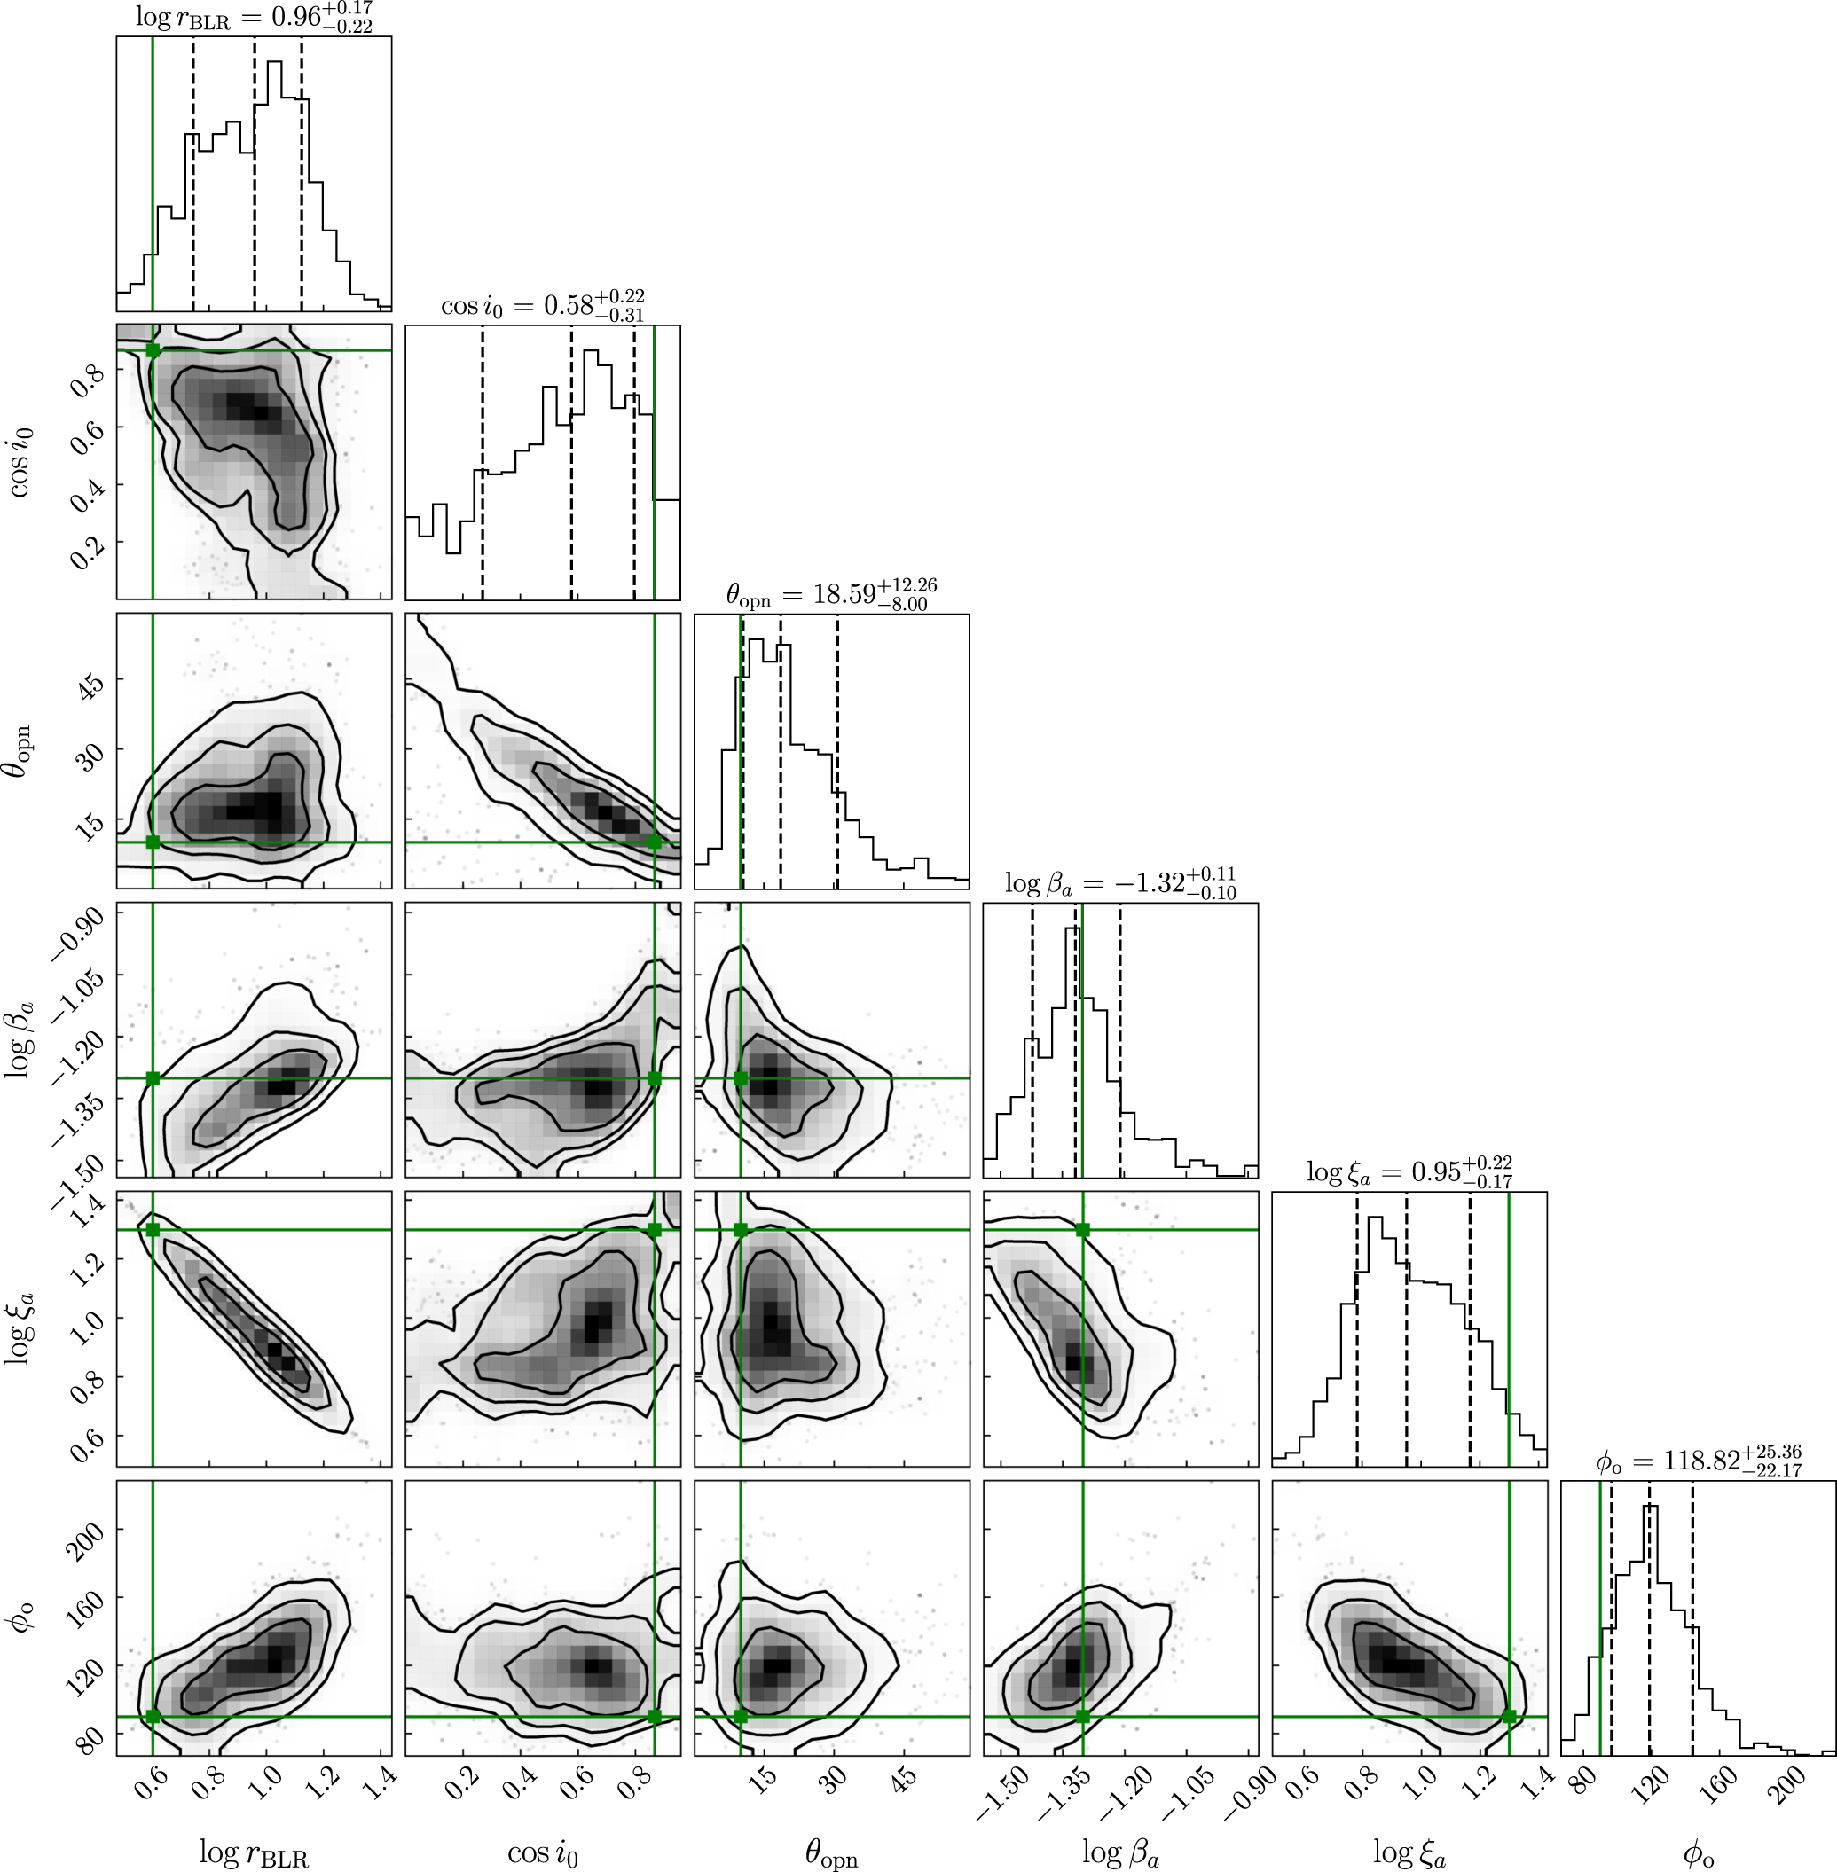
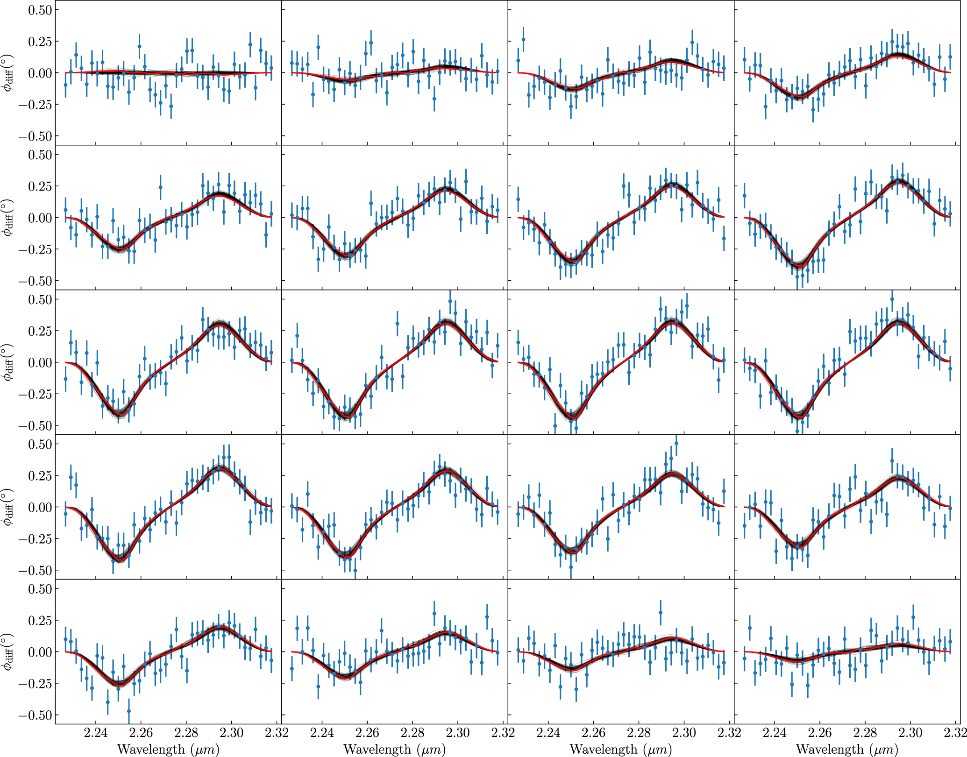
Fitting the model to mock data

Slide 18
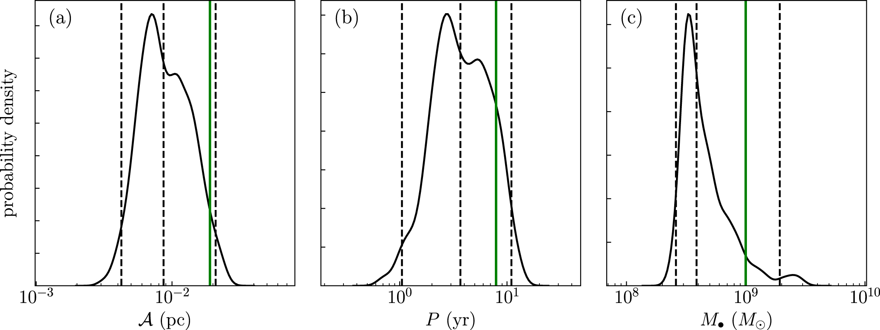
Measuring orbital velocities

Slide 19
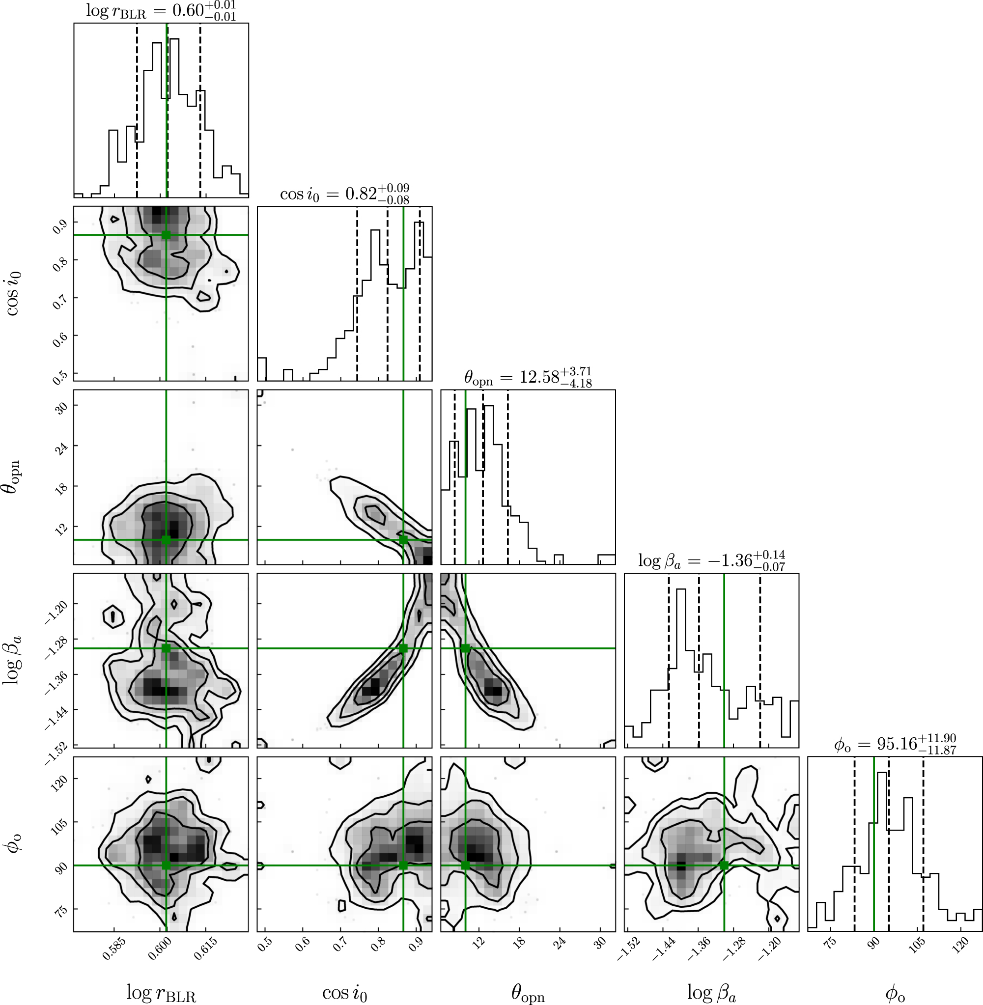
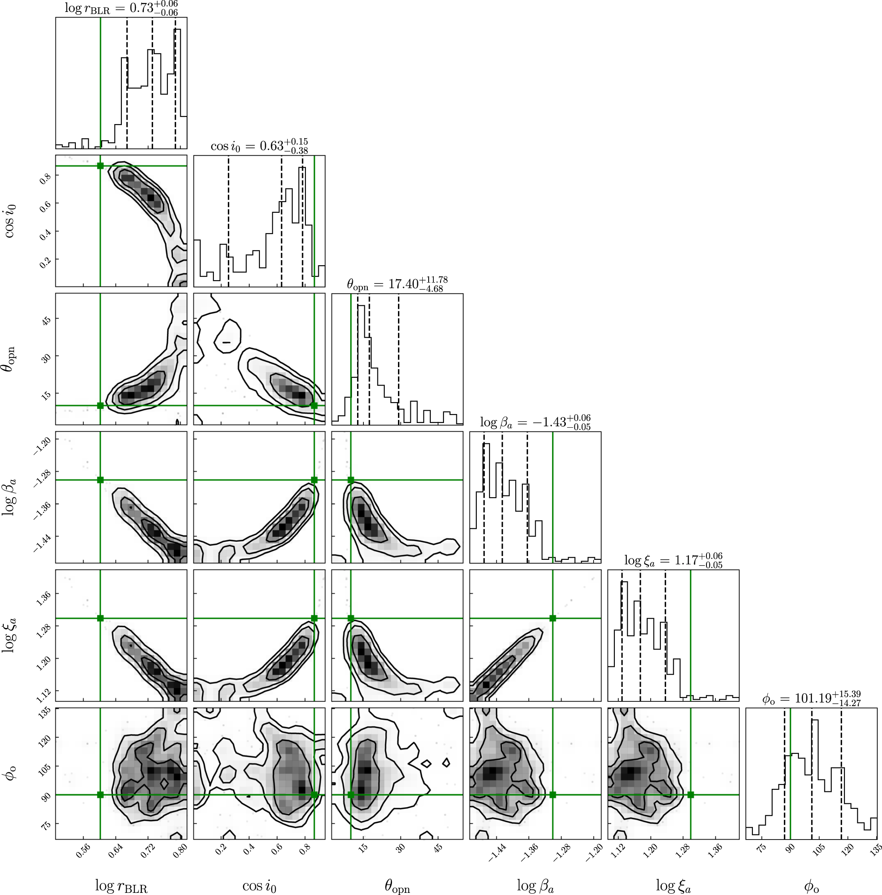
Eliminating degeneracies with other method
Fixed BH distance
Fixed orbital period

Slide 20
The next step
Program to fit RM data of the binary
Joint analysis of RM and interferometry data
Joint analysis of EM and GW data（pulsar timing arrays）

Slide 21
Conclusions
Identifying CB-SMBH, measuring orbital parameters need BLR dynamics
Optical interferometry – new method for BLR dynamics
Interferometric signatures of detached BLR: phase platform, multiple peaks/valleys
Interferometric signatures of merged BLR: Doppler boosting, asymmetries.
Measuring orbital parameters using interferometry: degeneracy
Joint analysis to eliminate degeneracy

Slide 22

Enjoy the excursion on the summer solstice

